Slide 1
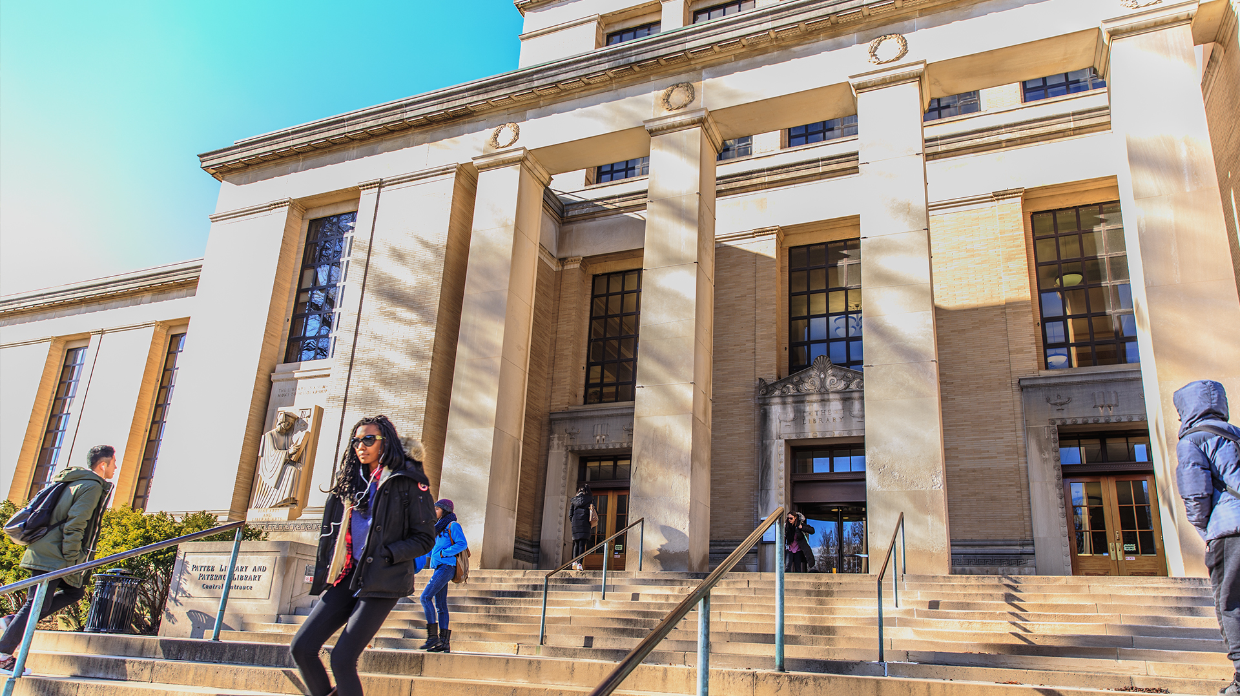
Greater Penn State Campaign Update
O. Richard Bundy, III
Vice President, Development and Alumni Relations
Academic Leadership Forum
April 6, 2018

Slide 2
A Greater Penn State
Time Elapsed: 35% as of March 31, 2018
Open Doors – Goal: $500M
Current Progress: $191.9M (38%)
Create Transformative Experiences – Goal: $225M
Current Progress: $82.9M (37%)
Impact the World – Goal: $475M
Current Progress: $259.3M (55%)
TOTAL FUNDRAISING PROGRESS – Goal: $1.6B
Current Progress: $612.3M (38%)

Slide 3
Receipts
Fiscal Year to Date – July 1 through March 31

Slide 4
Commitments
Fiscal Year to Date – July 1 through March 31

Slide 5
Matching Programs Update
As of March 31, 2018
Matching Program | Number of Funds Established | Donor Gifts | Total Impact | Proposals Outstanding | Amount Solicited | Potential Total Impact
Open Doors Scholarship | 216 | $12,231,207 | $36,693,621 | 287 | $21,233,334 | $63,700,002
First-time Scholarship | 99 | $8,715,734 | $17,431,468 | 79 | $6,935,000 | $13,870,000
Graduate Matching Scholarship | 22 | $4,210,000 | $8,420,000 | 30 | $5,750,000 | $11,500,000

