Slide 1
Major Initiatives Underway at Penn State
Academic Leadership Forum
December 5, 2018

Slide 2
Our Focus…
Appropriation
Access and Affordability Programs
Greek Life Reform
Invent Penn State
A Greater Penn State for 21st Century Excellence
What Does It Mean to be a Modern Land-Grant University?
  One Penn State 2025
  The Commonwealth Campuses
  Research
  Outreach and Service to the Communities

Slide 3
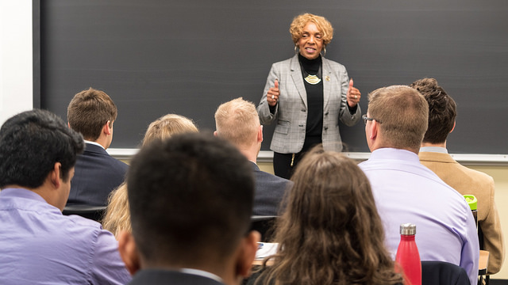
1. Appropriation
State appropriation provides crucial funds that help keep a Penn State education affordable for PA resident students.
Funds help support Agricultural Research and Cooperative Extension, Medical Assistance Funding for the Penn State Health Milton S. Hershey Medical Center, and the Pennsylvania College of Technology.
State Representative Carol Hill-Evans speaking to the Council of Commonwealth Student Governments

Slide 4
Appropriation Request Cycle
Developed by senior leadership of the University.
Presented/discussed/approved by Board of Trustees; typically submitted to the state in late September.
Appropriation hearings in Feb./March.
Discussions continue until the budget is approved by June 30.

Slide 5
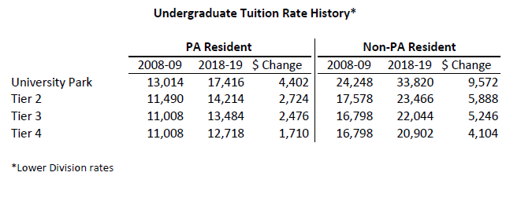
Request Considerations: PA Resident Tuition
Desire to keep PA resident tuition increases as low as possible.

Slide 6
Expense Increases
Salary pool for faculty/staff of 2.5% ($32.9M)
Capital improvement, facilities, and maintenance ($19.9M)
Strategic investment/innovation ($12M)
Health insurance and retirement ($9.1M)
Uncertainty: Unknown SERS increase

Slide 7
Additional Considerations
Revenue increases/cost savings
Targeted budget reductions and reallocations to be identified ($13.4M commitment)
Increased Facilities & Administration cost recovery due to growth in sponsored research grants ($7.0M)
Some elements of the budget are not yet identified
Gap without other revenue/savings could be $38.3M
Gap will determine tuition scenario proposals

Slide 8
Proposed 2019-20 State Appropriation Request
($ in 000’s)

Slide 9
2. Access and Affordability Initiatives
Targeting total cost of a degree, student borrowing, reducing time to graduation, and success of need-based students.
Raise.me Micro-Scholarship Program
  Began in 5 Phila. Schools; now in 24 urban and rural schools
Pathway to Success Summer Start (PaSSS)
  More than 550 have now enrolled in PaSSS
Student Transitional Experiences Program (STEP)
  Began with Smeal; now open to all colleges
Financial Literacy & Wellness Center
Complete Penn State

Slide 10
Matching Programs Update
As of October 31, 2018
Matching Program | Committed Donor Gifts | Donor Gifts | Total Impact | Proposals Outstanding | Amount Solicited | Potential Total Impact
Open Doors Scholarship | 479 | $30,800,000 | $92,400,000 | 178 | $18,300,000 | $54,900,000
First-time Scholarship | 172 | $14,300,000 | $28,600,000 | 72 | $6,900,000 | $13,800,000
Graduate Matching Scholarship | 41 | $8,600,000 | $17,200,000 | 19 | $4,500,000 | $9,000,000
Leadership Scholarship Match | 5 | $12,400,000 | $24,800,000 | 4 | $30,500,000 | $61,000,000

Slide 11
3. Greek Life Reform
Leading conversations at Penn State and on the national stage.
Participated in The New York Times Forum on May 31st.
Held discussions with other university leaders at APLU.
Supported passage of the Timothy J. Piazza Antihazing legislation that was signed into law Oct. 19.
Steve Veldkamp, Danny Shaha and members of the Office of Fraternity and Sorority Life discussed efforts at the national Association of Fraternity/Sorority Advisors on Dec. 1.

Slide 12
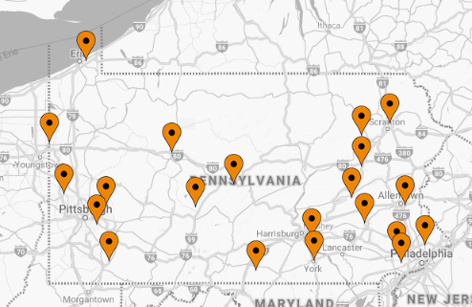
4. Invent Penn State
Activity | FY ’16-‘18
Entrepreneurs Assisted | 1,792
Students Engaged | 4,529
Faculty/Staff Engaged | 519
New Product Development Projects | 170
New Startups Program Graduates | 154
New Companies in PA Communities | 45
Jobs Created | 107.5
Internships Created | 317
In-Kind Support Est. Value | $781,306
External Matched/Leverage Funds | $4,523,456
21 LaunchBoxes across the state
6 opened in 2016; 5 in 2017;
4 in 2018; 5 in progress.

Slide 13
Disclosures, Patents, Licenses and Startups

Slide 14
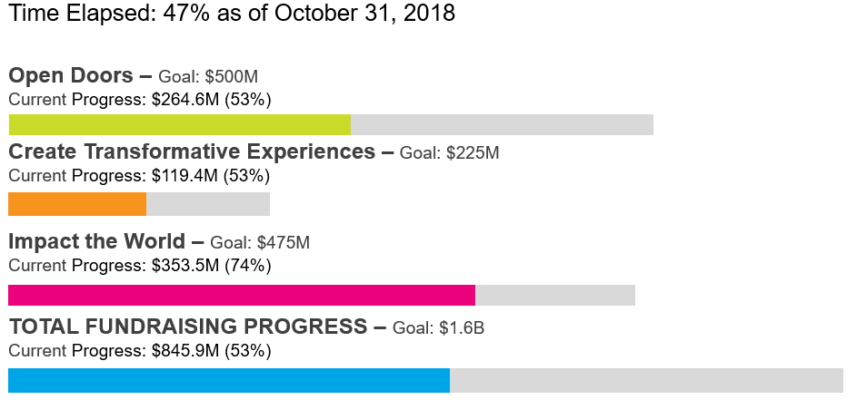
5. A Greater Penn State for 21st Century Excellence

Slide 15
Commitments
Fiscal Year to Date – July 1 through October 31

Slide 16
Receipts
Fiscal Year to Date – July 1 through October 31

Slide 17
Major Gift PIPELINE
As of October 31, 2018
Activity from July 1 to October 31:
  1,042 pending or verbally awarded proposals valued at $52,812,000
  2,173 prospects targeted or cleared for submission of proposals valued at $257,886,000
Total proposals outstanding:
  69 proposals for $1 million or more totaling $217,205,000
  2,422 pending proposals totaling $321,306,318

Slide 18
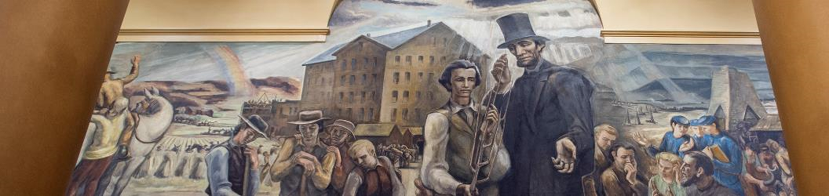
6. What Does it Mean to be a Modern Land-Grant University?
One Penn State 2025
The Commonwealth Campuses
Outreach and Service to Communities
Research

Slide 19

One Penn State 2025: Penn State as a Leader in the Transformation of Higher Education
Academic ranking
History as an online pioneer
Brand strength
Financial stability
Technological capabilities and growth
Efforts to tackle costs over the last decade
All yield a potential for innovation that few institutions are capable of accomplishing.

Slide 20
The Process
Gathered input from more than 600 academic leaders, faculty, students and staff; expanded the role to learning at Penn State by leveraging the digital environment.
Oct
2016
SP
2017
SP
2018
Finalized report focusing on five Guiding Principles: business processes, curricula, timely content and modalities, lifelong engagement and support systems.
The Future of Online Learning and the Role of the World Campus Task Force charged to review trends, leverage the success of the World Campus and recommend a vision and framework for the future of online learning at Penn State.

Slide 21
The Vision: One Penn State 2025
To be more integrated, flexible and responsive as an institution
Seamless online access to curricula and processes across all Penn State campuses
Function 24/7/365
Serving needs of people where they are
A higher level and strengthening of existing commitments
To be more diverse and inclusive

Slide 22
Guiding Principles
Provide a Seamless Student Experience
Achieve Curricular Coherence
Design Relevant and Responsive Programs
Engage Learners Throughout Their Lifetimes
Achieve the Highest Level of Efficiency of University Resources

Slide 23
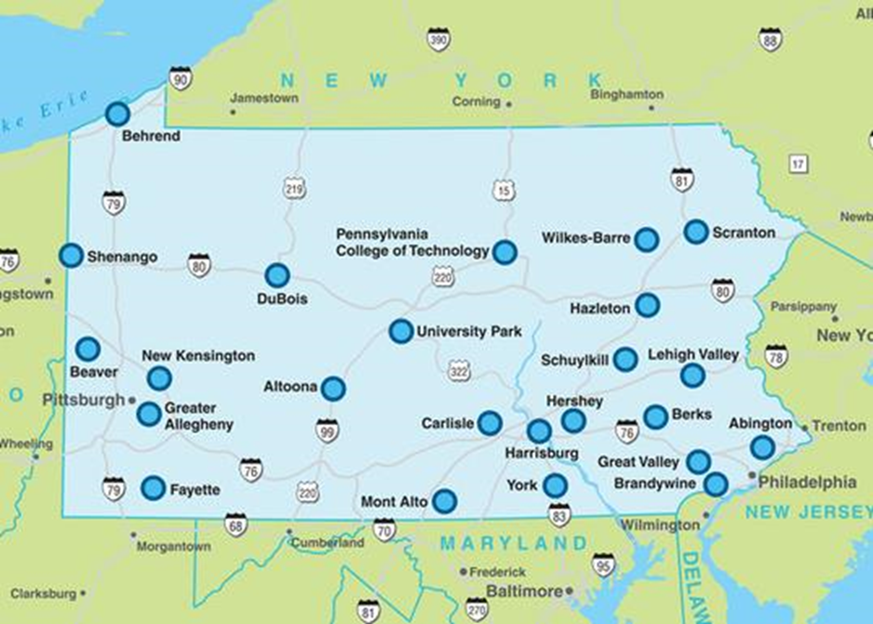
The Commonwealth Campuses:
One University, 20 Undergraduate Campuses
Integration across the state provides stability
Affordable access to a world-class degree
Pipeline for diversity
Economic impact to communities
Philanthropy tied to campuses

Slide 24
20-Year Enrollment Trend: Commonwealth Campuses

Slide 25
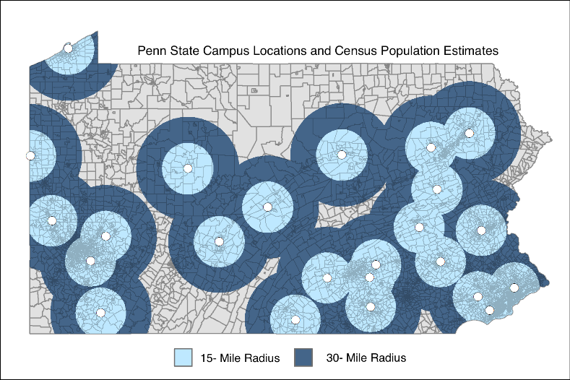
Providing Access to More PA Residents
75.2% of PA residents live within a 15-mile radius of a campus
95.6% of PA residents live within a 30-mile radius of a campus

Slide 26
Serving Families of Modest Means

Slide 27
Minority Enrollment by Campus
Source: Official Fall 2017 Census Data

Slide 28
Philanthropy/Volunteers Tied to Campuses
Individuals and businesses connected to Penn State through campuses.
PSAA: 21 Campus Societies and 200+ alumni volunteers serving more than 468,000 alumni who attended a CC.
20 CC Advisory Boards with 610 Board Members.
294 CC Campaign Committee Members.
Local industries provide 3,500 internships annually.

Slide 29
Recap of Initiatives
Appropriation
Access and Affordability Programs
Greek Life Reform
Invent Penn State
A Greater Penn State for 21st Century Excellence
What does it mean to be a Modern Land-Grant University?
  One Penn State 2025
  The Commonwealth Campuses
  Research (February 2019)
  Outreach and Service to the Communities (May 2019)

Slide 30

Discussion
Questions?

