Slide 1
How to Manage an Effective Compliance Program in a Decentralized Environment
Kenya Mann Faulkner
Chief Ethics & Compliance Officer
April 2019

Slide 2
Ethics & Compliance Mission
Support the University community in fulfilling its mission
Promote an ethical culture
Promote compliance with legal and regulatory obligations
Notes:
The Office of Ethics and Compliance supports the University community in fulfilling its mission by promoting an ethical culture and compliance with legal and regulatory obligations.
Examples:
Setting forth guidelines for conduct designed to prevent, deter, and detect violations of the law; uphold accreditation standards; and comply with University policies
Offering support through training and educational resources

Slide 3
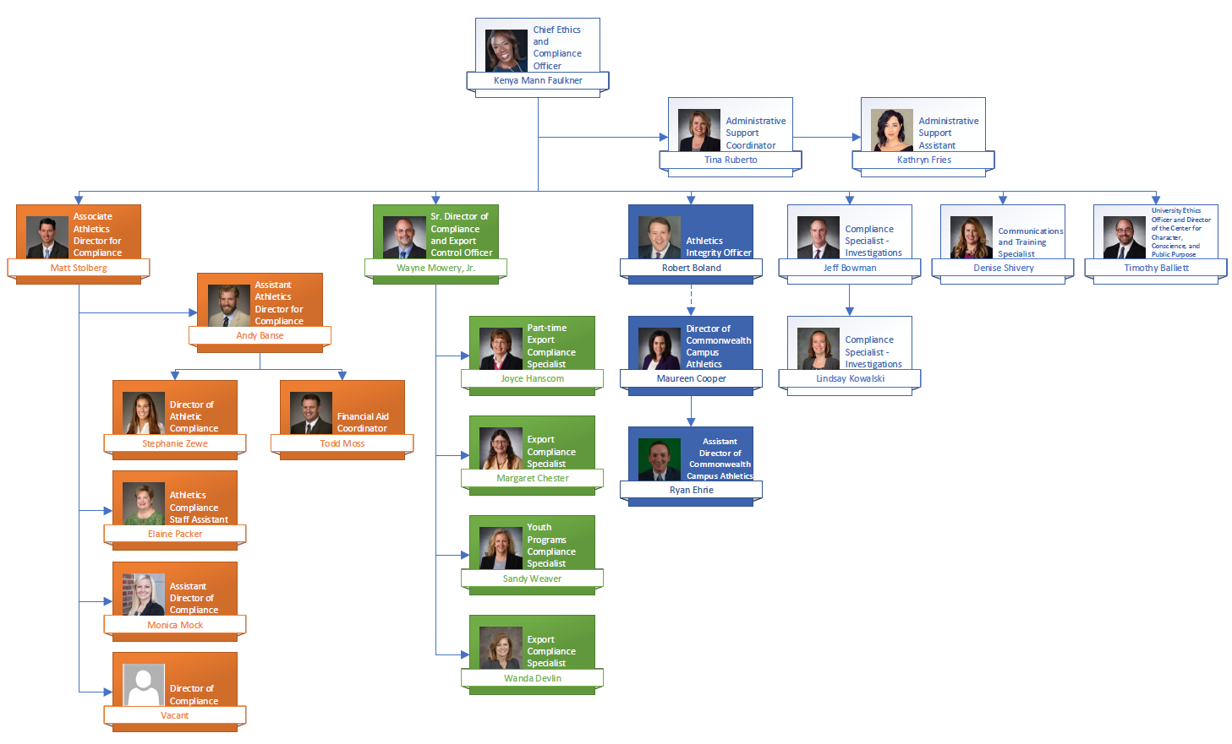
Ethics & Compliance Organizational Chart

Slide 4
Office of Ethics & Compliance Units
Athletics Compliance
Athletics Integrity
Commonwealth Campus Athletics
Communications and Training
Export Control
Investigations
University Ethics
Youth Program Compliance
Notes:
Athletics Compliance
Provide NCAA rules education to all constituents
Investigate and report NCAA/Big Ten rules violations
Coordinate student athlete housing, admissions, and eligibility certification
Develop and manage rosters for 31 sport programs
Research and draft NCAA and Big Ten requests to waive rules as appropriate
Develop and implement compliance monitoring systems designed to detect and prevent rules violations
Oversee the administration of over $20 million in athletically related aid
Athletics Integrity
Implement transition from the externally-monitored Athletic Integrity Agreement to the University’s voluntarily-undertaken Athletics Integrity Program (AIP)
Identify risk, develop and implement corrective action plans
Ensure compliance with NCAA and Big Ten rules, state and federal law and regulations, the terms of the AIP, and University Policy
Provide enhanced oversight of compliance and investigative function for Athletics in matters of programmatic integrity
Commonwealth Campus Athletics
Monitor and provide enhanced oversight of athletics compliance across the Commonwealth Campuses
Act as a liaison between UP units (i.e. OVPCC, Risk Management, OGC, ICA, Purchasing, HR, etc.) and intercollegiate athletics programs at all campuses
Provide independent review and evaluation to ensure that compliance issues or concerns are being appropriately investigated and resolved in a manner consistent with all applicable laws, and University, National Governing bodies, and Conference policies
Serve as a consultant to Chancellors on issues/concerns related to athletics
Communications and Training
Plan, develop, implement, and evaluate training programs to ensure compliance with legal, regulatory, and policy requirements
Develop and communicate processes and procedures related to compliance training
Act as an administrator for the Learning Resource Network and coordinate with HR and IT on LRN-related issues
Develop and implement communications initiatives related to ethics and compliance
Export Control
Support embedded export compliance efforts in other units (e.g. Sponsored Research, Development, Procurement, Risk Management, ARL, and College of Medicine)
Conduct/support reviews for export compliance (e.g. foreign travel, foreign visitors, foreign shipments, contractual terms, etc.)
Sign and file all government export licensing requests
Respond to government inquires and assessments of export programs
Investigations
Administer the Penn State Hotline, including oversight of investigations that are referred to other offices
Conduct investigations
Provide investigative support, consultation, and oversight to other University offices tasked with leading inquiries
University Ethics
Research, develop, implement, assess, and support programs and policies involving the University’s ethics, values, and organizational culture across the University
Coordinate gifts and entertainment requests
Consult and advise on conflicts of interest and other ethical matters
Youth Program Compliance
Provide compliance oversight and resources to all PSU-sponsored youth programs, activities, and services
Act as the University’s youth protection subject matter expert by evaluating and resolving questions and concerns relating to youth protection
Monitor/review regulatory/legislative changes impacting youth protection
Monitor the internal process for reporting of suspected child abuse
Assess and identify risks related to youth-serving activities

Slide 5
Compliance Plan
1.0 Introduction/Objectives
2.0 Compliance Risk
3.0 Organizational Commitments to the Plan
4.0 Plan Oversight and Implementation
5.0 Policies and Procedures
6.0 Communications
7.0 Responding to Reports
8.0 Training and Education
9.0 Risk Assessment
10.0 Auditing and Monitoring
11.0 Authority and Enforcement

Slide 6
Compliance Plan Updates
Specific objectives for the plan
Provisions for increased insight and collaboration with embedded compliance units
Further definition of roles and responsibilities of the CECO
Formal guidelines for responding to reports
Notes:
Deepen the culture of compliance
Interface and communicate with embedded compliance staff throughout the University
Identify, document, and track compliance risks and violations across the University

Slide 7
E&C Council
Bimonthly meetings, 26 representatives
Goal:
To increase central awareness regarding violations of regulations and/or law
To better understand areas requiring monitoring or assistance
Make recommendations on training, education, and outreach to raise awareness of compliance
How it works:
Each meeting to include a report from a different unit
Council provides feedback
Unit returns in 2-3 months to update
Notes:
Mission:
Serve as an advisory board with oversight responsibility for all University ethics and compliance matters
Review and advise on ethics and compliance programs and content
Help to develop strategy
Evaluate results
Suggest improvements and updates
Provide central oversight for the ethics and compliance programs within the University’s various units
New format:
Presentations from the various embedded ethics and compliance units and programs within the University
Presenter will provide a brief review of the related statutes, rules, and/or laws, then discuss their compliance programs, trainings, and education
Share any efforts being made in their respective area of compliance, but the primary focus of the presentation should be gaps in the program where the Council could provide advice or assistance
Council asks questions and offers constructive feedback
Schedule:
February – Student Aid Compliance
April – Clery
June – Athletics
August – Title IX
October – HIPAA
December – Office of Research Protections

