Slide 1
Office for Research Protections
Candice Yekel
Associate Vice President for Research
I
where
Re search
ntegrity
come together
Notes:
Most of you have never heard of my office. I have one goal for the next 15 minutes: remember that the Office for Research Protections exists. Why? Show of hands:
How many of you came here to do research?
How many of you think that research will involve people?
How many of you will be working with animals?
If you raised your hand, you need to know about my office. If you’re working with people, that’d human subjects research, and you can’t do your research without talking to our office. Same for animals. There are both federal regulations and Penn State policies overseeing your research. These regulations exist in order to make sure that research is conducted responsibly and to reduce risk to the participants. I don’t need to know all the regulations today, but I want you to know they exist.
Our programs
Penn State has a lot of policies, not because we think making policies is fun but because there are federal regulations requiring them. My office provides the oversight for many of the research policies. We cover a lot of ground, from sea to sky. I want to give you a broad overview of the scope. This involves a lot of acronyms!

Slide 2
IACUC: Animal Research
Quality Management and Education
UAS: Drones
IRB: Institutional Review Board
Biohazardous Materials
Research Conflict of Interest
Penn State Research
Dual Use Research of Concern
Embryonic Stem Cells
Controlled Substances
Scientific Diving
Research Misconduct
Radioisotopes
Institutional Conflict of Interest
AC80: Outside Business Activities and Private Consulting
research.psu.edu/orp
Notes:
IRB/Human Subjects research— IRB stands for Institutional Review Board, and it’s the board that reviews research proposals involving human subjects. Human subjects research is often thought of just as clinical drug trials, but it’s also if you’re giving a survey, interviewing people, testing them—even if it’s a secondary data set but that data is about people, even if it takes place in another country. You need to talk to us first before you do that research. Our office has analysts who also serve on the institutional review board and review every application. We also have an online system for submitting your application.
IACUC/Animals: Institutional Animal Care and Use Committee. Same concept as IRB; committee that reviews protocols.
Biohazardous Materials – bodily fluids, viruses,
Dual use research of concern – select agents and toxins
Isotopes
Embryonic stem cells
Scientific Diving
Unmanned Air Systems (drones)
Conflict of Interest – manage financial conflicts of interest
Controlled Substances
Research Misconduct
Quality Management and Education
If you tuned me out when I got to isotopes, I need you to start paying attention again.

Slide 3
Office for Research Protections
Outside Business Activities and Private Consulting (AC80)
Use of Unmanned Aircrafts (SY45)
research.psu.edu/orp
Notes:
IRB/Human Subjects research— IRB stands for Institutional Review Board, and it’s the board that reviews research proposals involving human subjects. Human subjects research is often thought of just as clinical drug trials, but it’s also if you’re giving a survey, interviewing people, testing them—even if it’s a secondary data set but that data is about people, even if it takes place in another country. You need to talk to us first before you do that research. Our office has analysts who also serve on the institutional review board and review every application. We also have an online system for submitting your application.
IACUC/Animals: Institutional Animal Care and Use Committee. Same concept as IRB; committee that reviews protocols.
Biohazardous Materials – bodily fluids, viruses,
Dual use research of concern – select agents and toxins
Isotopes
Embryonic stem cells
Scientific Diving
Unmanned Air Systems (drones)
Conflict of Interest – manage financial conflicts of interest
Controlled Substances
Research Misconduct
Quality Management and Education
If you tuned me out when I got to isotopes, I need you to start paying attention again.

Slide 4

AC80 - Outside Business Activities
Clint Schmidt, J.D.
Director, Conflict of Interest
Office for Research Protections

Slide 5
AC80 Background
Formerly HR80, originally published in 1974
Responsibility given to ORP
Substantial revisions made to make less restrictive
  Worked with Faculty Senate
  Benchmarked with peer institutions
  Revised policy published fall 2018
  Limited requirement for prior approval
    Other activities must be reported annually
Notes:
-Policy saw inconsistent enforcement through the years.
-The Provost asked the ORP to take responsibility for this policy several years ago.
-Not driven by regulation, but is national best practice, and has been increased attention in recent years at most research institutions (often called conflict of commitment).
-Annual reporting has been done for many years; ORP now handles is, and it is currently in progress.

Slide 6
AC80 Applies to all Faculty
Allows 40 hours/month of consulting and other activities outside PSU, within area of expertise
During appointment period
  Policy does not apply during summer, unless on summer salary
  Except: Teaching semester length courses at other institutions must be reported, even over summer
Annual reporting in progress – due to ORP June 1
Notes:
-40 hours/ month; 1 day/week is standard among institutions nationally.
-Right to consult is a privilege granted to faculty; staff must ask for time off of work for similar activities.

Slide 7
Exclusions
Activities generally expected of faculty are not subject to the policy – for example:
  Peer review of manuscripts, grant proposals, etc.
  Leadership positions for professional societies
  Artistic/creative performances
  Service on advisory committees for government
Notes:
-Activities that fall into these exclusions may vary somewhat from college to college.
-These types of activities do not count toward the 40 hours per month.
-ORP can provide guidance, answer questions.

Slide 8
Prior Approval Requirement
5 types of outside activities require approval:
  Starting a company
  Involving students/staff in outside activities
  Teaching semester length course at other institution
  Assuming officer/director position at a company
  Exceeding monthly time limitation of 40 hours
Department Heads grant approval
New form available – ORP website, and we will communicate widely in time for AY19/20
Notes:
-Activities not requiring prior approval still must be reported annually.
-Again, here, ORP Staff can answer questions and provide guidance to promote consistency among colleges and departments.
-Will be hearing from Kathy Bieschke’s office about the new form in June.
-University is looking to enforce this requirement and get everyone to request approval when they need it.

Slide 9
Looking Ahead
Working toward an electronic system to capture both AC80 approvals and annual reports, as well as Conflict of Interest financial disclosures.
ORP to visit college leadership meetings.
Questions: coistaff@psu.edu

Slide 10
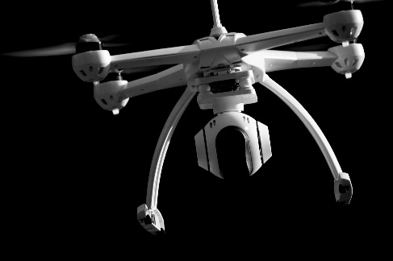
Unmanned Aircraft (UA) Operations
April 15, 2019
Jenn Stewart, UA Operations Manager
Office for Research Protections

Slide 11

Privacy or Safety Concerns?
*Image credit: WPSU

Slide 12

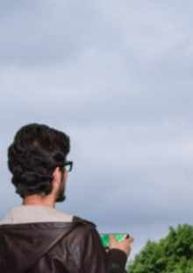
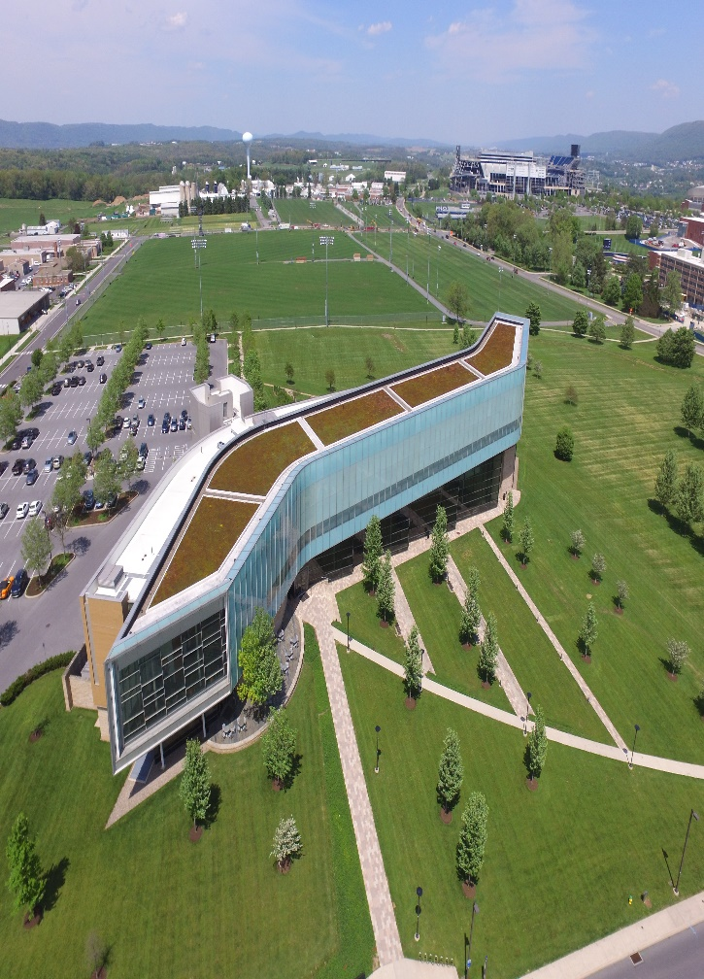
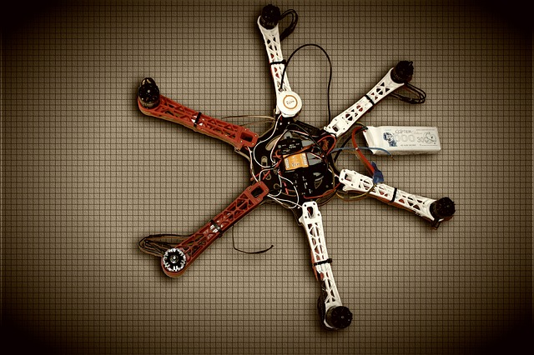
teaching
research
contractors
departmental
Usage at Penn State

Slide 13




SY45 Cornerstone Drivers
Use
Safety
Compliance
Responsibility

Slide 14
Lifecycle Stages
Purchase
Request
Use

Slide 15
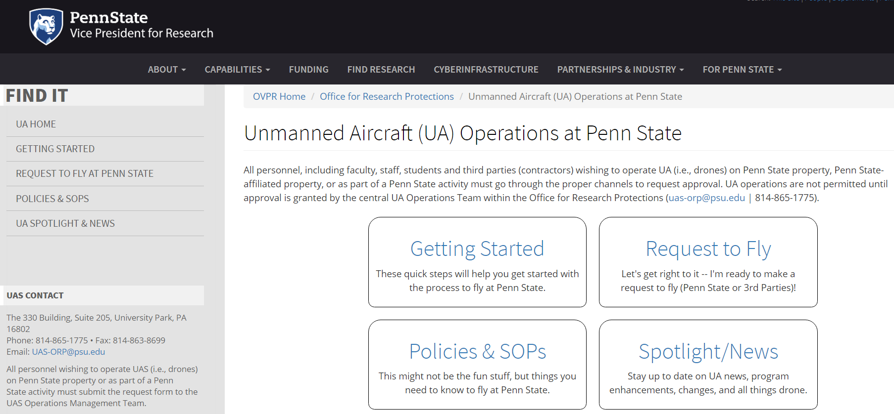

Slide 16
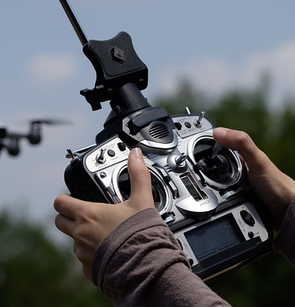
Thank you
Office for Research Protections
Jenn Stewart
UA Operations Manager
uas-orp@psu.edu
814-865-1775

Slide 17
research.psu.edu/orp
I
where
Re search
ntegrity
come together

