Slide 1
New Administrators Seminar “What Comes Across Our Desk: Your Problem-Solving Partners” September 27, 2019
Presented by:
Suzanne Adair, Associate Vice President for Affirmative Action
Katherine Allen, Associate General Counsel
Kathy Bieschke, Vice Provost for Faculty Affairs

Slide 2
My Role in Faculty Affairs
Dedicated to ensuring that all University faculty have every opportunity to be successful
Work closely with Provost in areas including promotion and tenure, faculty development, executive searches and reviews, and academic personnel issues/concerns
Liaison for Provost, President to Penn State college deans and campus chancellors
Office of the Vice Provost for Faculty Affairs
vpfa.psu.edu
OFFICE OF THE VICE PROVOST FOR FACULTY AFFAIRS
Notes:
BIESCHKE – Slide 3 of 38: My Role in Faculty Affairs
So, what is the role of the Vice Provost for Faculty Affairs – my role – in supporting Penn State faculty, including those on the tenure track?
In a sentence: My position is dedicated to ensuring that all faculty at Penn State have every opportunity to be successful.
Among other responsibilities, I work closely with Executive Vice President and Provost Nick Jones in areas including promotion and tenure, faculty development, executive searches and reviews, and issues that arise related to academic personnel and their concerns.
As Vice Provost, I am also the Provost’s contact person for the Big Ten Academic Alliance, the academic arm of the Big Ten Conference, and for the University Faculty Senate in issues relating to faculty affairs. I also serve as the liaison for Provost Jones and President Barron to our college deans and campus chancellors.

Slide 3
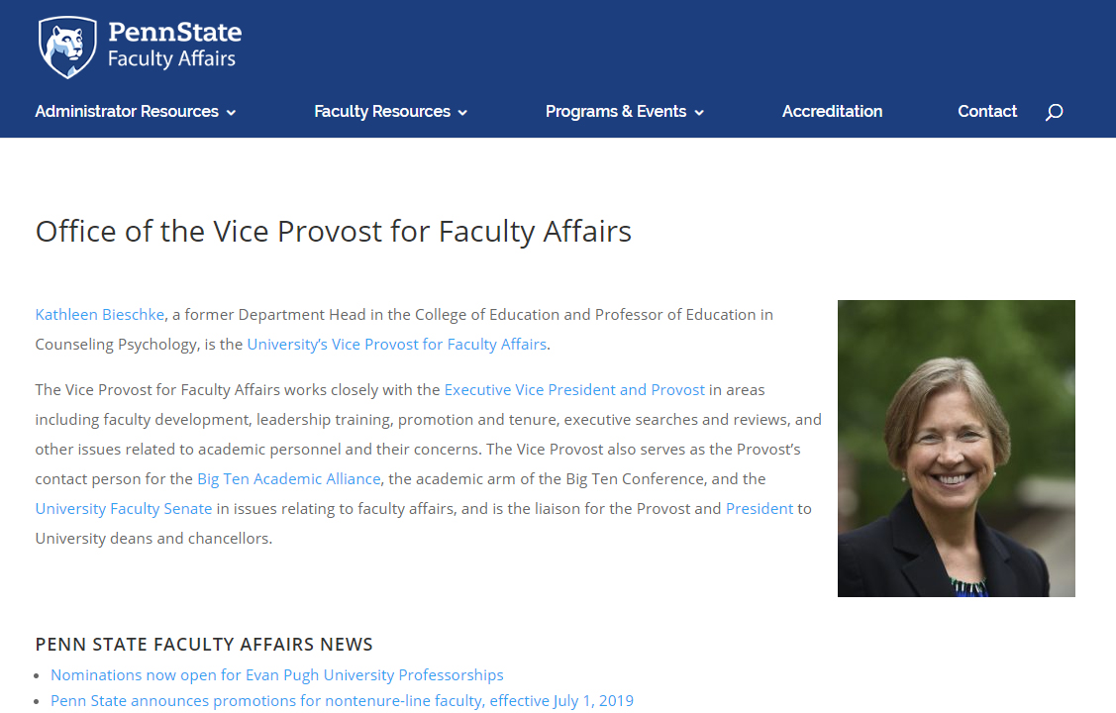
VPFA Website – vpfa.psu.edu
OFFICE OF THE VICE PROVOST FOR FACULTY AFFAIRS
Notes:
BIESCHKE – Slide 5 of 38: VPFA Website – vpfa.psu.edu
You can learn more about everything done in the Office of the Vice Provost for Faculty Affairs on the office’s website, vpfa.psu.edu.
Among the features on the site is a menu of Administrator Resources, includes links to important policy documents, as well as comprehensive information related to promotion and tenure.
I highly recommend reviewing what’s available in this section and on the entire website to identify resources that will be useful to you.
Even if you have reviewed it before, I recommend revisiting it because we update a lot of information annually, and more often as needed. This includes key information related to our promotion and tenure policies and processes.
If you have suggestions regarding information you would to see on the VPFA website, let us know.
Incidentally, this slide presentation will be posted to the website for your reference.
This workshop is also being streamed live and recorded. A link to the recording will be posted on the website, as well.

Slide 4
VPFA Office Staff
Jennifer Hamer, Associate Vice Provost for Faculty Affairs, Faculty Development, jfh5819@psu.edu
Tineke Battle, Assistant Vice Provost for Faculty Affairs, Human Resources, txb683@psu.edu
Karen Parkes-Schnure, Executive Assistant to the Vice Provost for Faculty Affairs – primary P&T contact, kjb138@psu.edu
Mindy Kowalski, Administrative Support Coordinator, msk22@psu.edu
Wendy Blumenthal, Administrative Support Assistant, wjy100@psu.edu
Office of the Vice Provost for Faculty Affairs
vpfa.psu.edu
OFFICE OF THE VICE PROVOST FOR FACULTY AFFAIRS
Notes:
BIESCHKE – Slide 4 of 38: VPFA Office Staff
The Office of the Vice Provost for Faculty Affairs staff provides support not only to me but to all faculty. I’ve provided a staff list on this slide for reference, including each person’s email address.
Karen Parkes-Schnure is the primary contact for questions and issues related to promotion and tenure.
Jennifer Hamer, Associate Vice Provost for Faculty Affairs, Faculty Development
Tineke Battle, Assistant Vice Provost for Faculty Affairs, Human Resources
Karen Parkes-Schnure, Executive Assistant to the Vice Provost for Faculty Affairs – primary P&T contact
Mindy Kowalski, Administrative Support Coordinator
Wendy Blumenthal, Administrative Support Assistant

Slide 5
Affirmative Action Office 328 Boucke Building 863-0471 https://affirmativeaction.psu.edu/
Ensure adherence to local, state and federal laws and University policy related to Equal Employment Opportunity (EEO) and Affirmative Action (AA).
Oversee the University’s Affirmative Action Plan and monitor employment practices:
Analyze data on hiring, promotion, compensation and termination.
Address practices which result in the exclusion of underrepresented individuals and groups.
Provide EEO and AA guidance to HR and Search Committees regarding recruitment and retention efforts.
Oversee all employee requests for Reasonable Accommodations due to a disability.
Develop and conduct diversity education/training for University employees to prevent discrimination and harassment in the workplace and to promote an environment of inclusion, equity, respect, and responsibility.
Investigate all allegations of discrimination and sexual misconduct by University employees.

Slide 6
COMMON PITFALLS & HOW TO AVOID THEM

Slide 7
1. Making it up as you go
Susan Stoner has been an outstanding researcher in her field. She wants to expand her time spent on her consulting work and asks her Department Head for a buyout of her spring teaching commitments. She describes her success as a paid consultant and mentions that many of her grad students have been assisting her and have enjoyed learning how to apply their learning in a practical way. Just after the Head grants her request, the Head gets a call from the Graduate School, informing him that 2 of Dr. Stoner’s students have filed complaints about being forced to work without compensation on projects for Dr. Stoner’s consulting firm.

Slide 8
Best practice: Learn to issue spot; Find the rules and follow them
AC80 – Outside Business Activities and Private Consulting
AC47 – General Standards of Professional Ethics
RP06 – Disclosure and Management of Significant Financial Interests

Slide 9
2. Handling problems on your own
Bob Berger, a distinguished professor, is concerned about his newest postdoc. Bob believes that the postdoc has submitted fabricated data in support of her most recent article. Bob wants to fire the postdoc immediately and asks for his Department Head’s approval. The Head likes Bob and tells him to do whatever he needs to do to protect the integrity of his research. A day later, the Head gets a call from the AAO, notifying her that 2 weeks ago, Bob’s postdoc filed a complaint of sexual harassment against Bob.

Slide 10
Best practice: Learn to issue spot; Ask for help
Office of Research Protections
Office of Postdoctoral Affairs
Affirmative Action Office (AAO)
Vice Provost for Faculty Affairs (OGC)
Office of General Counsel (OGC)

Slide 11
3. Deviating from policy or practice
Two undergraduate female students separately report to the DAA on their campus that David Duncan, a tenure-track professor in his sixth year, makes them feel uncomfortable. One student says that Dr. Duncan is constantly hovering over her as she performs her lab work and she’s the only woman in her lab. The other student, visibly upset, says that she was struggling with the material in Duncan’s class and he offered to tutor her twice a week. The first tutoring sessions took place on campus, but later, Dr. Duncan began inviting her to his home for lunch with his wife. At the last 2 sessions, Dr. Duncan and the student were alone. The DAA immediately called David Duncan and asked him to explain. Dr. Duncan insisted that both students were overreacting and hyper-sensitive.

Slide 12
Best practices: Learn to issue spot; Find the rules and follow them; Ask for help
AD85 – Sexual and Gender-Based Harassment and Misconduct
AC47 - General Standards of Professional Ethics
AAO
HRSP
VPFA
OGC

Slide 13
4. Ignoring a growing problem.
You receive an email from a student who is frustrated with a professor. The professor frequently cancels class and as a result, students are performing poorly on course exams. The professor is non-responsive to emails and does not hold office hours. Further, the professor clearly has a preference for male students and makes derogatory comments about women. When you review SRTEs, it is evident from the comments that this behavior is not new. You decide to confront the professor and you are accused of being “biased” because this individual has routinely received a rating of “meets expectations” for teaching in the annual review evaluation. How do you respond?

Slide 14
Best practices: Document early and often; Learn to issue spot; Find the rules and follow them; Ask for help
AC40: Annual Evaluation of Faculty Performance
AD85 – Sexual and Gender-Based Harassment and Misconduct
AAO

Slide 15
TAKEAWAYS
Learn to issue spot
Find the rules and follow them
Ask for help
Document early and often
Indemnification and defense

