Slide 1

Managing Student Debt
Academic Leadership Forum
October 30, 2019

Slide 2
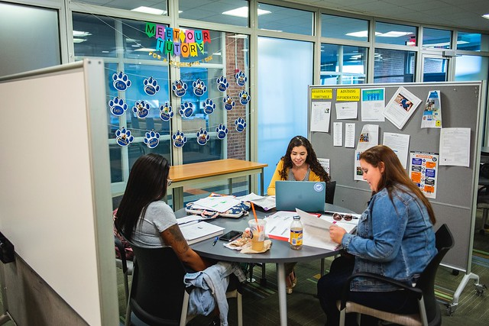
Keys to Managing Student Debt at Penn State
Controlling the Total Cost of Attendance
Financial Literacy
Ensuring Graduation
Promoting Career Success
2

Slide 3
A National Primer on Debt
Annual increases in student debt are declining steadily.
More students are borrowing.
Grants-in-aid are now almost 2 times the amount of loans for undergraduates.
Federally subsidized loans are steadily declining; risk growing with rise in private lenders.
1/3 of the $1.5 trillion debt was borrowed by the top income holders.
36% of borrowers owe less than $10,000 and 57% of borrowers own less than $20,000; medical and law students are the biggest borrowers.
For-profits dominate student debt loads.
Time to degree and age are highly correlated with debt loads.
Lifestyle borrowing contributes to student debt (Indiana University financial literacy programming resulted in $30M in reduced borrowing/less debt.)
Students who don’t graduate are 3 times as likely to default.
Source: Sandy Baum, Urban Institute, to APLU in June 2019
3

Slide 4
Penn State: Average Baccalaureate Loan Debt by Income Band 2017-18
Who is borrowing?
50% of PSU students have loans; 68% have some type of financial aid.
Borrowing rises faster as time to degree increases.
2010 cohort: Graduation in 4 years or less has average debt of $35,575; in 4.3+ average debt is $41,202;
in 6+ years it’s $47,376.
Income Band | Average Loan Debt
$0-$50K | $36,086
$50.1K-$75K | $38,146
$75.1K-$110K | $40,022
>$110K | $37,503
No FAFSA | $36,710
Source: 2017-18 Annual Report, Undergraduates

Slide 5
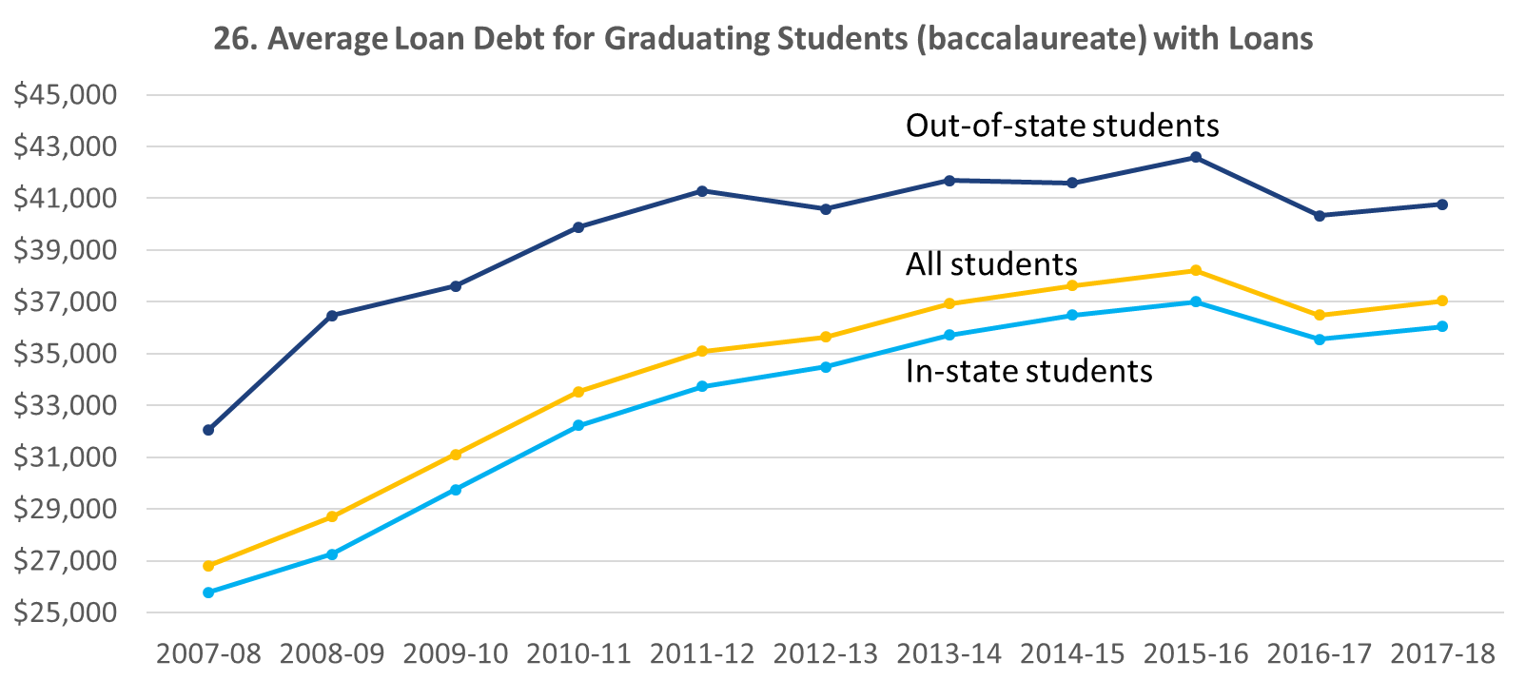
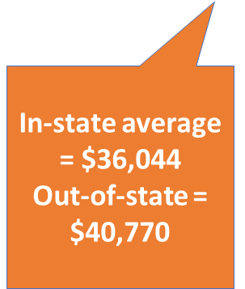
Changes in Penn State Average Loan Debt at Graduation
Notes:
Note: The method of calculating loan debt had to change for 2016-17 because OSA did not have access to each graduate's NSLDS (National Student Loan Data Base) balance at the time of our loan debt calculations. So, 2016-17 loan debt figures do not include any loan debt from other institutions. Loan debt for 2016-17 was calculated using only OSA records back to 1995-1996. The loan debt figure in 2016-17 did decline nationally.

Slide 6
Changes in PSU Average Loan Debt at Graduation by Income Bands – PA Residents

Slide 7
Changes in PSU Average Loan Debt at Graduation by Income Bands – Out of State

Slide 8
Changes in PSU Average Loan Debt at Graduation by Income Bands – All

Slide 9

Do loans impact graduation rates?
There’s little or no difference in graduation rates
between those with and without student debt:
University Park 87% no loans
84% with loans
5 Larger Commonwealth Campuses 62% no loans 60% with loans
14 Smaller Commonwealth Campuses 46% no loans
46% with loans

Slide 10
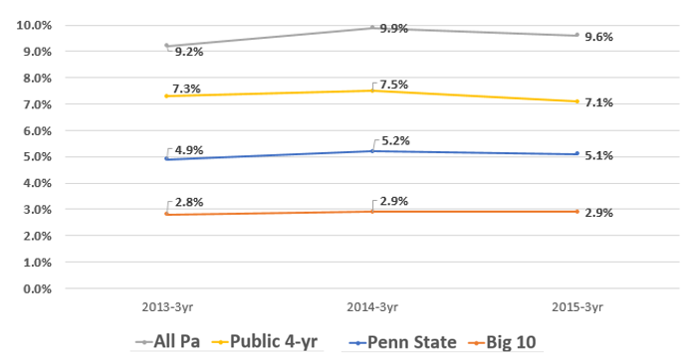
Student Loan Default Rates
Source: U.S Department of Education – 3-year Student Loan Default Rates

Slide 11
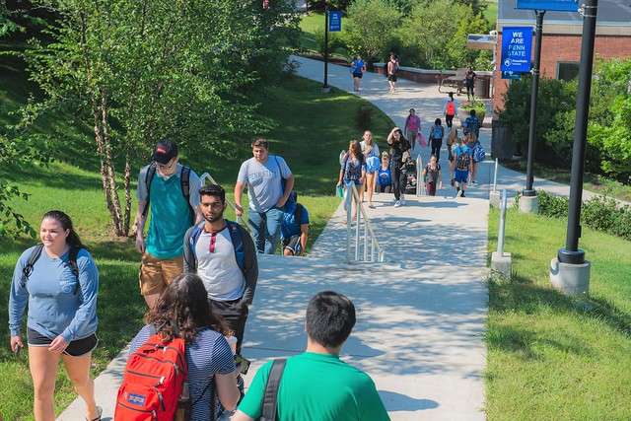
What Can We Do About It?
Focus on targeted solutions
Protect vulnerable borrowers
Minimize future debt
Ensure degree completion
8

Slide 12


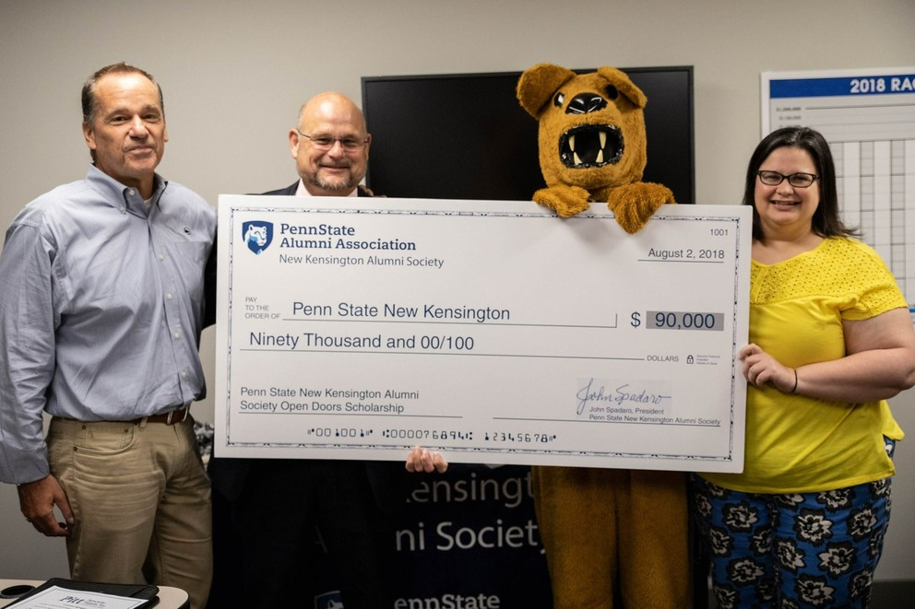
Targeted Solutions
9

Slide 13
Impact of Targeted Solutions
Tuition Freeze vs. 2%: All resident students save $175 a semester regardless of need. 2019-20 Impact: $12M
Provost Awards: Awards ranged from $5K to $7K per student/per year in 2019-20, for a cumulative total of $24K to each awardee. These are need-based awards for high achieving students.
    Notable fact: Since the Provost Awards began in 2013-14, $109M has been awarded to 13K students. 2019-20 Impact: $22.4M
10

Slide 14
Targeted Solutions—RaiseMe Scholarships
For students enrolled at specific PA high schools serving low-income areas. Includes micro-scholarships earned through outstanding work in high school.
390 awards to students on 20 campuses in 2019-20.
Awards range from $145 to $4,000 per year.
Notable fact: average first-year retention rate was 87%.
2019-20 Impact: $676K
11

Slide 15
Targeted Solutions—PaSSS
Pathway to Success: Summer Start bridge program to help entering students from underserved populations make a successful transition to a Commonwealth Campus. Includes $250 scholarship per credit
for summer courses, employment, mentoring, and a “Math Academy.”
364 students across 16 campuses in 2019.
Notable fact: PaSSS students maintain an average GPA of 3.0.
Summer 2019 Impact: $754K
12

Slide 16
Targeted Solutions—Smart Track
Designed for distance learners who are first-time students; offers $3,000 scholarship support, mentoring, prep courses, and support.
120 students received a minimum of $1,500 in scholarship support plus additional assistance in 2018-19.
Notable fact: Participants are 34% active duty or veterans, 33% underrepresented minorities; 94% adult learners.
2018-19 Impact: $232K
13

Slide 17
Targeted Solutions—STEP
Student Transitional Experience Program helps undergraduates successfully transition to University Park after 2 years at a Commonwealth Campus; Includes a scholarship, 2 courses that meet degree requirements, a professional seminar, mentoring, and networking experiences.
40 students awarded a minimum of $1,500 in summer 2019.
Notable fact: At Smeal, one of the originating colleges, 4-yr and
6-yr graduation rates for STEP cohorts are: 4-yr is 96.4% and 6-yr is 98.3%, both higher than for non-STEP counterparts.
Summer 2019 Impact: $95K
14

Slide 18
Targeted Solutions—Complete Penn State
Addresses situations when students in good academic standing within 30 credits of completing their degree walk away due to some unforeseen challenge.
In just over a year, 339 students from 15 campuses and 11 colleges have been assisted by the program.
Notable fact: To date, 273 have graduated and an additional 59 will graduate in summer or fall.
2018-19 Impact: $1.0M
15

Slide 19
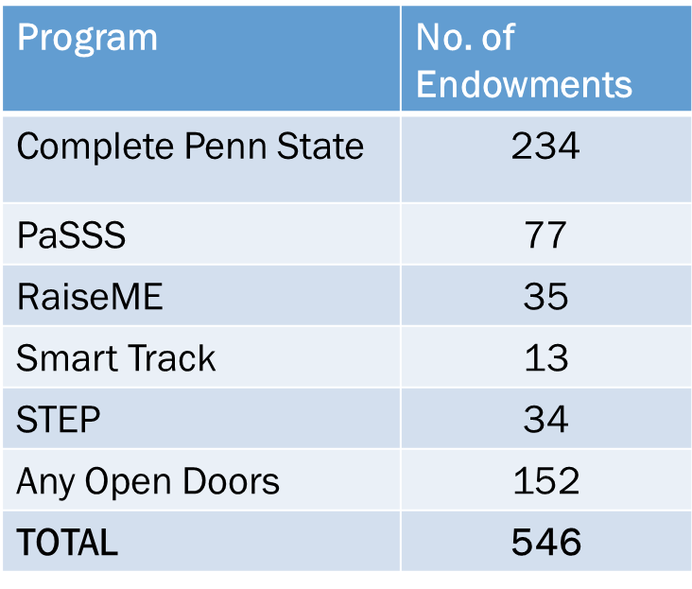
Impact of Open Doors
Open Doors Programs Scholarships
2017-2019 Summary by Program
906 donors have contributed to
546 endowments;
$2.8M has been awarded to
1,305 students.
Average award: $2,146.
Notable fact: Recipients have higher retention rates, higher grade point averages, and lower late drop rates than the comparable population.
16

Slide 20
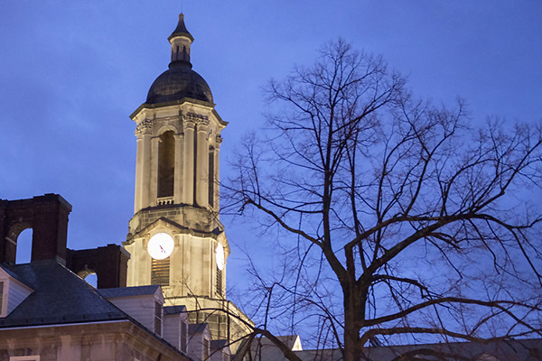
Total Impact of Philanthropy:
809 new scholarships inspired by the matching program.
$188.1M in endowed student support.
$8.5M in annual support once endowments are fully funded.
In total, we’ve raised more than $330M in the Open Doors campaign imperative.
17

Slide 21

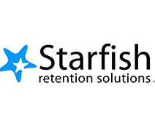
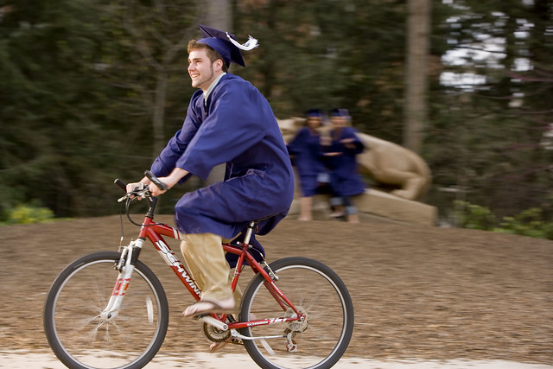
Advising and Institutional Support
18

Slide 22
Sokolov-Miller Family Financial and Life Skills Center
Named No. 13 in the top college financial literacy programs in the nation for 2019; No. 1 in the Big Ten.
Received a generous endowment from the Sokolov-Miller family in July 2018 that expanded the operation to:
  5 full-time staff
  2 graduate assistants
  10 student ambassadors
Received $100K gift from PSECU; $150K from PNC to support
self-study modules and expand outreach.
financialliteracy.psu.edu
Source: LendEDU
19

Slide 23
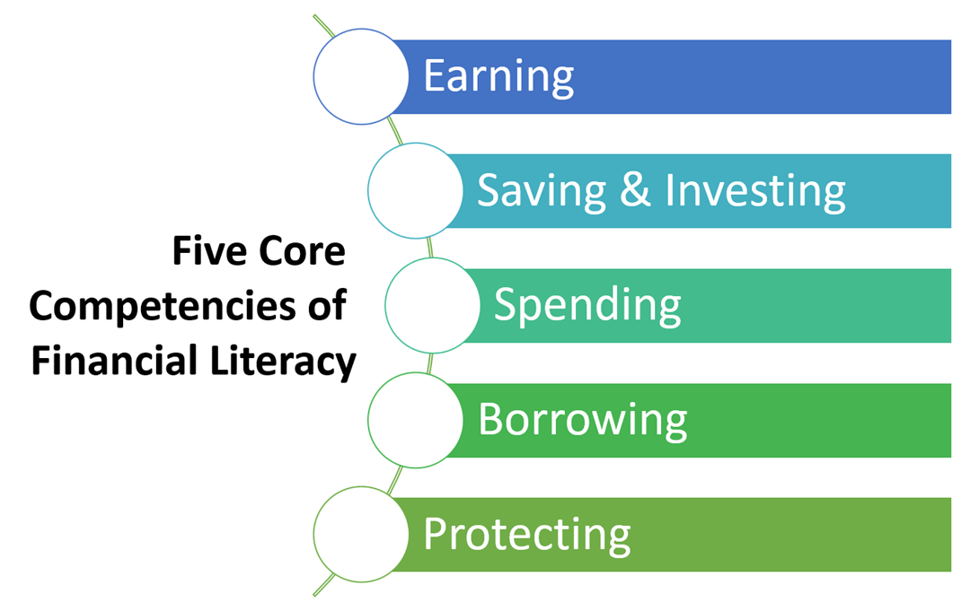
Sokolov-Miller Family Financial and Life Skills Center
First Year Experience: 499 sessions since 2013.
202 classes reaching 5,000 students last year.
One-on-one staff and peer counseling sessions.
  388 personal meetings last year
Mentoring program with alumni.
Bi-monthly webinars; 24 held last year.
Financial literacy programs for student-athletes.
ZOOM presentations to Commonwealth Campuses.
Pilot peer mentoring program at Penn State
New Kensington.
20

Slide 24
Academic Advising Drives Student Success
Student
Advisers
Instructors
Student Aid
Study Abroad
Transfer Credit
Tutors
Goes beyond selecting classes and checking degree requirements.
Sustained conversation to bring together the many parts of education and to transition to post-graduate life.
It’s about intentionality and impact.

Slide 25
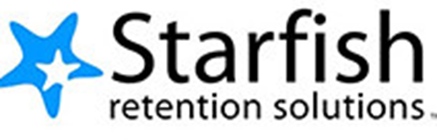

Starfish Facilitates Connections
Introduced university-wide in 2015.
Allows all academic advisers to use the same platform to maintain advising notes and monitor student progress.
Identifies at-risk students in real time and connects students to valuable services.
Serves undergraduate and graduate students.
Allows easy appointment scheduling.
New data analytics will further improve effectiveness.
22

Slide 26
Starfish Impact (2018-2019)
50,000+ unique students heard from at least one instructor
about their course progress.
49,339 students scheduled 159,657 academic advising appointments with 808 different advisers.
11,972 students scheduled 26,280 meetings with 575 other people who are here to help—Instructors, Financial
Aid coordinators, Fellowships directors, College Engagement specialists, Study Abroad counselors and others.
23

Slide 27
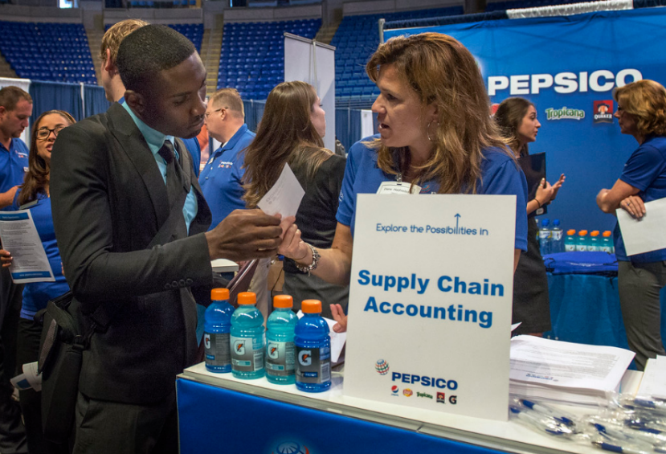
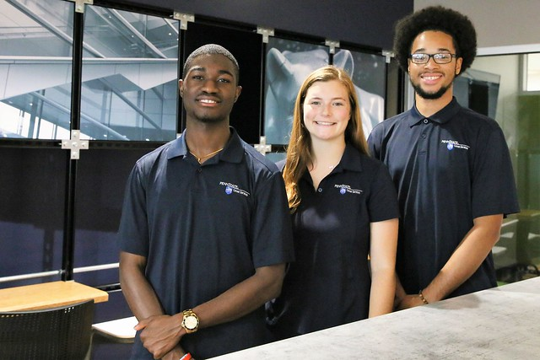
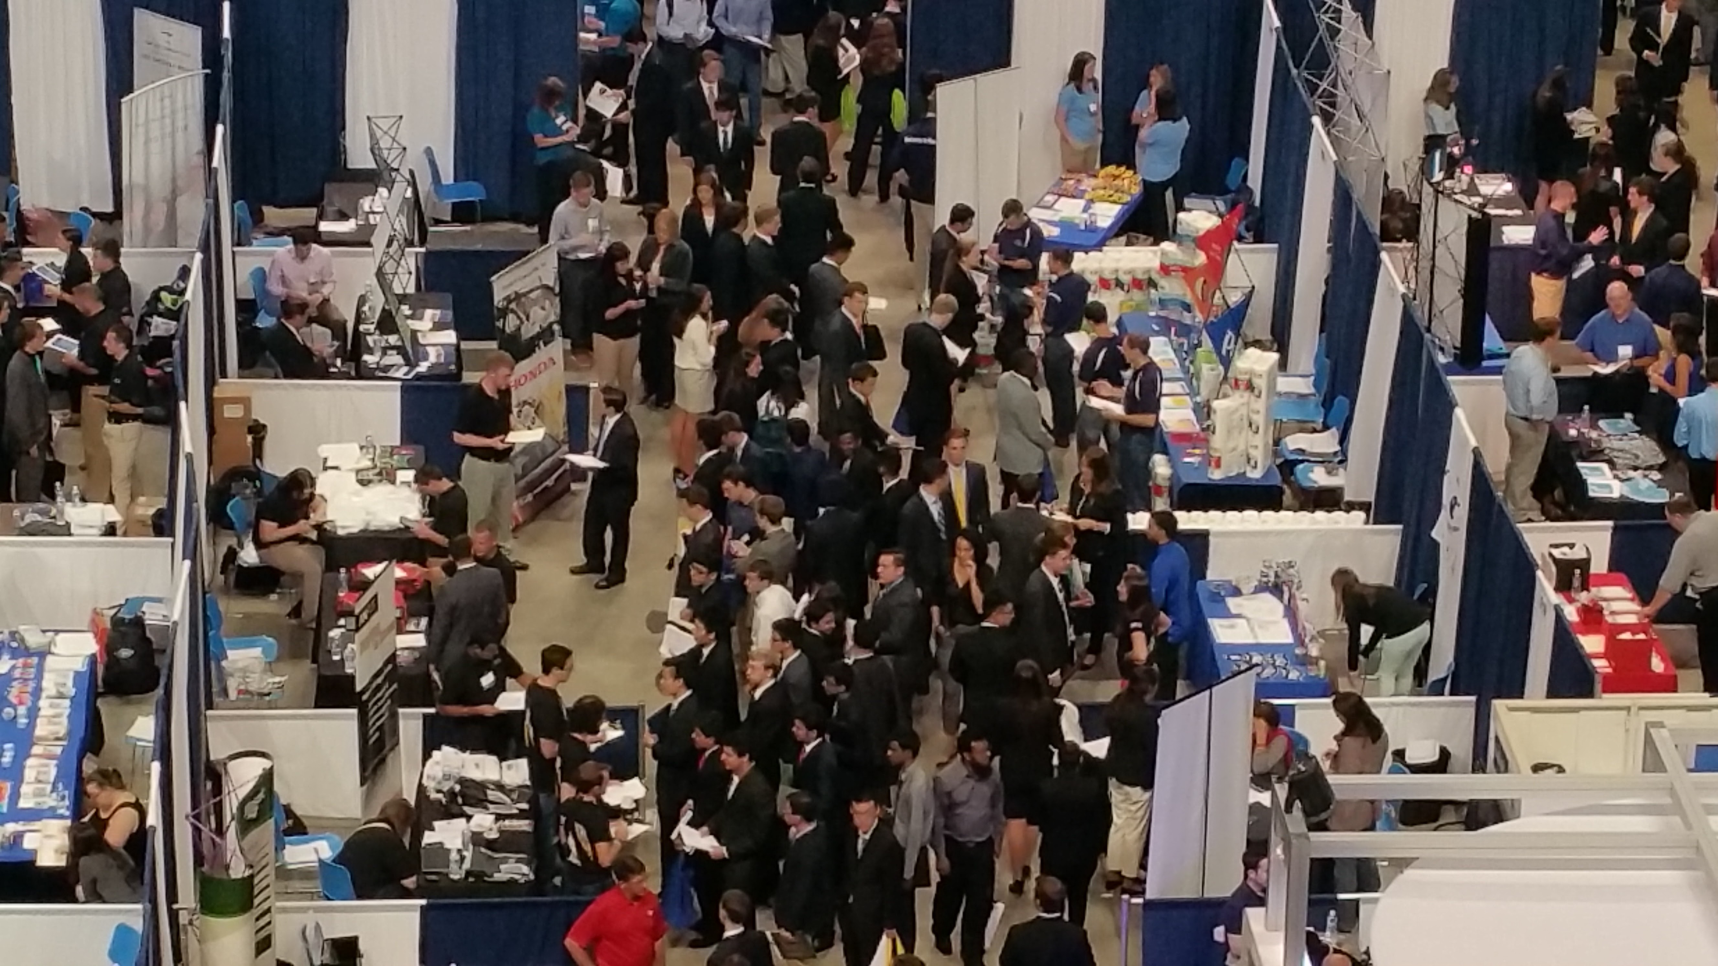
Career Services
24

Slide 28
Penn State Career Services
Since 2018, a single, integrated career enterprise system for
37 career units across Penn State.
  Provides access to all jobs and services for all
  students and alumni.
  Allows employers to post career opportunities on
  one central system.
  Enables both university-wide reporting and college-specific/campus-specific reporting of career success activity.
Penn State is a national leader among large universities for holistically, collaboratively managing career services.
25

Slide 29
The Largest College Career Operation
In 2017-2018…
73 Career Fairs; 4,675 employers; 33,315 students/alumni;
Fall Career Fair alone: 550 employers and 10,000 students.
17,000 on-campus interviews annually.
44 interview rooms in Career Services Center.
42,898 individual career coaching sessions annually.
1,934 career workshops/events: 67,696 participants.
78 career courses taught to 2,597 students.
26

Slide 30
Penn State Students are Career Ready:
Feedback from Employers at Career Fairs
When asked, “How would you rate the overall preparedness of students?” 95% rated “Excellent” or “Good.”
“Penn State students were far more prepared and professional than students at the other schools I attended.”
“I have been in talent acquisition for many years and attended career fairs all over the country. I have never been more pleased with the preparedness of a student body at a fair than I was today.”
27

Slide 31
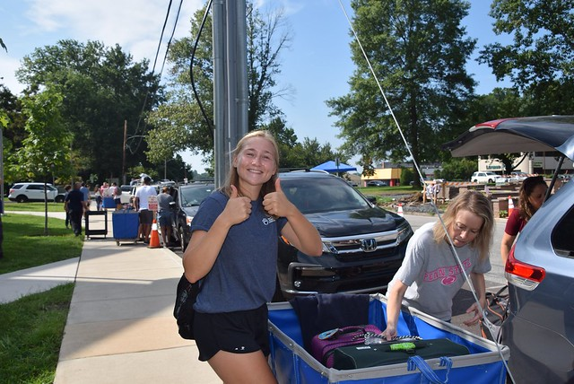
Managing Student Debt:
What Can We Do About It?
Focus on targeted solutions
Protect vulnerable borrowers
Minimize future debt
Ensure degree completion
28

