Slide 1
Enhancing Academic Advising
Academic Leadership Forum
October 30, 2020

Slide 2
Panel Members
Emmanuel Almonte, Student, Political Science, College of the Liberal Arts
Ryan Godbey, Student, Physics, Eberly College of Science
Peyton Loomis Student, Letters, Arts, and Sciences, Altoona College
Donna Quadri-Felitti, Ph.D. Marvin Ashner Director & Associate Professor, School of Hospitality Management, College of Health & Human Development
Nicholas J. Rowland, Ph.D. Professor of Sociology, Chair, University Faculty Senate
Janet Schulenberg, Ph.D. Associate Director, Division of Undergraduate Studies
David R. Smith, Ph.D. Associate Dean for Academic Advising and Executive Director Division of Undergraduate Studies
Michael Verderame, Ph.D. Senior Associate Dean, The Graduate School

Slide 3
The advisor has the unique opportunity to introduce the student to the idea that an education is not just a sum of its parts. (Lowenstein 2005, p. 71)
Notes:
“Academic advising has both a history and a reputation” (Titley & Titley, 1982, p. 45). That reputation is a mixed one. A relatively famous quote summarizes advising in this way:
“Advising is a process with a long and dignified history in college and university. At the same time, involving as it often does tedious clerical work combined with hit-and-run conferences with students on curricula, it is a most cordially hated activity by the majority of college teachers . . .” (MacLean, 1953, p. 357).

Slide 4
Academic advising is an educational endeavor
Founded on a relationship between student and adviser
Pre-requisites for this relationship:
The adviser is knowledgeable
The adviser is accessible
Good advising matters
To individual students
To the long-term health of the institution
Notes:
What is good advising?
Relational, not transactional
Educational, not procedural
Good advising involves discussion of information, the individual student, and the future

Slide 5
Advising matters to students
Emmanuel Almonte Student Political Science College of the Liberal Arts
Ryan Godbey Student Physics Eberly College of Science
Peyton Loomis
Student
Letters, Arts, and Sciences
Altoona College
Notes:
We know that students want access to good advising from college and unit-sought feedback from students. We know from student organizations – for example, UPUA and CCSG calls for an SRTE around academic advising. We also know from students themselves.

Slide 6
Advising matters to the institution
Good advising plays a role in student sense of belonging, progress toward degree, and engagement with their education
Good advising has a greater positive effect on students who are traditionally underserved by educational institutions
Notes:
“George Kuh makes the … point that these [high impact] practices have an even greater positive impact on students who are still underserved by higher education. Effective academic advising practices are especially important for these often first generation students. Encouraging students to take advantage of learning opportunities that are designed to challenge their intellectual and social development and add value to the college experience is central to good academic advising and at the heart of student engagement.” (Nutt and Campbell, 2008)

Slide 7
Advising matters to the institution
As undergraduate demographics shift, we need to improve outcomes
https://budget.psu.edu/factbook/StudentDynamic/StudentTableOfContents.aspx#GraduationRates&FBPlusIndc=N
Graduation rates | Total | Hispanic/ Latino | Black/African American | Asian | International | White
University Park | 85.0% | 77.9% | 72.2% | 81.1% | 80.6% | 87.2%
Commonwealth Campuses | 57.1% | 47.0% | 41.9% | 59.3% | 75.2% | 59.9%
Total | 71.4% | 60.4% | 49.2% | 70.0% | 78.9% | 74.4%
Notes:
The achievement gap exists here at Penn State, and will only widen as our demographics shift. Academic advising is one piece of the puzzle in closing this gap.

Slide 8
University Senate Policy on Academic Advising (32-00)
Academic advising is a critical part of our educational and teaching mission, contributing to retention, student success, and building a citizenry that understands and values higher education.
Our new policy indicates advising should be
An educational endeavor
Conducted by people who are knowledgeable and available
Notes:
Faculty Senate passed revisions to policy 32-00 in 2018. These revisions set the baseline criteria that are needed for supporting an intentional advising program.
When this policy was passed, it was with the recognition that it was aspirational. It is important to our institution as a whole and to our students as individuals that we work toward meeting this policy’s guidelines on academic advising.

Slide 9
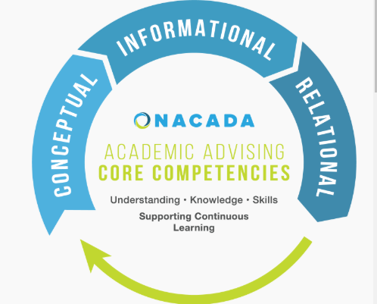
An educational endeavor
Academic advising has intentional learning outcomes and those outcomes are assessed
Example outcomes:
https://dus.psu.edu/exploratory-process
https://nacada.ksu.edu/Resources/Pillars/CoreCompetencies.aspx
Notes:
In the ideal, learning outcomes for advising include things like:
Students self-reflect on the meaning and value of their own higher education
Students can navigate our system
Students seek learning opportunities that make sense for their interests and goals
The global association for academic advising – NACADA – has codified this in the CONCEPTUAL component in its core competencies.

Slide 10
Conducted by people who are knowledgeable
The multiple purposes of higher education
Human diversity and its relationship to equity
The Penn State curriculum
Penn State policies and procedures
Campus resources
https://nacada.ksu.edu/Resources/Pillars/CoreCompetencies.aspx
Notes:
Often, we think of advising as requiring knowledge about degree requirements, policies, and procedures, but it’s about much more. In particular, advising requires knowledge about both higher education and how students from different populations come to be here and experience our institution.

Slide 11
Conducted by people who are available
Willing to build a relationship
Available for one-on-one meetings
https://nacada.ksu.edu/Resources/Pillars/CoreCompetencies.aspx
Notes:
When students complain about advising, it’s first because it wasn’t readily available and second because once they found access, they didn’t feel they were given full attention. We can make immediate gains by first focusing on just being available and interested in the individual student.

Slide 12
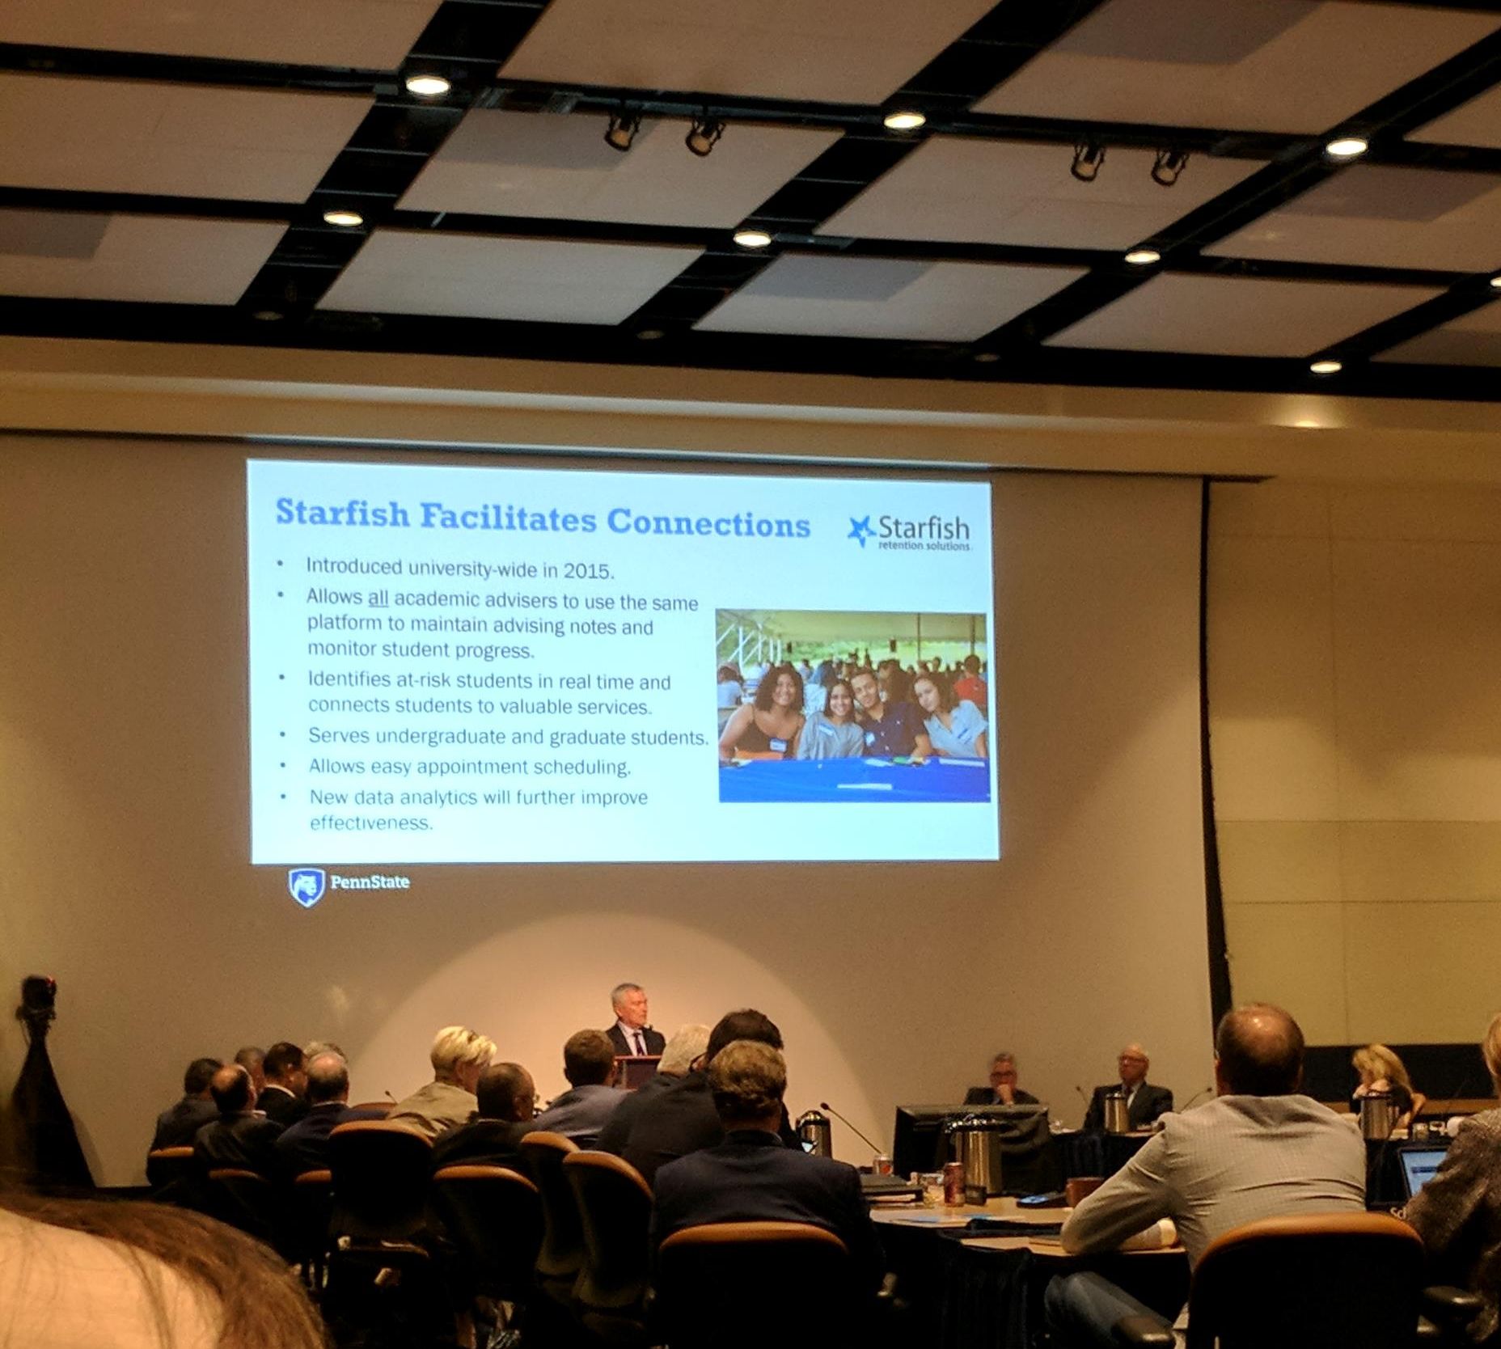
Opportunities
Notes:
Achieving the aspirational goals of this legislation requires active leadership at many levels to embrace the value and importance of intentionality within academic advising. We have opportunities already at our disposal through expertise and tools here and most importantly, through leadership.

Slide 13
Expertise
Body of scholarship and professional standards (NACADA)
Advising experts who work here
Notes:
There is a body of scholarship and base of expertise here at Penn State that can be drawn upon. Advising staff in colleges, departments and at campuses have a depth of knowledge that should be leveraged. There is a large and active professional association with resources that can help.

Slide 14
https://nacada.ksu.edu/Resources/Pillars/CoreValues.aspx
Notes:
We can draw on the body of scholarship and guidance offered from the field of academic advising. For example, there are core values for the practice. These values were developed by an international task force and intended to apply to all who perform academic advising by any role, title, or position as educators at their institutions. While nations, institutions, and students will offer unique circumstances, the Core Values are intended to provide guidance to academic advisors in their professional lives.

Slide 15
Tools
Bulletin – better information
Starfish – platform for sharing and connecting
Notes:
We haven’t made it easy on ourselves, but are getting better at streamlining information and presenting it consistently. The Bulletin is one such tool. Starfish is another. Use of this tool is growing and it’s helping people realize how we depend on each other to educate and support students.

Slide 16
Proactive outreach
Instructor notices something
Instructor lets Adviser know via Starfish
Adviser reaches out to student
Student is connected to resources
Student is more successful
Notes:
The early alert function in Starfish provides an example of collaboration facilitated through software.
Alert: Student doing poorly on assignments – can connect student to supplemental resources – learning centers, study skills, office hours (students don’t know what these are, for example. Or don’t know that those who are most successful have been using these helping resources their whole lives.)
Alert: Student not attending classes – can reach out to see if everything is OK as an act of caring; conveys clearly to a student that their presence matters and that they do belong here. We have seen countless cases where something significant happened in a student’s life and they needed help. Mom diagnosed with cancer, student recovering from a personal trauma, student not understanding the expectations because they lack the cultural capitol coming in.
Kudos: Alternatively, these systems can let others know that things are going very right. There is real power in positive feedback, especially for those who are here in spite of their own imposter syndrome.
In many cases, it takes minimal effort to make a big difference for a student

Slide 17
Leadership
Donna Quadri-Filetti
Marvin Ashner Director and Associate Professor
School of Hospitality Management
Michael Verderame
Senior Associate Dean The Graduate School
Nicholas Rowland
Professor of Sociology
Chair, University Faculty Senate
Notes:
Donna Quadri-Filetti shares how she has worked with faculty in the School of Hospitality Management to engage in academic advising
Michael Verderame shares how the Graduate School is focusing efforts on advising at the graduate level
Nicholas Rowland shares perspectives from Faculty Senate leadership about how to improve academic advising across the institution

Slide 18
Advising Matters
Notes:
We can make a difference if we choose to recognize the importance of academic advising to our students and our institution. Those who advise need to be supported, through better resources and through leadership that clearly situates it as important and valued work.

