Slide 1
Classroom Disruption Protocols A Resource for Faculty
Thursday, August 20, 2020
Jennifer Hamer, Ph.D.
Professor, Department of African American Studies
Senior Faculty Mentor, Office of Educational Equity
1

Slide 2
Inclusive Classrooms
Where the contributions and perspectives of students, regardless of social differences, are respected and valued.
Where faculty are prepared and able to respond to incidents that negatively affect the learning environment, such as inappropriate classroom behaviors or minor and major disruptions that distract from the course.
2

Slide 3
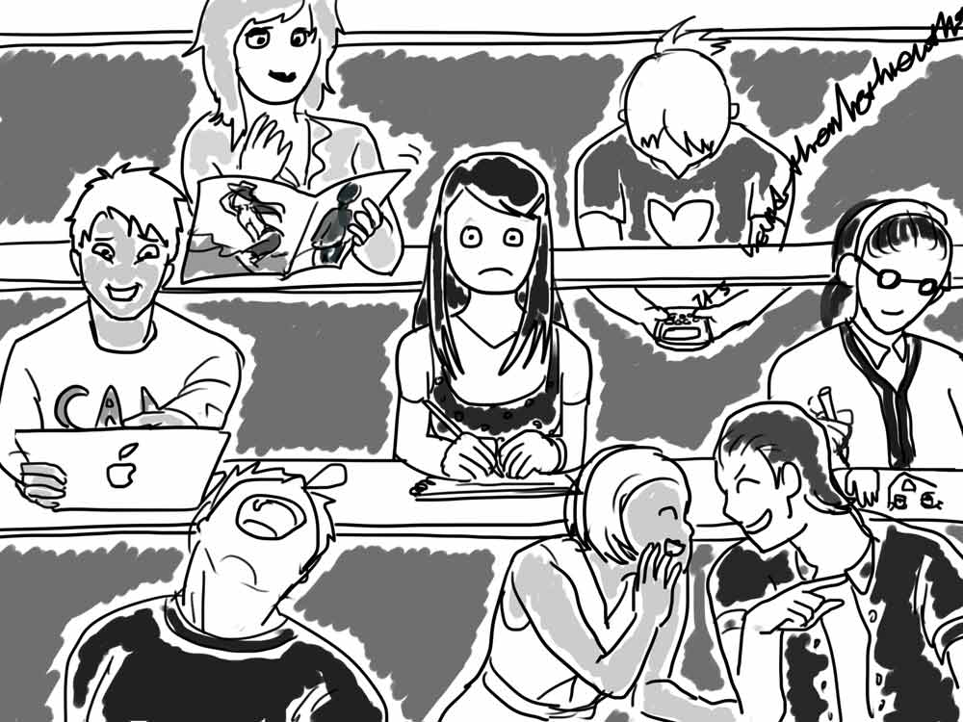
Minor Disruptions
Some examples:
Sleeping in class
Chronic lateness
Mobile phone use
Interruption of instructor/peers
A few appropriate faculty responses:
Speak with student privately
Remind student of expectations
Zoom lock classroom/control chat
3
3

Slide 4
Major Disruptions
Some examples: Impact on students:
Progressive/chronic disruptions silence
Erratic/irrational behavior fear/intimidation
Physical threat, verbal assault heightened emotion
A few appropriate faculty responses: emotional trauma
Speak directly to student physical harm
Ask student to leave unwelcome
Dismiss class feel unsafe
Zoom—mute/stop video/remove
Report
4
4

Slide 5
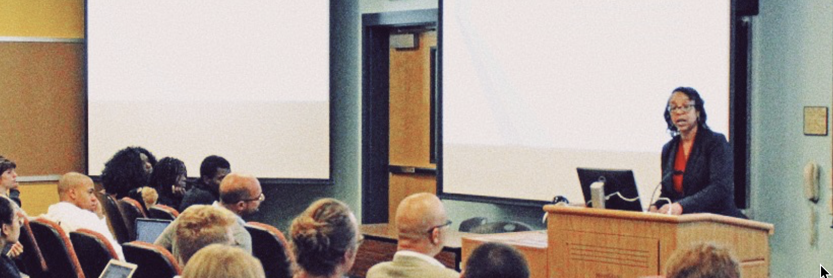
Social Identities and Subject Matter
Faculty of all ranks and across social differences are increasingly challenged by classroom disruptions
Visible social identities, such as race, ethnicity, gender and gender expression, and physical disabilities affect the classroom experience
Those who teach “hot button” subject matters such as race and ethnicity, gender and sexuality, religion and politics lend themselves to emotional disagreement among classroom participants
5

Slide 6
In sum… Classroom Disruption Protocols are guidelines that:
Acknowledge that the classroom experience differs by social identities
Offer quick assessment of misconduct by categorizing “minor” vs. “major”
Help instructors to strategize how to manage disruptive and threatening behavior and recognize the varying comfort levels in doing so
Provide appropriate faculty responses to minor and major disruptions
Point instructors to appropriate others should they need advice, information, and/or support before, during, or following an incident
Facilitate an instructor’s ability to manage situations and feel supported in the process
6

Slide 7
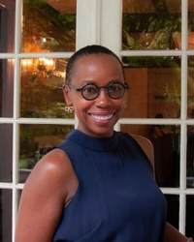
For guidance on the management of inappropriate classroom behavior and steps to follow when you need assistance, please see: Classroom Disruption Protocols: Guidelines for Faculty and Academic Units at http://equity.psu.edu/sfm/classroom-disruption-protocols.
For guidance on Zoom tools: Visit Teaching and Learning with Technology, https://tlt.psu.edu/
For direct classroom support: Consider Tech Tutors and Tech Teaching Assistants, https://techtutors.psu.edu/
For guidance on the navigation of workplace concerns, which can sometimes include the classroom, contact Senior Faculty Mentors
Keith Gilyard, Departments of English and African American Studies and Jennifer Hamer, Department of African American Studies at seniorfacultymtr@psu.edu.
To continue the conversation, contact me, Jennifer Hamer, at jenniferhamer@psu.edu.
7
7

