Slide 1
Welcome to Penn State’s
2020 New Faculty Orientation
Dr. Kathleen Bieschke
Vice Provost for Faculty Affairs
Thursday, August 20, 2020
Office of the Vice provost for faculty affairs
Notes:
BIESCHKE– Slide 1: Welcome
Good morning and welcome to today’s orientation for new Penn State faculty.
My name is Kathy Bieschke, and I am the University’s Vice Provost for Faculty Affairs. I’ve been a Penn State faculty member in the College of Education since 1991 and I have been serving in this position for about two years.
I’m looking forward to our time together today. This is a high level overview and welcome to Penn State, and the first ever held via zoom! We hope it will provide you with the opportunity to learn more about this institution. I suspect that even though I’ve worked at Penn State for nearly 30 years, I will learn new information right along with all of you. As you’ll soon recognize, Penn State is a large and complex university.
There is a lot to cover and we cannot possibly give you everything you need to know in one short half day session. We see this session as the first in series of orientation sessions and you’ll learn more about those in the closing session.
Thank you in advance for your time, attention, and participation today. Make the most of it!

Slide 2
Today’s Agenda
  Conversation with the President
  Promotion, Tenure, and Annual Reviews
  Closing Remarks
Key Topics Include:
  Conversation with Provost Jones
  Research and Development
  Teaching in the COVID Era
OFFICE OF THE VICE PROVOST FOR FACULTY AFFAIRS
Notes:
BIESCHKE – Slide 2: Today’s Agenda
This will be a busy day, as you can see from the slide.
Today will be a combination of a high level overview as well as some “in the weeds” information we want you to have sooner rather than later. To that end, we’ve invited the Provost, Nick Jones, President, Eric Barron, and the Senior Vice President for Research, Lora Weiss to speak with you.
We are also recognize that this semester is an unusual one, to put it mildly, due to the pandemic and other ongoing social and political issues. Classes begin Monday and in order to ensure that you feel as comfortable as possible walking in to teaching your class, we have a panel devoted to teaching in a covid era.
Finally…we know that each of you likely has promotion and/or tenure on your mind. We will devote a bit of time to discussing those processes so that you will have on hand all the information you need.
In short, our goal today is to ensure you have the tools, resources, and information you need to be successful at Penn State.
Before we get started this morning, I’d like to share some information for context about our extraordinary faculty and how the Office of the Vice Provost for Faculty Affairs is set up to support you and your work at Penn State.

Slide 3
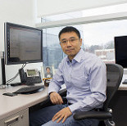
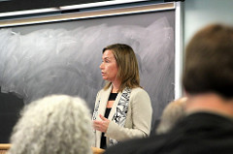
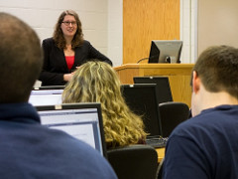
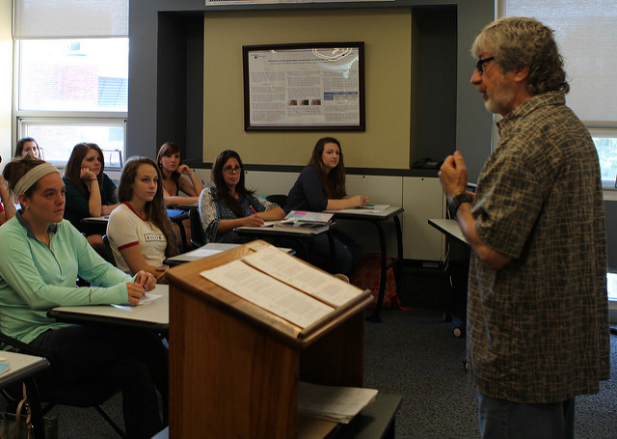
Faculty Facts – Who We Are
Fall 2019
  Full-Time Faculty: 6,388
  Part-Time Faculty: 1,654
  Total Faculty: 8,042
  Sources: University Budget
  Office / Penn State Factbook
OFFICE OF THE VICE PROVOST FOR FACULTY AFFAIRS
Notes:
BIESCHKE – Slide 3: Faculty Facts – Who We Are
As new Penn State faculty, you are joining an esteemed group. So, here’s a little information about this group of which you are all are now a vital part.
Who are our faculty, by the numbers?
For the most recent academic year that began in Fall 2018, across Penn State University, we had:
• 6,388 full-time faculty, across all of Penn State’s campuses and
• 1,654 part-time faculty …
• … for a total of 8,042.

Slide 4
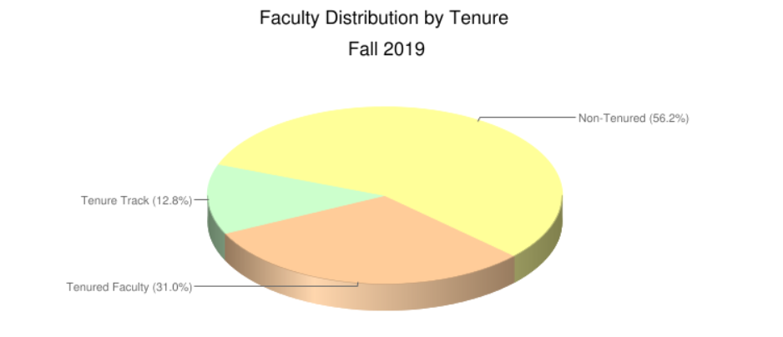
Faculty Facts – By Tenure Status
  Sources: University Budget Office / Penn State Factbook
OFFICE OF THE VICE PROVOST FOR FACULTY AFFAIRS
Notes:
BIESCHKE – Slide 4: Faculty Facts – By Tenure Status
Who are our full-time faculty, by tenure status?
As of Fall 2018, the numbers were:
• Tenured: 31.6%
• Tenure-Track: 12.6%
• Non-tenured: 55.8%

Slide 5
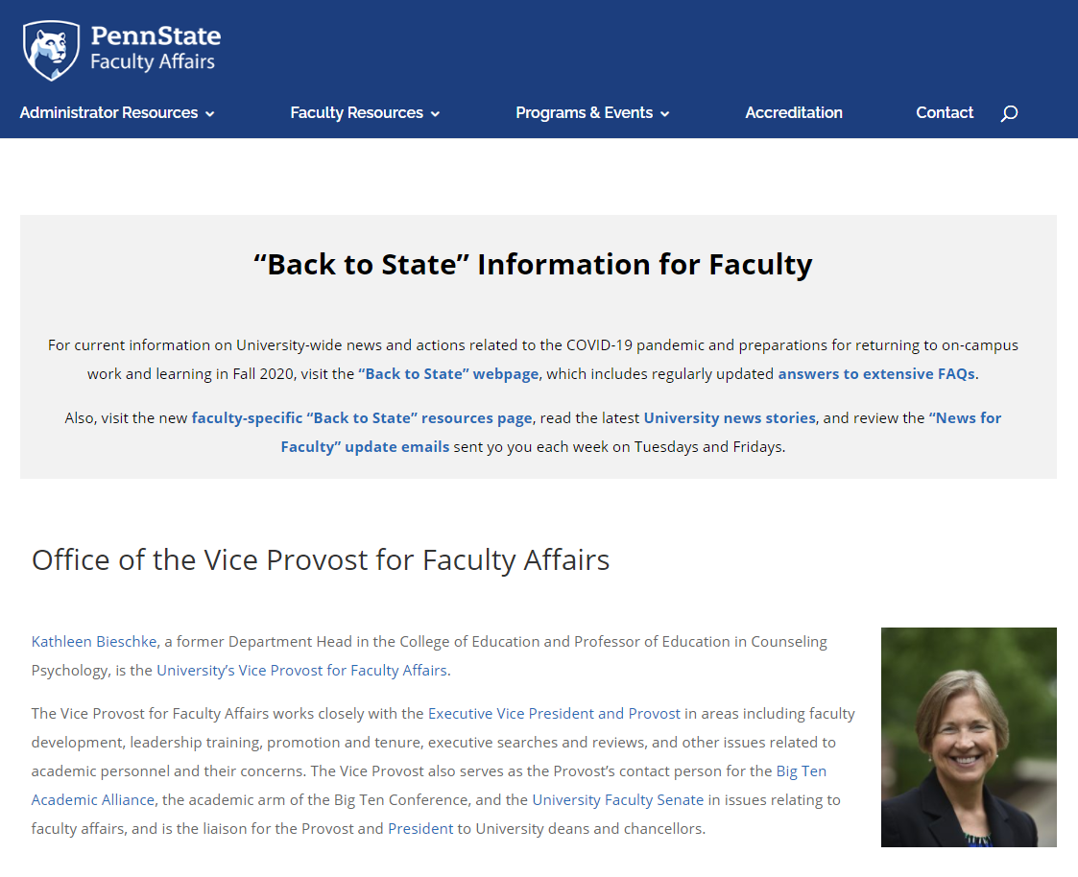

Full-Time Focus on Faculty Affairs
Office of the Vice Provost for Faculty Affairs
vpfa.psu.edu
OFFICE OF THE VICE PROVOST FOR FACULTY AFFAIRS
Notes:
BIESCHKE – Slide 5: Full-Time Focus on Faculty Affairs
• So, what is the role of the Vice Provost for Faculty Affairs in supporting all Penn State faculty?
• In a sentence: My position is dedicated to ensuring that all faculty at Penn State have every opportunity to be successful. It’s an ever-evolving role, with a full-time focus on faculty affairs.
• Among other responsibilities, I work closely with Executive Vice President and Provost Nick Jones in areas including faculty development, leadership training, promotion and tenure, executive searches and reviews, and myriad issues related to academic personnel and their concerns.
• You can learn more about me, my background, and the Office of the Vice Provost for Faculty Affairs online at vpfa.psu.edu.

Slide 6
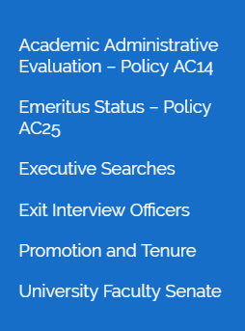
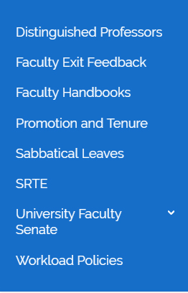
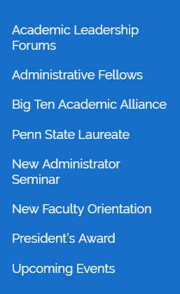
A Closer Look
Office of the Vice Provost for Faculty Affairs
vpfa.psu.edu
policy.psu.edu
OFFICE OF THE VICE PROVOST FOR FACULTY AFFAIRS
Notes:
BIESCHKE – Slide 6: A Closer Look
A closer look at the content on the VPFA website reveals the depth and breadth of the office’s work.
Here you’ll see three of the main sections of the website and the extensive drop-down menus with links to information on a variety of important topics, some of which we will be covering today.
• Administrator Resources – includes links to important policy documents, as well as information about Promotion and Tenure and the University Faculty Senate, which you will learn more about later from Senate Chair Nicholas Rowland.
• Faculty Resources – Here you’ll find more information about sabbatical leaves, SRTEs, and workload policies, among other topics. Always ask questions and consult specific University policies as needed for up-to-date information. You can find them at policy.psu.edu, and the Academic Policies section will be of particular interest to you.
• Programs and Events – Many of our events our tailored toward supporting faculty as they pursue administrative roles. Note, however, that here is where you will find our New Faculty Orientation page, and this is where select materials from today’s event will be posted for your future reference.
• And topical resources…such as COVID!
The Bottom Line: The VPFA website is a great place to review material that all of you will consider relevant, in addition to and beyond everything we will cover today.

Slide 7
Let’s Get Started!
“Housekeeping” Notes:
  Scheduled breaks
  Questions and comments
vpfa.psu.edu
Our First Speaker: Dr. Nick Jones, Penn State Executive Vice President and Provost
OFFICE OF THE VICE PROVOST FOR FACULTY AFFAIRS
Notes:
BIESCHKE – Slide 7: Let’s Get Started!
So, with that information for context, we can get started!
A few housekeeping notes:
• I’d also like to introduce the staff in my office who are here today. Abby Diehl is the Assistant Vice Provost for Faculty Affairs. Many thanks Abby, for organizing this session. Abby will serve as my co-moderator throughout the day. In the closing session, Abby will provide a brief wrap up and will close with a description of the orientation activities to come this academic year.
• I also would like to thank Wendy Blumenthal. Wendy is a staff person in my office who has worked tirelessly behind the scene to ensure today’s event runs as smoothly as possible.
• In conjunction with today’s presentations, there will be some opportunities to take your questions or comments. Please submit your questions via the Q&A feature on the bottom of your screen.
Now I’d like to introduce and welcome our first speaker and special guest: Dr. Nick Jones, Executive Vice President and Provost at Penn State. I’ve worked with Nick for 3 years and I can tell you that from my perspective, we are fortunate to have him in that role.

