Slide 1
Promotion, Tenure, and Annual Reviews
Dr. Kathleen Bieschke
New Faculty Orientation
Thursday, August 20, 2020
Office of the Vice provost for faculty affairs
Notes:
BIESCHKE– Slide 1: Title/Introduction
I know it’s been a busy day, with a lot of information conveyed to you. It’s a bit like “drinking from a fire hose.” Thank you for your continued time, attention, and participation today.
Here’s how I plan to use this time:
First, I want to offer some reminders about material I covered briefly this morning – regarding the work of my office and the composition of Penn State’s faculty, of which you all are now a part.
Then, I want to discuss some key topics – Performance Reviews and Promotion and Tenure – and allow time for your comments and questions.

Slide 2
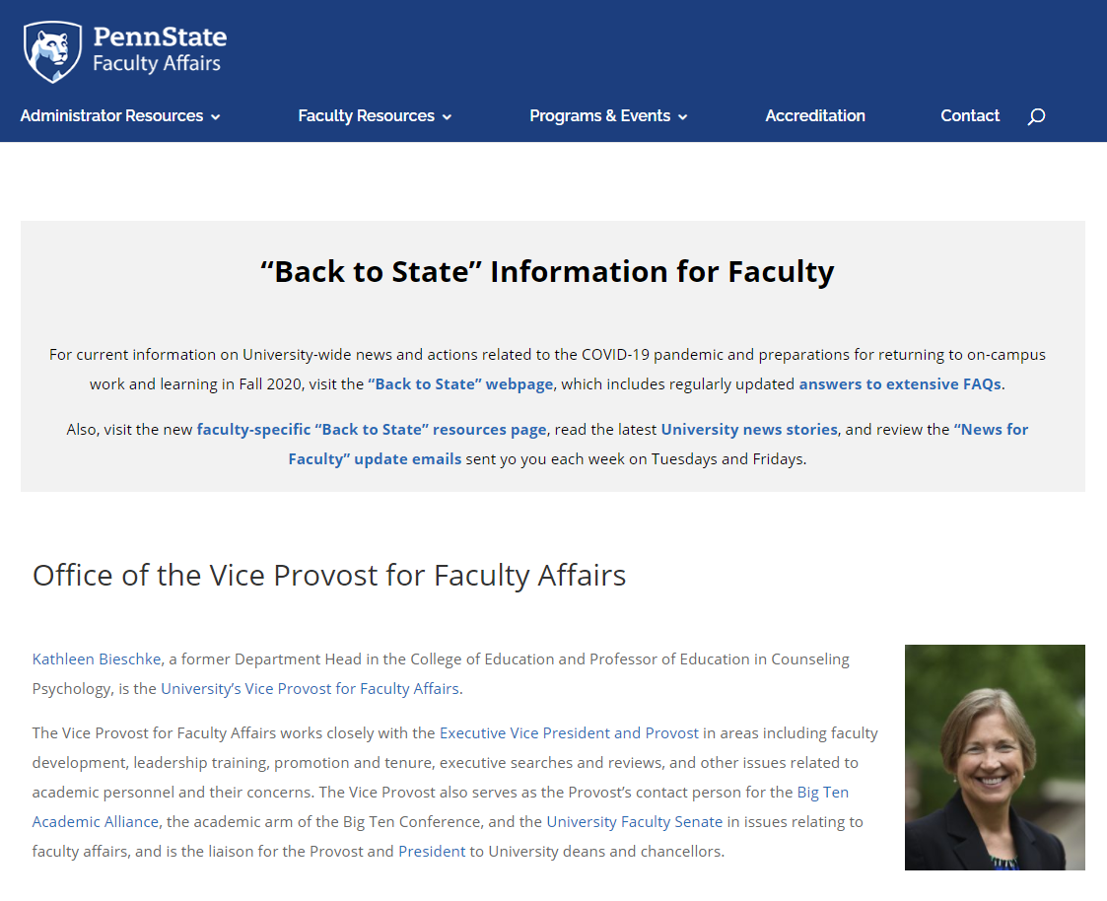

Office Focused on Faculty Affairs
Office of the Vice Provost for Faculty Affairs
vpfa.psu.edu
OFFICE OF THE VICE PROVOST FOR FACULTY AFFAIRS
Notes:
BIESCHKE – Slide 2: Office Focused on Faculty Affairs
As Vice Provost for Faculty Affairs, I am committed to ensuring that all Penn State faculty have ample opportunities to succeed.
My work comprises faculty development, leadership training, promotion and tenure, and much more. I am the Provost’s contact person for the University Faculty Senate in issues relating to faculty affairs, and I serve as the liaison for Provost Jones and President Barron to college deans and chancellors. Most germane to this presentation, my office oversees the promotion and tenure process at Penn State.
The website for my office, vpfa.psu.edu, will be an excellent, ongoing resource for you during your work at Penn State.

Slide 3
Key Topics: Annual Evaluations, Promotion, and Tenure
Evaluations:
  Penn State Policy AC40
  Everyone is reviewed annually
policy.psu.edu
Promotion and Tenure:
  Penn State Policies AC21 and AC23
  Many considerations beyond policies
OFFICE OF THE VICE PROVOST FOR FACULTY AFFAIRS
Notes:
BIESCHKE – Slide 3: Key Topics: Annual Evaluations, Promotion, and Tenure
With that information for context, we can move ahead to discuss the annual evaluation of faculty, as well as paths for promotion and tenure for our tenure-line faculty. I’ll say just a few words about the path for promotion for our non-tenure-line faculty, so you have a good understanding of the faculty landscape and faculty-related policies at Penn State.
I’m confident this will not be the last time you’ll learn about and discuss these topics. All of this information bears repeating throughout your time as faculty at Penn State.
I’m here to speak with you broadly about University policy in these areas. But each of your units (i.e., department, college, campus) will also hold workshops and meetings to discuss these topics. This is far from the last time you’ll hear about them.
Please know that we are committed to your success.

Slide 4
Annual Evaluations: Policy AC40
Highlights of Policy AC40 (policy.psu.edu – Academic section):
  All full-time faculty reviewed annually; also five-year “extended reviews” for tenured faculty
  Evaluations conducted at “local level” (coordinated by deans or chancellors and handled by department or division heads, or directors of academic affairs)
  Important opportunities for faculty to receive regular feedback, reflect on performance, identify growth areas
OFFICE OF THE VICE PROVOST FOR FACULTY AFFAIRS
Notes:
BIESCHKE – Slide 4: Annual Evaluations: Policy AC40
Penn State addresses faculty reviews and assessment in myriad ways, starting with what is articulated in University Policy AC40, Annual Evaluation of Faculty Performance.
This policy and others can be found online at policy.psu.edu, in the “Academic” section on the upper left of that page.
Some key elements of Policy AC40:
At Penn State, all full-time faculty and staff have a performance review every year. These annual reviews are separate from the promotion and tenure process.
While we won’t discuss this in detail today, note that tenured faculty members are evaluated with an extended review every fifth year after the most recent promotion decision.
Responsibility for these evaluations is at the “local level” – coordinated by deans/chancellors, and typically conducted by department/division heads, directors of academic affairs, etc.
The evaluations are conducted using elements listed in policies AC21, Definitions of Academic Rank, and AC23, Promotion and Tenure Procedures and Regulations, and in accordance with procedures developed independently within each College.
We will discuss these policies shortly. Here, however, it is important to emphasize that maximum weight is given to the area of major emphasis in an individual’s assignment.
Faculty members submit written annual reports and should have one-on-one discussions with administrative officers.
These reviews ARE used in decisions regarding general salary increases.
Ultimately, these annual evaluations represent critical opportunities for faculty members to get regular feedback about their performance. You also can reflect on your performance and identify potential areas for improvement and growth in your academic role.

Slide 5
Promotion and Tenure Policies
Promotion:
Policy AC21: Definition of Academic Ranks
Promotion and Tenure:
Policy AC23: Promotion and Tenure Procedures
and Regulations
OFFICE OF THE VICE PROVOST FOR FACULTY AFFAIRS
Notes:
BIESCHKE – Slide 5: Promotion and Tenure Policies
Penn State also covers faculty promotion and tenure issues in two other University Policies: AC21, Definition of Academic Ranks, and AC23, Promotion and Tenure Procedures and Regulations.
You can find links to them on the VPFA website on its Promotion and Tenure page, along with related information and documents.

Slide 6
Policy AC21:Definition of Academic Ranks
Highlights of Policy AC21 (policy.psu.edu – “Academic” section)
  Provides guidance on qualifications necessary for appointment or promotion to various academic ranks
  Describes all ranks, including those of tenure-line and
  non-tenure-line faculty
  Recently updated to standardize titles for non-tenure-line faculty
OFFICE OF THE VICE PROVOST FOR FACULTY AFFAIRS
Notes:
SLIDE 6 BIESCHKE – Policy AC21 Definition of Academic Ranks
Highlights of Policy AC21 (policy.psu.edu – “Academic” section)
Provides guidance on qualifications necessary for appointment or promotion to various academic ranks
Describes all ranks, including those of tenure-line and
non-tenure-line faculty
Recently updated to standardize titles for non-tenure-line faculty

Slide 7
Promotion Procedures for NTL Faculty
While each college has its own guidelines and criteria, all units shall operate under the following University assumptions.
Positions above the first rank are designed to be promotion opportunities, with a recommended period of at least five years in rank before consideration before promotion. Reviews for promotions should be conducted solely with regard to merit of the candidate.
Reviews for promotion shall be conducted by Non-Tenure-Line Promotion Review Committees for a college/campus.
All promotions should be accompanied by a promotion raise and successful candidates should be considered for a multi-year contract.
OFFICE OF THE VICE PROVOST FOR FACULTY AFFAIRS
Notes:
BIESCHKE – Slide 7: Promotion Procedures for NTL Faculty
While each college has its own guidelines and criteria, all units shall operate under the following University assumptions.
Positions above the first rank are designed to be promotion opportunities, with a recommended period of at least five years in rank before consideration before promotion. Reviews for promotions should be conducted solely with regard to merit of the candidate.
Reviews for promotion shall be conducted by Non-Tenure-Line Promotion Review Committees for a college/campus.
All promotions should be accompanied by a promotion raise and successful candidates should be considered for a multi-year contract.

Slide 8
Promotion procedures consist of recommendations by
  Campus/department faculty committee
  Director of academic affairs or department/division head
  Approval of the campus chancellor/dean.
OFFICE OF THE VICE PROVOST FOR FACULTY AFFAIRS
Notes:
BIESCHKE – Slide 8: Promotion procedures consist of recommendations by
Campus/department faculty committee
Director of academic affairs or department/division head
Approval of the campus chancellor/dean.

Slide 9
Promotion for NTL Faculty in 2018-2019
Of the 182 non-tenure line promotion dossiers put forward for review at University Park and the Commonwealth Campuses, 162 (89%) received a promotion.
Of those 162 promotions, 41 were promoted to assistant professor, 98 were promoted to associate professor, and 23 were promoted to professor.
Per AC-21, faculty members who are promoted shall be considered for a multi-year contract and those promoted to the third rank shall be considered for the longest length of contract available to NTL faculty. Of the 162 who were promoted, 142 (88%) hold a multi-year contract. This represents 78% of assistant professors, 91% of associate professors, and 91% of professors.
OFFICE OF THE VICE PROVOST FOR FACULTY AFFAIRS
Notes:
BIESCHKE – Slide 9: Promotion for NTL Faculty in 2018-2019
Of the 182 non-tenure line promotion dossiers put forward for review at University Park and the Commonwealth Campuses, 162 (89%) received a promotion.
Of those 162 promotions, 41 were promoted to assistant professor, 98 were promoted to associate professor, and 23 were promoted to professor.
Per AC-21, faculty members who are promoted shall be considered for a multi-year contract and those promoted to the third rank shall be considered for the longest length of contract available to NTL faculty. Of the 162 who were promoted, 142 (88%) hold a multi-year contract. This represents 78% of assistant professor, 91% of associate professors, and 91% of professors.

Slide 10
Promotion and Tenure: Policy AC23
Highlights of Policy AC23 (policy.psu.edu – “Academic” section):
  Provides guidance on determining the criteria, procedures, and conditions of the review of University academic personnel and for the awarding of promotion and tenure
  Substantive policy warrants thorough individual review; also should see related documents on website: P&T Administrative Guidelines and P&T FAQ
OFFICE OF THE VICE PROVOST FOR FACULTY AFFAIRS
Notes:
BIESCHKE – Slide 10: Promotion and Tenure: Policy AC23
All of you here today have tenure-line appointments so I want to highlight a few key elements of Policy AC23, Promotion and Tenure Procedures and Regulations:
The policy provides guidance on determining the criteria, procedures, and conditions of the review of University academic personnel and for the awarding of promotion and tenure.
The policy is useful to review. You will also want to review two documents on my website: The Administrative Guidelines for Policy AC23 and the Promotion and Tenure FAQ. These documents are updated annually.
The list of members serving on the University Promotion and Tenure Review Committee is also posted on this webpage.

Slide 11
Promotion and Tenure:
Three Levels of Review
  Level One: Department/Campus – Most familiar with candidate’s discipline and standards
  Level Two: College – Evaluates using a specific college’s criteria and expectations
  Level Three: University – Focused on ensuring compliance with college and institutional standards and consistency of excellence across Penn State
OFFICE OF THE VICE PROVOST FOR FACULTY AFFAIRS
Notes:
BIESCHKE – Slide 11: Promotion and Tenure: Three Levels of Review
There are three levels of review and it’s important to note that there are three sets of guidelines to accompany each level of review. Each set is consistent with AC-23, our policy for promotion and tenure of tenure-line faculty members.
Level One: Department/Campus – Most familiar with candidate’s discipline and quality and quantity standards. At this level, your materials will be reviewed by a committee elected at the unit level as well as the leader of the unit (e.g., DAA/Department Head).
Level Two: College – Evaluates using a specific college’s criteria and expectations. Similarly, you will be reviewed by a committee elected by the larger unit as well as the unit leader (e.g., Chancellor, Dean).
Level Three: University – Focused on ensuring compliance with college and institutional standards and consistency of excellence across Penn State. Again, your materials will be reviewed by a committee elected by your peers as well as the unit leader, which in your case is the Provost and, ultimately, the President of the University.

Slide 12
Promotion and Tenure Criteria
Key areas of evaluation and assessment:
  Scholarship of Teaching and Learning (SOTL)
  Scholarship of Research and Creative Accomplishments
  Service and scholarship of service to the University, society, and one’s profession
  Important: 2020-2021 Administrative Guidelines for Policy AC23 are on the VPFA website -- more than 60 pages of information and forms related to all of these areas, including an appendix on dossier sections and format.
OFFICE OF THE VICE PROVOST FOR FACULTY AFFAIRS
Notes:
BIESCHKE – Slide 12: Promotion and Tenure Criteria
Here’s a snapshot of the key areas of Promotion and Tenure-related evaluation and assessment:
Scholarship of Teaching and Learning (SOTL)
Scholarship of Research and Creative Accomplishments
Service and scholarship of service to the University, society, and one’s profession
Important: The 2019-2020 Administrative Guidelines for Policy AC23 are posted on the VPFA website – more than 60 pages of vital information and forms related to all of these area, including an appendix on dossier sections and format. The document can be found on the site’s Promotion and Tenure page; it’s the third one under the “Key Policies and Guidelines” header.

Slide 13
Promotion and Tenure:
Additional, Periodic Reviews
Pre-Tenure Reviews in 2nd and 4th Years:
  Developmental and evaluative processes
  Can be denied either year
  If improvement opportunities are noted, a plan is developed to focus on those areas
6th Year Tenure Review:
  95 cases in 2019-2020; 95 of those earned tenure
OFFICE OF THE VICE PROVOST FOR FACULTY AFFAIRS
Notes:
BIESCHKE – Slide 13: Promotion and Tenure: Additional, Periodic Reviews
Individuals seeking tenure or promotion undergo additional, periodic reviews.
Pre-Tenure Reviews in 2nd and 4th Years – These are developmental and evaluative processes that sometimes involve college committees. The second-year review typically occurs during the spring semester of your second year of service. You can be denied tenure as a result of the review processes in your second and/or fourth years. If improvement opportunities are noted, a plan is developed to focus specifically on those areas. Deans may request special third and/or fifth-year reviews as they deem appropriate.
6th Year Tenure Reviews – This is the final review for tenure. In the 2019-2020 academic year, there were a total of 95 sixth-year tenure cases. Of those, 95 ultimately received tenure, 100 percent of those who sought it.

Slide 14
Promotion and Tenure in 2019-2020
The University Promotion and Tenure Review Committee reviewed 167 cases during the past academic year. All but one included a positive recommendation by the submitting dean. The Committee recommended 167 cases, and the President approved 167 cases.
Dossiers for promotion to the rank of professor, librarian, and research professor for
72 candidates were forwarded by deans to the Committee, with 72 including positive recommendations by the submitting deans. One of the 72 cases had an accompanying tenure recommendation. The President approved 72 cases.
Dossiers for promotion to the rank of associate professor, associate librarian, and associate research professor for 88 candidates were forwarded by deans to the Committee. Eighty-seven cases had positive recommendations by the submitting deans, and 86 of them included tenure recommendations. The Committee recommended 88 cases, and the President approved 88 cases.
OFFICE OF THE VICE PROVOST FOR FACULTY AFFAIRS
Notes:
BIESCHKE – Slide 14: Promotion and Tenure in 2019-2020
I’d like to share additional details regarding promotion and tenure cases during the last academic year.
The University Promotion and Tenure Committee reviewed 167 cases during the 2019-20 academic year. Of the 167 cases, all but one carried positive recommendations by the submitting dean. The University Committee recommended 167 cases, and the President approved 167 cases and denied zero.
Dossiers for promotion to the rank of professor, librarian, and research professor for 72 candidates were forwarded by the deans to the University Committee with all positively recommended by the submitting dean. Of those 72 cases, one case carried with it an accompanying recommendation for tenure. The President approved 72 cases presented.
Dossiers for promotion to the rank of associate professor, associate librarian and associate research professor for 88 candidates were forwarded by the deans to the University Committee. All but one case carried positive recommendations by the submitting dean. Of those 88 cases, 86 also included a recommendation for tenure. The University Committee recommended 88 cases, and the President approved 88 cases.

Slide 15
Tips and Takeaways
Understand policies at all levels
Pay attention to details of performance review letters
Consult with colleagues and mentors
Establish independence as a scholar
Take advantage of available resources
Have a strategy
OFFICE OF THE VICE PROVOST FOR FACULTY AFFAIRS
Notes:
BIESCHKE – Slide 15: Tips and Takeaways
Be aware of and understand the policies at the department, college, campus, and University levels. Ask questions if you need clarification or guidance about anything.
For example, the typical probationary review period is six years. We know that some of you may run into unforeseen circumstances that might make achieving the criteria for promotion and tenure challenging within the time frame (e.g., pregnancy, medical concerns, etc.).
We do allow for “stays of tenure” to accommodate such concerns (and level the playing field), and the guidelines for how to obtain a stay can be found in the Administrative Guidelines document.
Pay attention to any of your performance review letters, especially those that are for the 2nd and 4th year reviews if you are on the tenure track. They will contain specific information about how to be successful moving forward.
Identify colleagues with whom you can consult about the process, as well as coaches and mentors. Take your time and choose wisely; they will be enormous assets to you if you do.
Establish your independence as a scholar. Focus on doing high-quality work with high impact.
Avail yourselves of the many resources we have available to improve your teaching.
Ultimately, have a strategy! For those seeking tenure, you have a fixed amount of time. Spend most of your time on those tasks that will allow you to accomplish your goals. Avoid the trap of doing what’s easy UNLESS it helps you along the way to your ultimate goal.
Please know that my office provides a Promotion and Tenure Workshop every year. You may attend this year’s workshop on Thursday, September 26th, from 10-11:30 a.m. in the Pattee Library’s Foster Auditorium or view a video recording on the VPFA website. Your units also will provide workshops or other resources specific to your campus or discipline.

Slide 16

Thank You.
Questions or Comments?
vpfa.psu.edu
OFFICE OF THE VICE PROVOST FOR FACULTY AFFAIRS
Notes:
BIESCHKE – Slide 16: Thank You. Questions or Comments?
Thank you again for your time as we prepare for the final parts of a very busy and informative orientation.
I now have a few minutes for any questions or comments you may have about performance reviews or our promotion or tenure processes.

