Slide 1
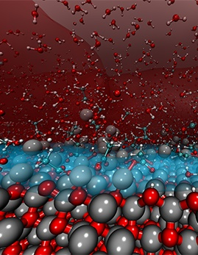
Welcome to Research @ Penn State!
Lora G. Weiss, Ph.D.
Senior Vice President for Research
August 20, 2020
Visualization of the powder/liquid interface at atomistic scale during the evaporation in Cold Sintering Process. Credit: van Duin Group / Penn State
Notes:
Ceramics are everywhere in our daily life, especially in electronics. Most of the ceramics require very high temperatures (around 1000 Celsius) during the processing stage, but using a process called “cold sintering,” the temperature has been decreased to 300 Celsius for several ceramics types. The mechanism behind what makes cold sintering work has been a mystery, but researchers around the world have been working on unveiling the mechanism.
This cover photo is from one of the lab of Adri Van Duin, professor of Mechanical Engineering, and shows the powder/liquid interface at atomistic scale during evaporation in Cold Sintering Process.

Slide 2
More than 5,300 researchers collaborating globally
11 members National Academy of Sciences
11 members American Academy of Arts and Sciences
11 senior members and fellows National Academy of Inventors
5 members National Academy of Engineering
3 members National Academy of Medicine
14 researchers named “Highly Cited Researchers” by Clarivate Analytics
Notes:
You are joining an extremely large research enterprise with more than 5,300 researchers.
Penn State is proud to have many active members of the national academies, and these numbers steadily grow each year.
Photo explanation: This map shows peer-reviewed journal collaborations in last five years; you can see our researchers have collaborated with universities on every continent (we’ve done work in Antarctica though there are no Universities there!)

Slide 3
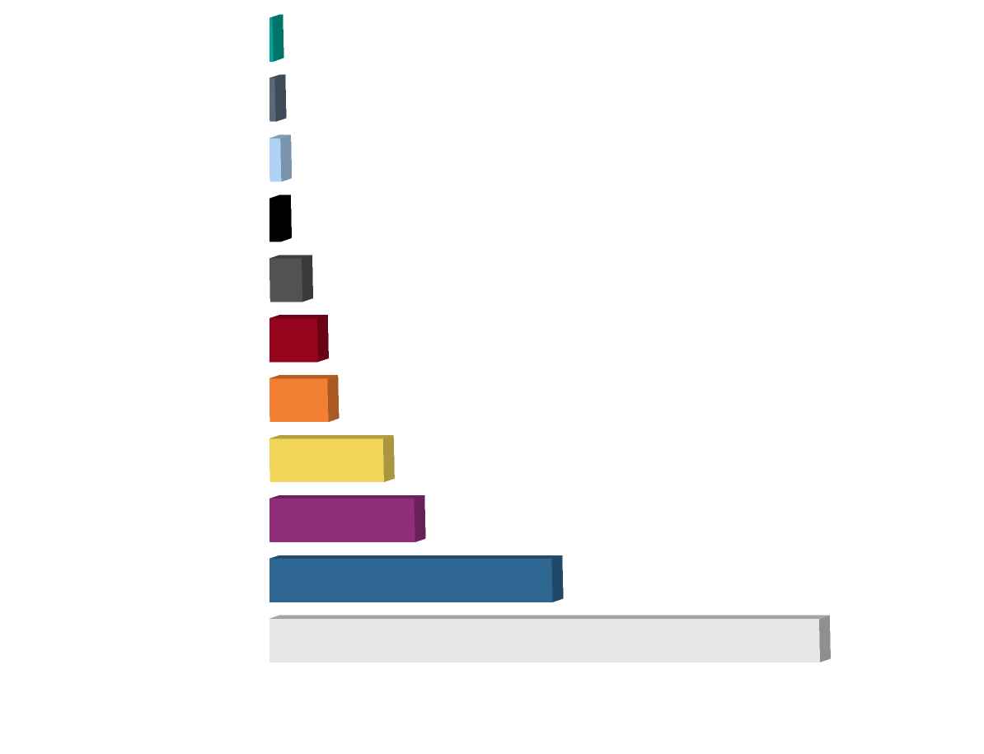
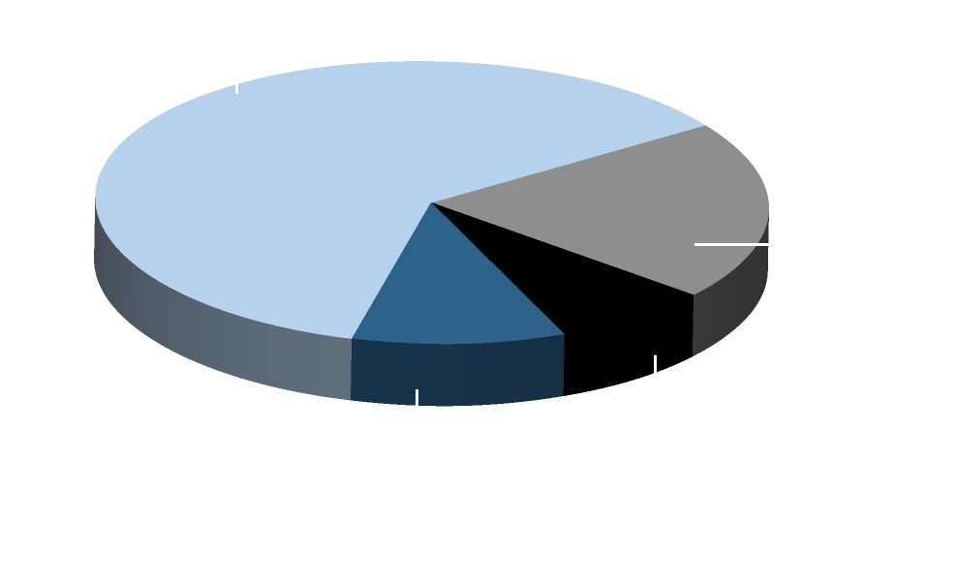
Research Expenditures FY 2019
Total Expenditures: $968 million
Federal Expenditures: $593 million
Notes:
In fiscal year 2019, our research expenditures totaled $968 million. Like many public universities, the majority of our funding comes from the federal agencies; at right you can see the breakout of spending from various federal sources.

Slide 4
NSF Higher Education R&D (HERD) Rankings for FY 2018
Penn State has 18 research fields ranked in the top 10
This is more than any other university
Testament to our
Excellence
Breadth
Depth
#1 Materials Science
#2 Materials Engineering
Mechanical Engineering
#3 Psychology
#4 Sociology
Electrical Engineering
#5-10 Industrial Engineering Manufacturing Engineering
Mathematics
Computer & Information Sciences
Geological & Earth Sciences
Agricultural Sciences
Chemical Engineering
Physical Sciences
Aerospace, Aeronautical & Astronautical Engineering
Research expenditures rankings
#21 All universities
#12 All public universities
Federal agencies rankings
#3 DOD
#11 USDA
#17 NSF
#20 NASA
Source: NSF Higher Ed R&D Survey FY2018, released Nov 2019
Notes:
This data is according to the NSF’s annual Higher Education Research and Development (or HERD) rankings, which simply collects data on expenditures in research topical areas. No other school has as many research areas in the Top 10 as Penn State.
You’ll hear us talk a lot about our interdisciplinary strength, and I’ll talk a bit about our University-wide interdisciplinary Institutes in a few moments, which are the envy of many of our peer universities. Our structure and administration is purposefully designed to support interdisciplinary research collaborations. And Penn State has been recognized as one of the few Universities who is doing this successfully – we think the fact that we have 15 research areas in the top ten is a demonstration of the breadth of our work. Not only in STEM areas, but the social sciences – you can see we are ranked #2 for research expenditures in sociology and psychology.

Slide 5
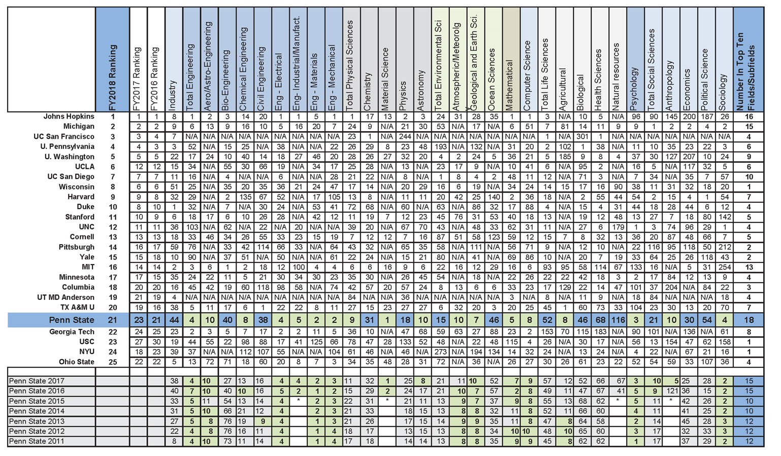
NSF Higher Education R&D (HERD) Rankings for FY 2018
Top 25 universities by key fields
Source: NSF Higher Ed R&D Survey FY2018, released Nov 2019

Slide 6
Matching Funds Policy
Equipment (if required by sponsor):
Match of 15% from central on minimum annual equipment cost of $100,000
College/department must match at a minimum of 7.5% policy.psu.edu/policies/rag51
Graduate Assistantships/Traineeships (GA):
Match equal to 50% of F&A generated on GA costs or 10% of total GA costs
Minimum annual match of $10,000 policy.psu.edu/policies/rag52
Notes:
Image

Slide 7
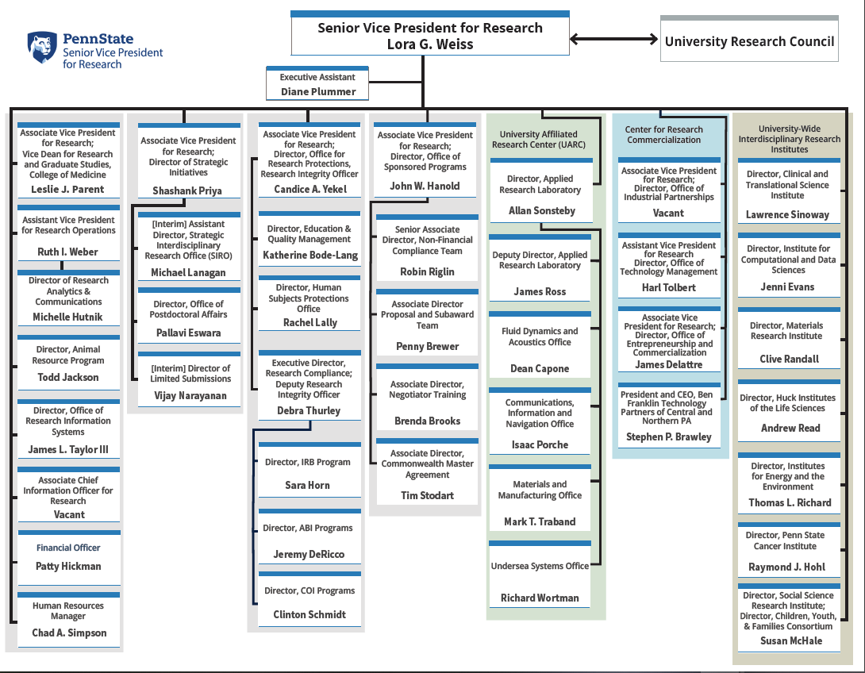
OSVPR Organization
Sponsored Programs
Research Protections
Animal Resource Program
ORIS
Strategic Initiatives
SIRO
Limited Submissions
Postdoctoral Affairs
UARC
Research Commercialization
Industrial Partnerships
Technology Management
Invent Penn State
Ben Franklin
Research Institutes (7)
URC/UHSC
Notes:
The University’s Office of the Senior Vice President for Research includes, as you can see, many administrative units in addition to overseeing the interdisciplinary institutes. We’ll go through these very briefly just to give you an idea of what support resources you’ll encounter while doing research at Penn State, but you can also find this chart and links to each of these units at our website, research.psu.edu.
At the far right of this chart, you’ll see our seven interdisciplinary research institutes.

Slide 8
Interdisciplinary Research Institutes
Applied Research Laboratory
Notes:
We have seven, university-wide research institutes that are uniquely positioned to tackle wicked problems. This system cuts across all silos and departments in the University. Each institute is primarily tasked with catalyzing a certain aspect of research collaboration – it could be in a specific research area, such as cancer, or high-performance computing.

Slide 9
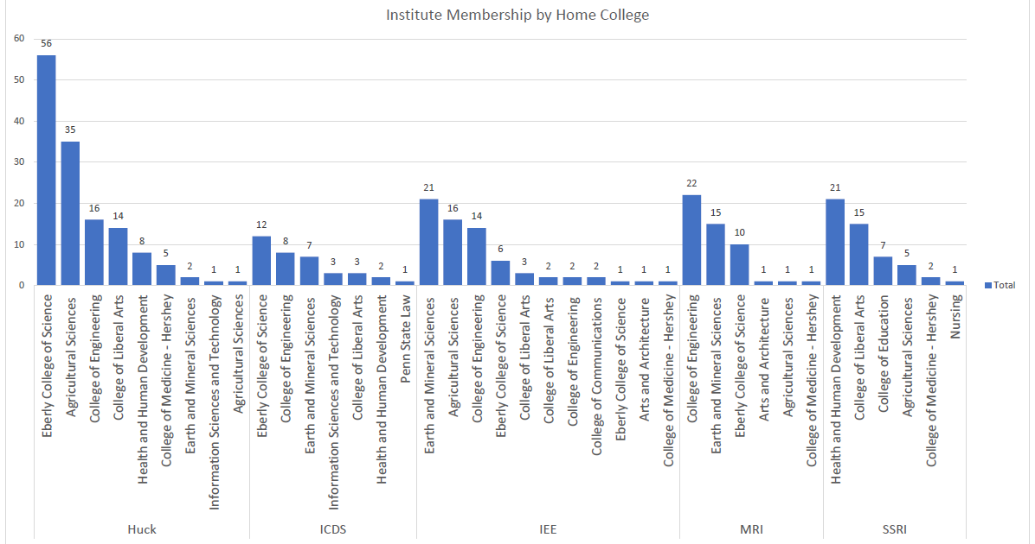
Co-Hires (Currently Active)
284 individual faculty members
11 faculty members co- funded by 2 institutes

Slide 10
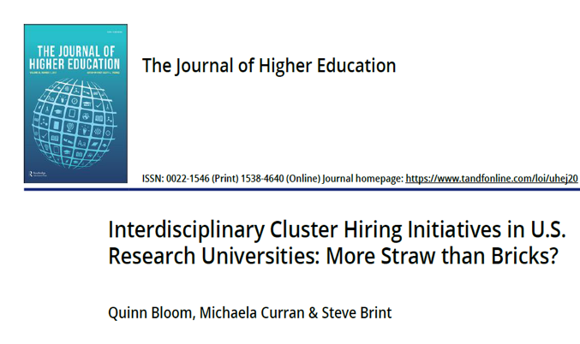
Interdisciplinary Collaboration & Co-Hires
Differentiators
Genuine partnership between deans & directors
Shared vision, shared expectations
Institute directors are top scholars
Exceptionally attractive to junior hires
Professional staffing of shared resources
Dedicated staff maintain and operate core facilities
Seed grants
High risk-high payoff collaborations, bold forays into new research directions, and creation of new partnerships.
Gathering performance metrics
~41% receive external funding
“There are exceptions to this rule. One university in our sample stood out…”
Dec 3, 2019
Notes:
What makes our institutes different – and thus, more successful? [talk about differentiators]

Slide 11
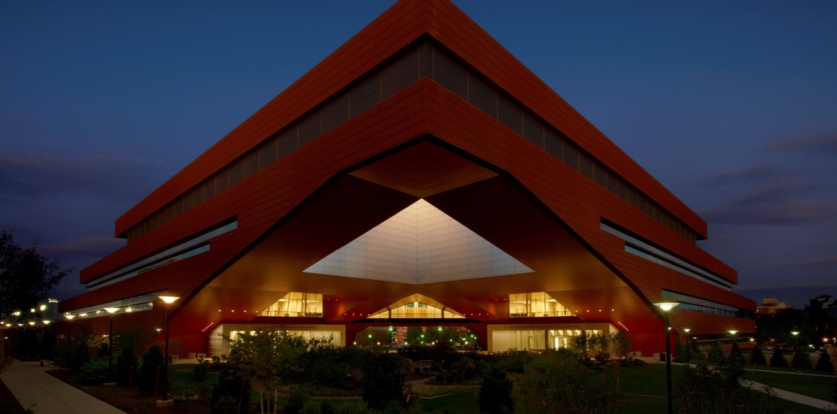
Mission of the Interdisciplinary Research Institutes
Community of Colleagues
Seminars & Workshops
Team Building for Research Initiatives
Co-Funded Appointments
Core Facilities
Seed Funds for Scholarship/Research
Notes:
Each institute is a bit different, but they share the same overall mission and offer you an incredible wealth of resources to take your work to the next level. I encourage you to take advantage of the many events, seminars, and funding workshops meant to connect you with colleagues with similar interests, but importantly, in different colleges or research areas. As part of our strategy to build research strength in certain areas, our institutes also co-fund many faculty; and of course the institutes offer several seed grant programs each year.

Slide 12
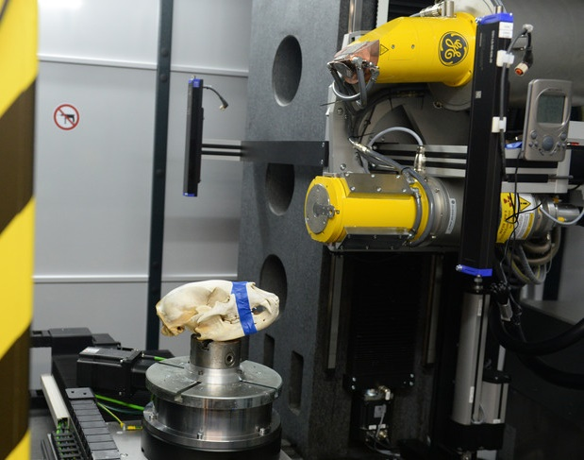
Research Instrumentation
The 7 interdisciplinary research institutes operate core shared facilities available to internal and external users.
Includes more than 300 instruments and services.
capabilities.psu.edu
Micro CT Scanner at the Center for Quantitative Imaging.
Notes:
We have made huge investments in shared research facilities. This includes research facilities such as the Millennium Science Complex you see in this photo, home to the Materials Research Institute on one side on the Huck Institutes of the Life Sciences on the other. Our shared core facilities include not only instrumentation and full-time expert staff to operate them, but services such as those offered by the Social Science Research Institute.
Photo explanation: Micro CT Scanner at the Center for Quantitative Imaging.

Slide 13
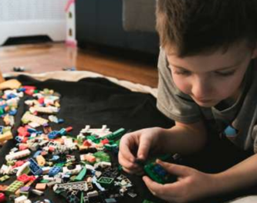
Social Science Research Institute (SSRI)
SSRI 2015-2020 Strategic Aims
Smart and Connected Health
The Human System
Social Disparities
Data ←→ Knowledge ←→ Impact
Innovative Methods
Dissemination and Implementation Science
Example program: Child Maltreatment Solutions Network.
In 2017, the Network was awarded the first-ever Capstone Center Grant from NIH for child maltreatment prevention research
Notes:
Let’s briefly discuss the institutes – this is a rapid fly-through, so again, I encourage you to explore each one further.
First, the Social Science Research Institute, or SSRI. In their recent strategic plan, SSRI faculty identified 5 aims that build on distinctive strengths in PSU social and behavioral sciences; our increasing investments have sparked innovation and impact. And example is the
In 2016, the network launched a first-of-a-kind, five-year study aimed at illuminating the bio-psych-social mechanisms that underlie the long-term negative health consequences of child maltreatment. In 2017, the network was awarded the first-ever Capstone Center Grant from the NIH for child maltreatment prevention research.

Slide 14
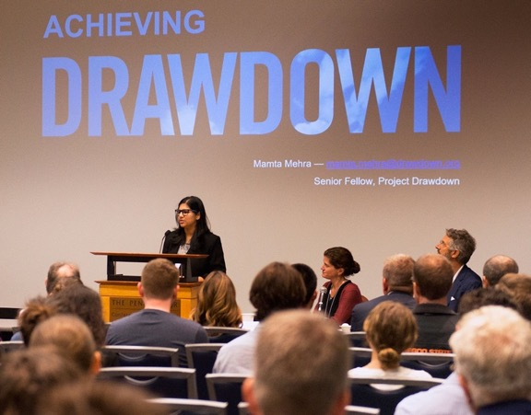
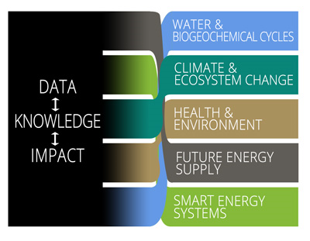
Institutes of Energy and the Environment (IEE)
More than 500 collaborating faculty
The mission of IEE is to foster and facilitate interdisciplinary scholarship and collaboration to positively impact important energy and environmental challenges.
Example program: Project
Drawdown
Notes:
The Institutes for Energy and the Environment includes more than 500 collaborating faculty working on research to solve energy and environmental challenges. A key goal of the institute is to translate data into knowledge and technical innovations, and its operations include the Energy and Environmental Sustainability Laboratories, which encompasses six laboratories with shared instrumentation. As part of the commitment to research-to-action in 2019 IEE hosted the first international Project Drawdown conference here at University Park, which brought in participants from across the globe.

Slide 15
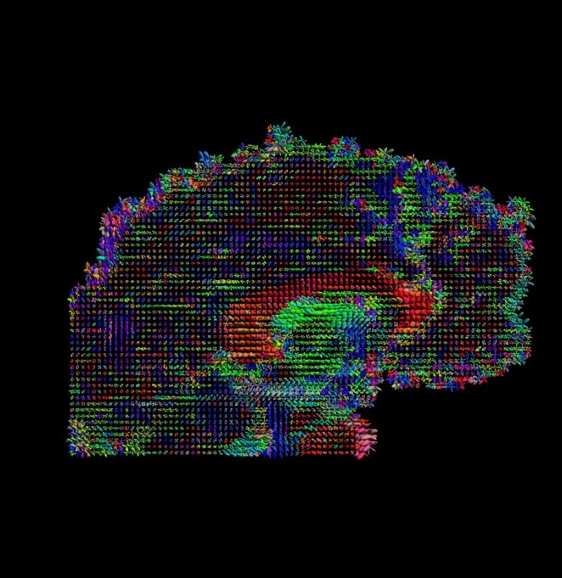
Institute for Computational and Data Sciences
ICDS supports researchers in applying big data and big simulation methods across the research landscape.
ICDS maintains the ICDS Advanced Cyber Infrastructure (ICDS-ACI), Penn State’s primary HPC system for researchers.
ICDS offers
36,500 computing cores
25 PB of storage
A dynamic software stack of broadly used research applications
~890 gigaflops of total peak theoretical performance
ICDS-powered study using data from the Human Connectome Project to better understand the correlations between brain features
Notes:
The Institute for Computational and Data Sciences, ICDS, is the computing engine powering our big data research. ICDS recently unveiled a brand new, state of the art data center to house our supercomputer, which was just given a new name by the Penn State community. ICDS’s mission is to help you apply big data and data simulation methods in your work. They offer world class service, but also offer other services like data visualization workshops and even grant-writing support.
Photo explanation : This image is from an ICDS-powered study using data from the Human Connectome Project to better understand the correlations between brain features, such as cortical thickness and connectivity, and various behaviors.

Slide 16
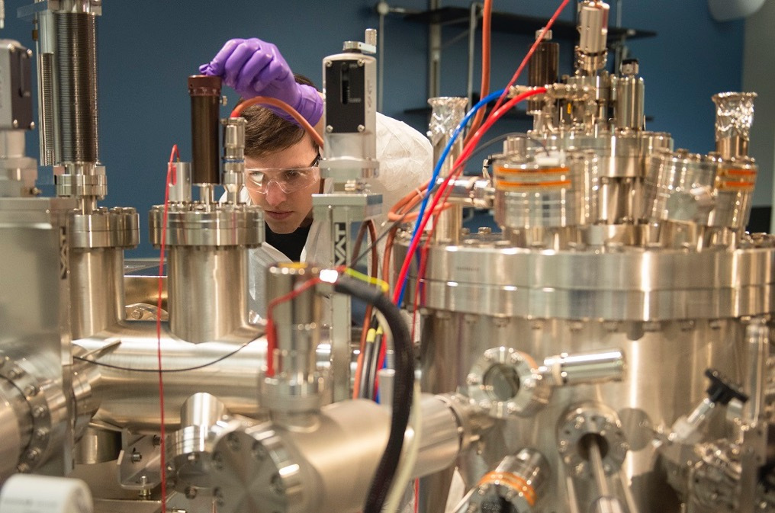
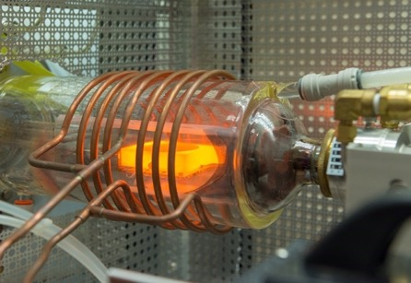
Materials Research Institute
State of the art shared core facilities supporting multidisciplinary research, education, and industry.
Example Project: The 2D Crystal Consortium (2DCC) is an NSF Materials Innovation Platform (MIP) national user facility focused on advancing the synthesis of 2D chalcogenides for next generation electronics.
One of only 2 NSF Materials Innovation Platforms in the U.S
Angle-resolved photoemission spectrometer
Notes:
The Materials Research Institute, MRI, is committed to furthering our research around Bio-inspired engineering, In Situ characterization, 2D materials, humanitarian materials engineering, additive manufacturing, and electrocaloric technologies.
Photo: Tim Pillsbury, graduate research assistant at MRI, working with an angle-resolved photoemission spectrometer (APSE).
An example initiative is the 2-D Crystal Consortium, 2DCC, directed by Dr. Joan Redwing. 2DCC, one of only 2 NSF Materials Innovation Platforms in the U.S., is focused on the development of two dimensional materials, only a few atoms thick, for applications in next generation electronics beyond silicon for digital circuits and flexible electronics.
I don’t know what this bulb looking photo is but it’s from Clive and involves the 2DCC! - amanda

Slide 17
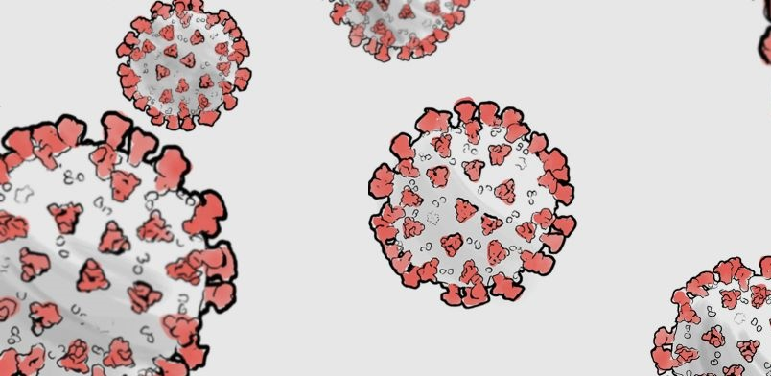
Huck Institutes of the Life Sciences
Promoting excellence in research and graduate training in the life sciences.
The Huck Institutes include:
30 research institutes and centers of excellence
11 shared core instrumentation facilities
7 advanced graduate programs
Recent project: In March 2020, Huck launched a rapid-response RFP for Penn State researchers seeding proposals to address the emerging COVID-19 outbreak.
Notes:
The Huck Institutes of the Life Sciences includes 8 participating colleges, 26 research institutes/centers of excellence, 11 core instrumentation facilities, 7 advanced graduate programs. Of course in recent months, it has become a foundational body for COVID research at Penn State; In addition to providing epidemiological expertise to the University, the surrounding community and our research peers, Huck moved immediately in March 2020 to launch a rapid-response RFP for Penn State researchers seeking proposals to address the emerging COVID-19 outbreak. More than 110 applications were submitted, and 47 faculty research teams from across 10 Penn State colleges were granted seed-funding.

Slide 18
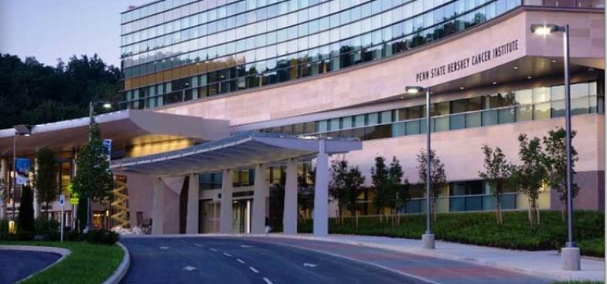
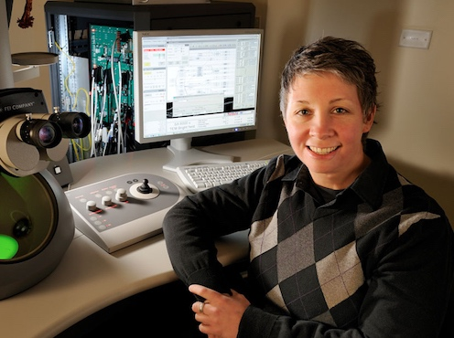
Penn State Cancer Institute
A premier academic oncology center that encompasses clinical care, research, education, and outreach.
Example Research:
Deborah Kelly, Cancer Institute, Huck, Engineering
Developed new field of structural oncology, studying the protein players of cancer at the atomic scale, utilizing Huck’s Cryo-electron microscope
Notes:
The Cancer Institute is not only a research institute, but it includes our clinical treatment center on the Penn State Health Milton S. Hershey Medical Center campus. We have several researchers looking at disease treatment at the molecular level, and one of those is Cancer Institute and Huck Institutes researcher Deborah Kelly, who joined Penn State in Jan. 2019. She actually utilizes Huck’s Cryo-electron microscope, which demonstrates the cross-collaboration we have even between institutes.

Slide 19
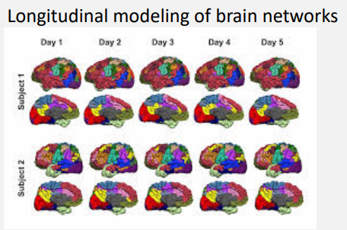
Clinical and Translational Science Institute
Accelerating discoveries to benefit human health.
Featured Resource: Center for Big Data Analytics and Discovery Informatics
Headed by Vasant Honavar, CTSI, IST
Research interests around AI:
Predictive modeling from big data
Predicting protein-RNA, protein-protein interfaces and complexes
discovery-informatics.ist.psu.edu
Notes:
Example: Center for Big Data Analytics and Discovery Informatics
Brain inspired machine learning
https://www.wpafb.af.mil/Welcome/Fact-Sheets/Display/Article/842033/afosr-information-and-networks/#anchor10

Slide 20
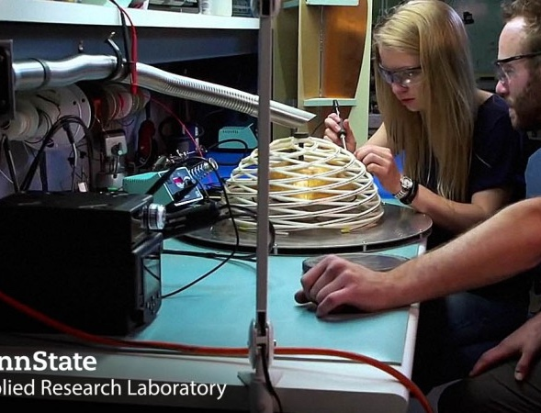
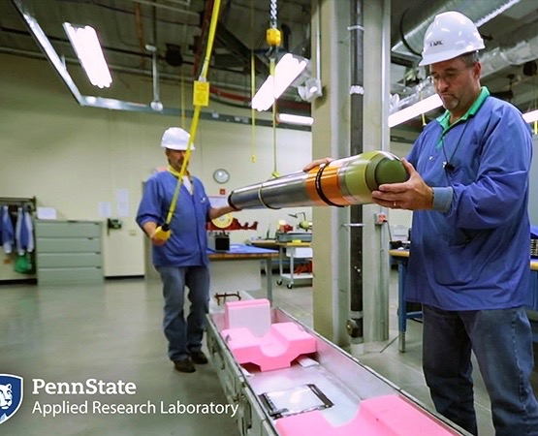
Applied Research Laboratory
University Affiliated Research Center (UARC)
Was approved by the Navy to execute up to $2.1 billion in research over 10 years aimed at improving U.S. national security.
Has supported nation’s security efforts for more than 75 years with basic and applied research.
www.arl.psu.edu
Electro Optics Center
Navy’s Technical Agent for Electro Optics
www.eoc.psu.edu
Notes:
ARL is our DoD designated University-Affiliated Research Center (UARC), and we are proud to support the U.S. Navy for more than 70 years with basic and applied research. ARL commits 25% of its fee (profit) to supporting students across Penn State (graduate and undergraduate)—that amount totaled $2M in FY18.
ARL’s operations include the Electro Optics Center: Photo https://www.wpafb.af.mil/Welcome/Fact-Sheets/Display/Article/842036/afosr-physical-sciences/#anchor4

Slide 21
Research Compliance

Slide 22
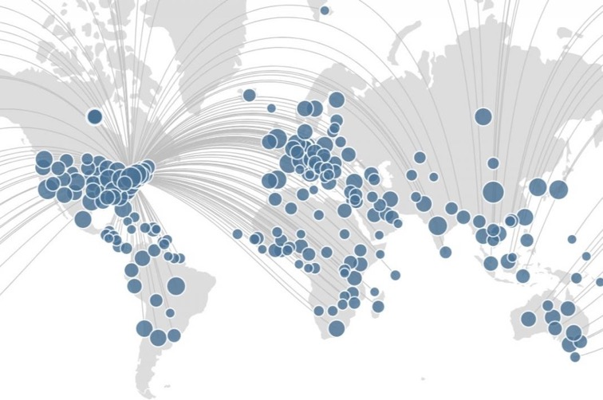
Disclosing International Activities
While most international collaborations are acceptable and encouraged, we urge researchers to err on the side of transparency.
It protects everyone’s interests – the Federal government, Penn State, individual PIs, and their international collaborators – to have international relationships disclosed and vetted to determine if there are any potential conflict of commitments, duplications of research, and/or diversion of intellectual property in the performance of federally funded research.
Our website details the steps you can take to protect yourself and your research. New guidance and clarifications are being issued on a rolling basis; agency-specific updates are sent to research administrators, those with active grants and are posted here: research.psu.edu/international_affiliations

Slide 23
Outside Professional Commitments
Outside business activities cannot exceed 40 hours per month.
Special care should be exercised in executing private consulting contracts or arrangements.
Contracts should be examined to ensure that the assignment of rights to intellectual property evolving from consulting activities does not conflict with the patent agreement signed by all faculty; and
Any associated compensation will likely require a financial disclosure by the faculty involved.
AC80 - Outside Business Activities and Private Consulting
policy.psu.edu/policies/ac80
AD77 - Engaging in Outside Professional Activities (Conflict of Commitment)
policy.psu.edu/policies/ad77
RP06 - Disclosure and Management of Significant Financial Interests
policy.psu.edu/policies/rp06
Notes:
As a reminder, Faculty are encouraged to engage in outside activities when such activities enhance the mission of the University and do not compete with the University. We encourage everyone to make yourselves familiar with these three policies, and of course you must understand these policies if you do any work outside of the University that is related to your research.

Slide 24
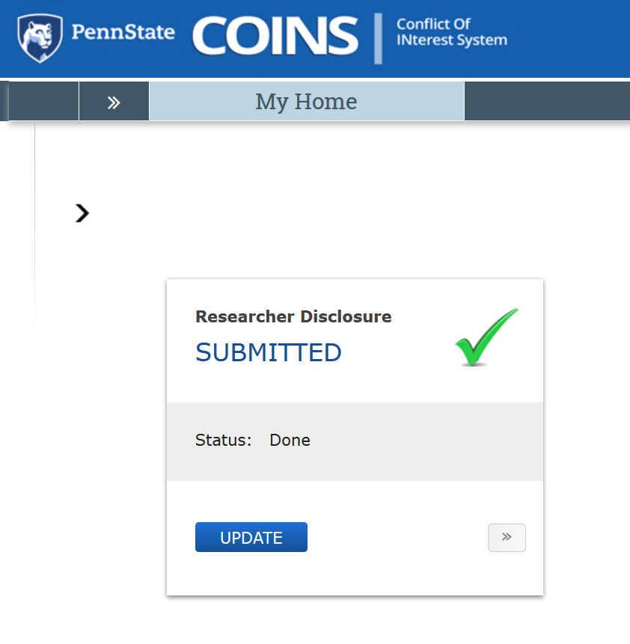
Significant Financial Interests (“SFI”)
Investigators are required to disclose personal financial interests that are related to his/her institutional responsibilities. You must disclose when:
You are hired*
At least annually
Within 30 days of discovering or acquiring a new SFI
Prior to submission of research proposals related to the SFI
If the COI Committee determines a potential or perceived conflict between the disclosed SFI and Penn State research, it will work with the investigator to reduce or eliminate the conflict.
See RP06: guru.psu.edu/policies/RP06.html *New faculty will receive an email to complete a disclosure this fall
Notes:
COINS is the system you will use to complete your disclosures. It’s a short process and you will receive emails when your disclosures are due.

Slide 25
Data Management and Integrity
Researchers are responsible for:
Ensuring the integrity of their data
RP02 policy.psu.edu/policies/rp02
Ensuring that the data from published papers are publicly accessible
datacommons.psu.edu
Properly archiving data
AD22 – Health Insurance Portability and Accountability Act (HIPAA)
AD35 – University Archives and Records Management
AD53 – Privacy Policy
AD95 – Information Assurance and IT Security
AD96 – Acceptable Use of University Information Resources

Slide 26
Research Administration and Support

Slide 27
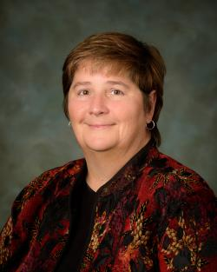
Office of Research Protections (ORP)
Leadership: Candice Yekel, Associate Vice President for Research and Director, ORP
research.psu.edu/orp
Human Research Protection Program (IRB)
Animal, Biosafety, and Isotope Research Protection Program (IACUC, IBC, UIC)
Dual Use Research of Concern
Scientific Diving Program
Unmanned Aircraft Program
Human Embryonic Stem Cells
Conflict of Interest Program
Education & Quality Management
Research Misconduct Inquiries & Investigations
Remember: You are a role model for your students
Notes:
The Office of Research Protections, ORP, is here to assist those of you who work with human subjects, animals etc. will be required to secure appropriate approvals
We want to emphasize your role as “examples” for your students – we want to instill good habits to help ensure our research activities are in compliance and done with integrity. We ask that you engage in regular conversations with your faculty and with your students about the issue surrounding research practices; everything from authorship, how it is determined and what is proper, to proper citation practices, notebook maintenance etc. Every year our office see cases of misconduct. The cases we adjudicate are usually faculty cases, but these people were once students. The habits we promote will last a life time; lets insure they are good habits.

Slide 28
ORP Training for Investigators
Required Training: research.psu.edu/education
Scholarship and Research Integrity (SARI@PSU) = training in the responsible conduct of research
Required for faculty: Any CITI online training OR 2 hours of discussion-based activities, plus 1 hour continuing education every 3 years: citi.psu.edu
ORP’s education arm is a central resource for:
IRB training (human subjects research)
IACUC training (research activities involving vertebrate animals)
Biosafety training (research activities involving biohazardous materials and/or bloodborne pathogens)
Trainings on UIC, IBC, UAS, GCP, GLP, DURC (based on your research)
Compliance system training (IRB, IACUC)
Notes:
The SARI@PSU program provides the foundational training for research integrity as well as training on the systems that you and your students will use to manage compliance, such as the IRB, IACUC and Biosafety trainings. ORP’s coverage is vast, and also includes safety and compliance for drone operations and dive safety. If you have a question, reach out! ORP, like all of our units, is committed to supporting you.

Slide 29
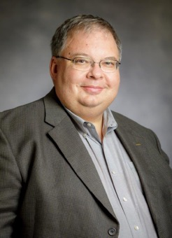
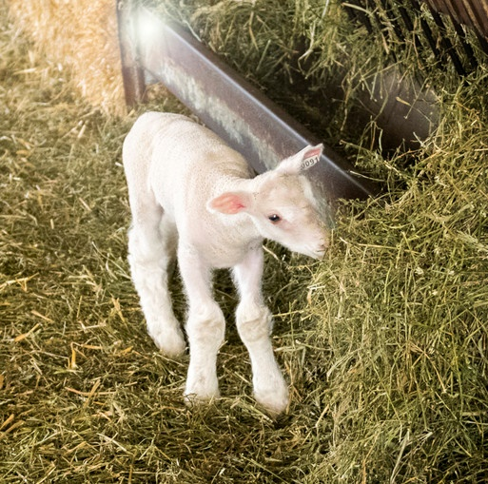
Animal Resource Program
Leadership: Todd Jackson
Veterinary Services
Education & Training
Purchase & Transportation
Experimental Guidelines
Husbandry/ Breeding
Research.psu.edu/arp
Notes:
ARP provides support and world-class care for animals used in teaching and research at University Park.
ARP is your resource for training materials for your students, information on purchase and transportation, and experimental guidelines.

Slide 30
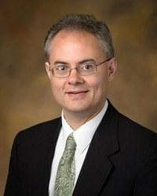
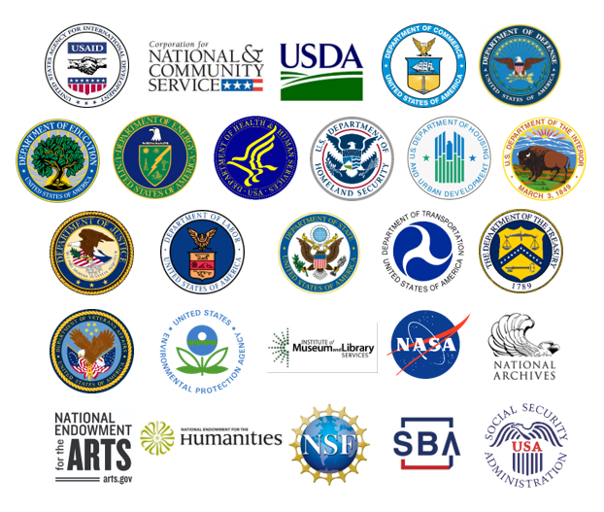
Office of Sponsored Programs (OSP)
Leadership: John Hanold, Associate Vice President for Research and Director, OSP
Processes proposals and negotiates grants and NDAs
Coordinates with research administrators across Penn State to ensure that all sponsored funds are administered in accordance with the agreed upon terms and conditions.
research.psu.edu/osp

Slide 31
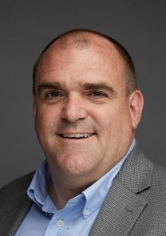
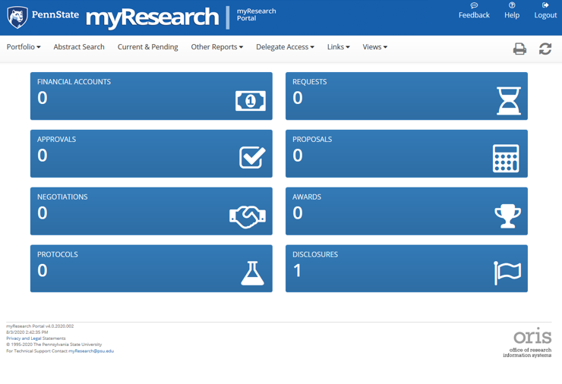
Office of Research Information Systems (ORIS)
Leadership: Jim Taylor, Director, OSP
ORIS administers research administration software systems
My Research Portal – centralized management of financial information, agreement requests (NDAs), proposal administration steps, conflict of Interest disclosures and more.
Provides investigators an integrated view of sponsored portfolio data
Simple tools to support the PI
Current and Pending report
Export financial data to Excel
MyResearch.psu.edu
New SIMBA portal

Slide 32
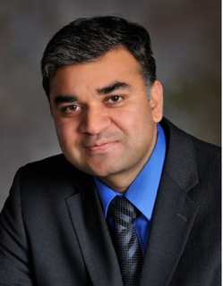
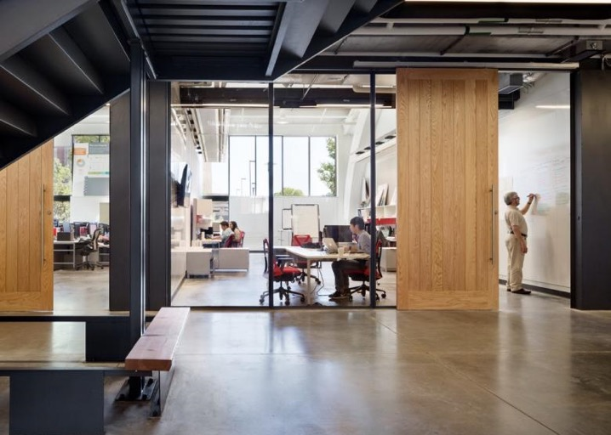
Strategic Initiative Submissions
Leadership: Shashank Priya, Associate Vice President for Research and Director of Strategic Initiatives
Strategic Interdisciplinary Research Office (SIRO) – Grant development and administration support for large, interdisciplinary projects
Service request form available at research.psu.edu/siro
Limited Submissions: research.psu.edu/limitedsubs
Penn State at the Navy Yard: NavyYard.psu.edu

Slide 33
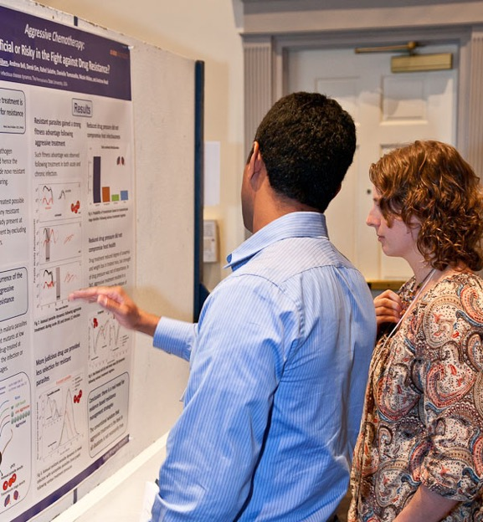
Office of Postdoctoral Affairs (OPA)
Leadership: Pallavi Eswara, Director, OPA
OPA manages all aspects of the unique and valuable relationship Penn State has with its postdoctoral scholars. This includes:
Travel
Benefits
Moving/residency
Collaboration and networking events
Research.psu.edu/opa
Notes:
Photo: Postdoc research exhibition in 2013

Slide 34
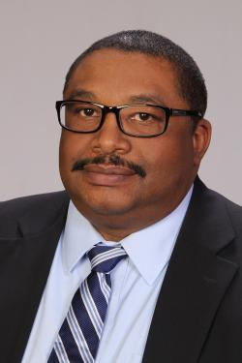
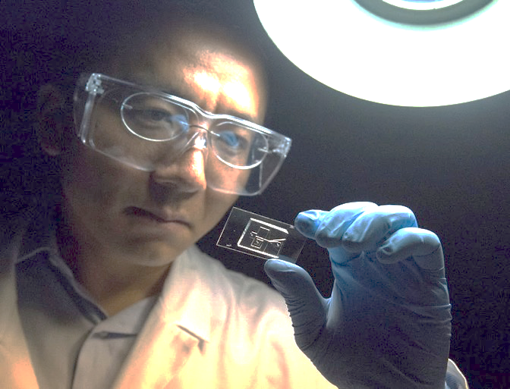
Office of Technology Management (OTM)
Leadership: Harl Tolbert, Assistant Vice President for Research and Director of OTM
Works with PIs to protect intellectual property, support researchers in the patent process, and work with corporate partners in licensing Penn State technology
Technology disclosure form and invention disclosure portal available at: research.psu.edu/otm
Notes:
Image: Professor Tony Jun Huang's work in using acoustic waves to sort cells on a chip formed the core of start-up company Ascent Bio-Nano LLC, with assistance from the Ben Franklin TechCelerator program, which helps Penn State faculty bring their research to the commercial marketplace.
Image: Patrick Mansell
2014

Slide 35
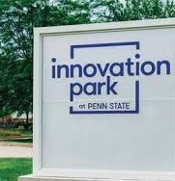
Office of Industrial Partnerships (OIP)
Works with PIs and external partners to support research collaborations with industry
Corporate Engagement Center supports PIs developing industry-funded research relationships, corporate visits to campus, and more: CorporateEngagement.psu.edu
Innovation Gateway provides opportunities for industrial research projects: InnovationGateway.psu.edu
PennTap
Innovation Park
Snap-Shot of Companies
23 Incubator Tenants
7 Incubator Graduates
11 from Local Area
7 from PSU relationship
1 coupled with research
3 in process
8 showing interest
Notes:
Image: Morgan Advance Materials Carbon Science Center of Excellence at Innovation Park.

Slide 36
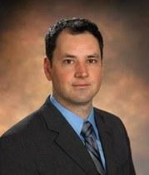
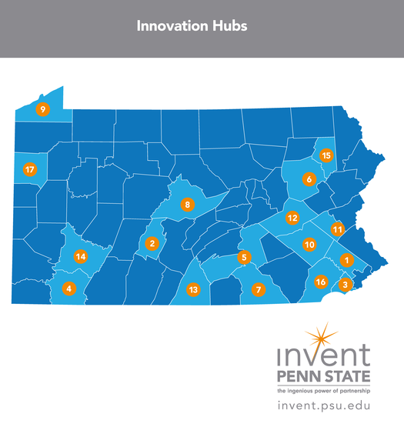
Office of Entrepreneurship and Commercialization (OEC)
Leadership: James Delattre, Associate Vice President for Research and Director of OEC
Invent Penn State: Invent.psu.edu
Innovation Hubs
Startup Week
NSF I-Corps Program
Fund for Innovation
Venture & IP Conference and more

Slide 37
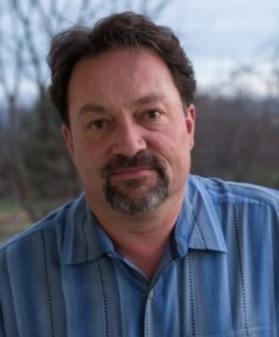
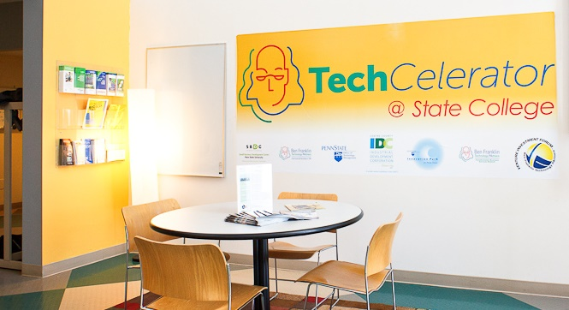
Ben Franklin Technology Partners of Central and Northern PA
Leadership: Steve Brawley, President and CEO
Invests in tech-based startups in 32 counties in PA
cnp.benfranklin.org

Slide 38
More Resources
Find Research
A searchable database of PSU researchers and papers: Pure.psu.edu
Find Computing/Data Resources
Find networking services, tools, data sources and more. ResearchData.psu.edu
Find Funding
Links to internal and external funding resources Funding.psu.edu
Find Instrumentation
Penn State’s shared core facilities Capabilities.psu.edu
Notes:
If you’re not feeling overwhelmed yet, don’t worry, there’s still time.
We know it’s a lot to navigate, so we have some tools to help you. The research.psu.edu website is a clearinghouse of all these units, departments, resources, institutes, and policies. The sites on this slide are also there, but you may find these shortcuts handy:
If you’re interested in finding collaborators at Penn State, it can be a challenge to search through all 5300. Pure.psu.edu is a great place to start, though. New faculty will be added this fall.
A catalog of computing services for research projects can also be found at researchdata.psu.edu.
We have several avenues to support your funding efforts – this includes SIRO, but also our funding opportunity database, Funding Institutional. You can find information on these at funding.psu.edu.
And lastly, for links to our institutes and the shared core facilities, you can visit capabilities.psu.edu.
Again, these are shortcuts to resources listed on the research.psu.edu website.

Slide 39
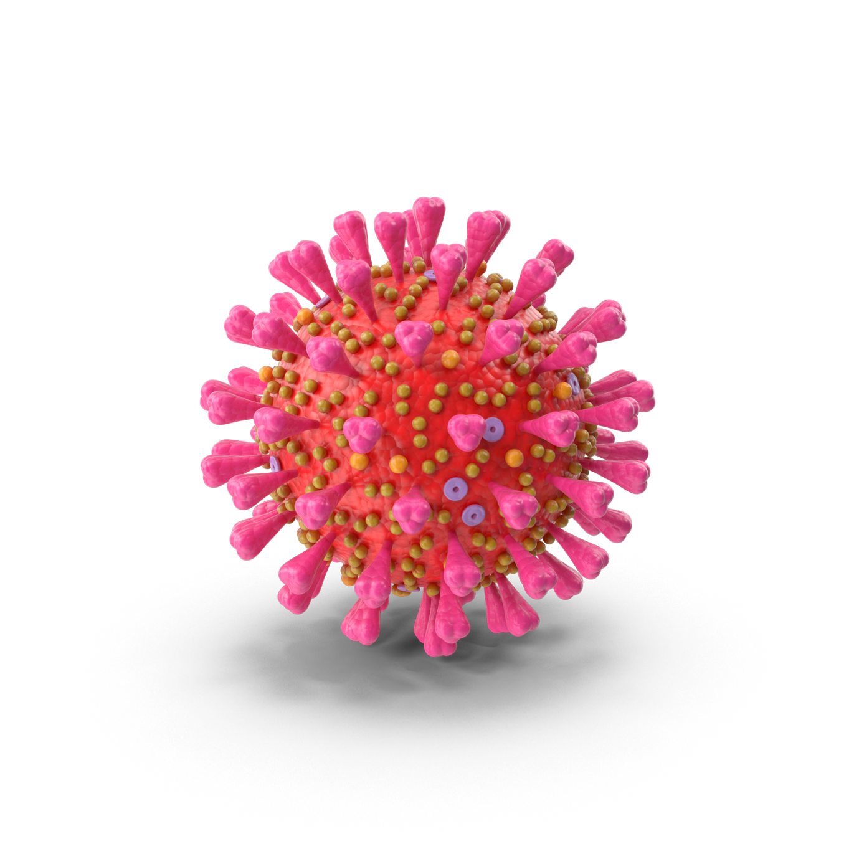
COVID-19 and Research Activity
Your dean or institute director is your primary source for guidance on conducting research amid COVID-19:
Each unit has research ramp-up and ramp-down plans that take into account unique and current circumstances for each unit, lab or campus location.
The Research.psu.edu website will have a link on its homepage directing you to information about COVID-19 and research activities.
Notes:
Lastly, the research website also offers guidance on navigating research activities in a COVID world. Your dean or institute director is your first point of contact for questions on how to operate. Our institution and campuses, labs and facilities are so broad and geographically spread out, including a full medical center in Hershey and medical operations at UP, that you will need to understand your specific requirements and procedures.

Slide 40
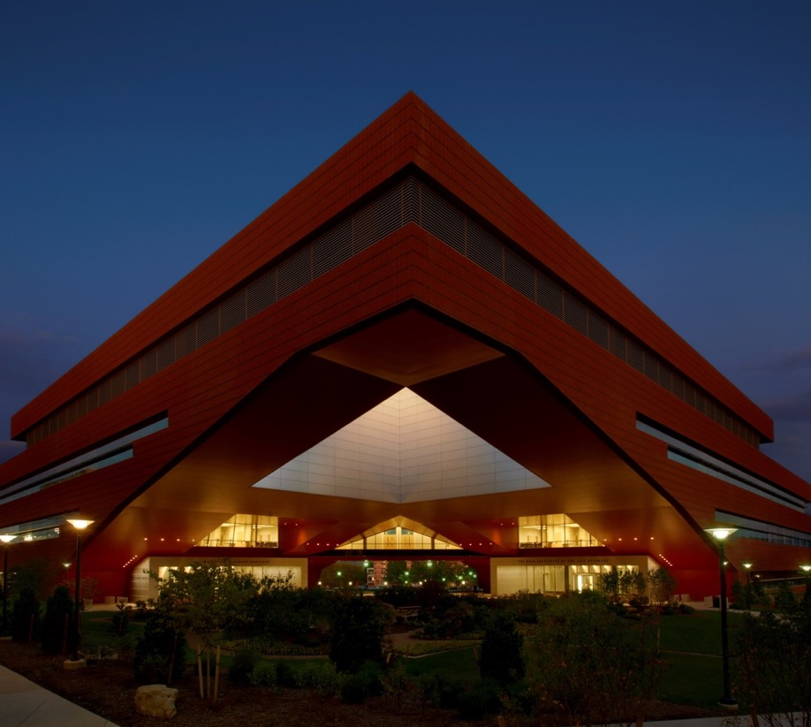
Rapid Response to COVID-19
February 18: Penn State became the first U.S. university signatory on the Wellcome Trust statement for providing immediate open access to research findings related to COVID-19.
March 3: Huck Institutes of the Life Sciences and Huck Family Endowment launch seed funding for COVID-19 research proposals.

Slide 41
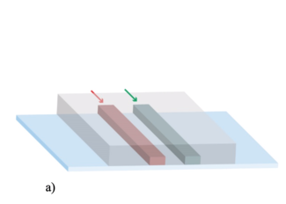
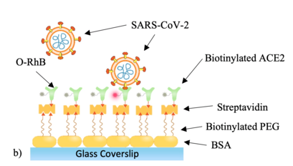
Seed Grants: $2.25 million Awarded to 47 teams
Example Seed Grant
Paul Cremer, Professor of Chemistry
Developing sensors to detect coronavirus in enclosed spaces.
Inexpensive, real-time sensors that continuously monitor for SARS-CoV-2 in enclosed spaces, such as a large conference room,
Identify the presence of an infection before it spreads.
41

Slide 42
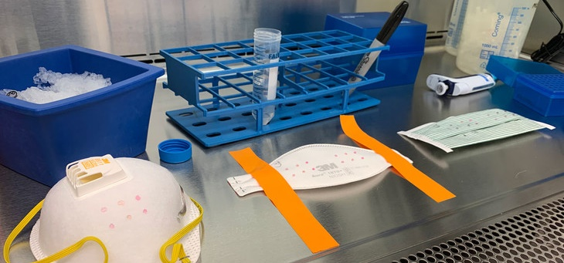
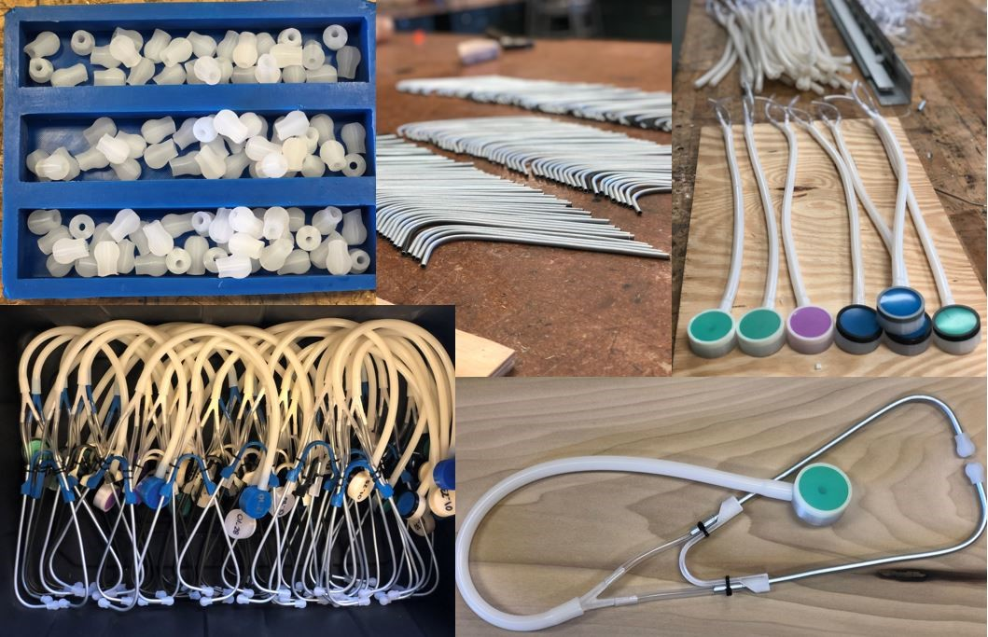
Grassroots Faculty Engagement: MASC
Manufacturing And Sterilization for COVID-19 (MASC)
Donors, community members, and researchers can get involved at:
www.masc.psu.edu
42

Slide 43
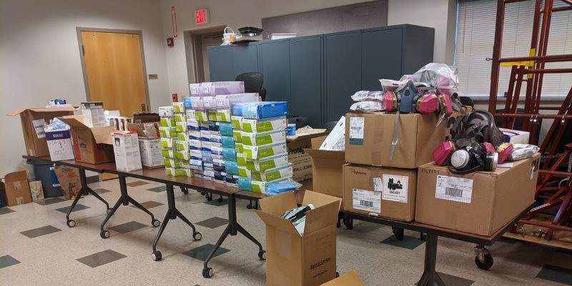
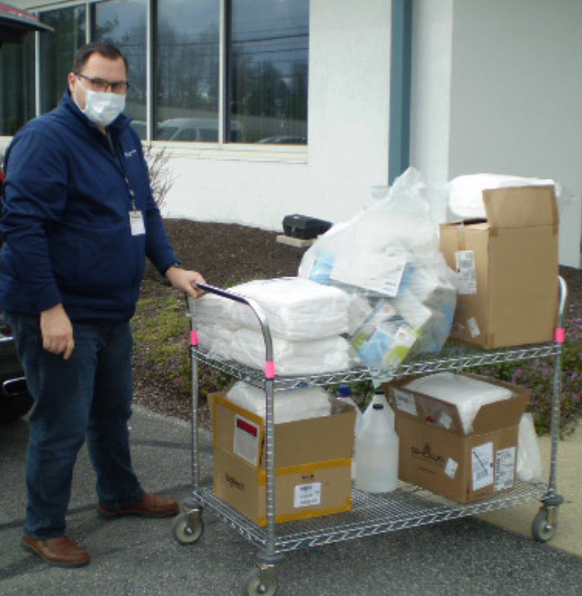
Penn State for PA
Penn State donated 10K pieces of personal protective equipment (PPE)
43

Slide 44
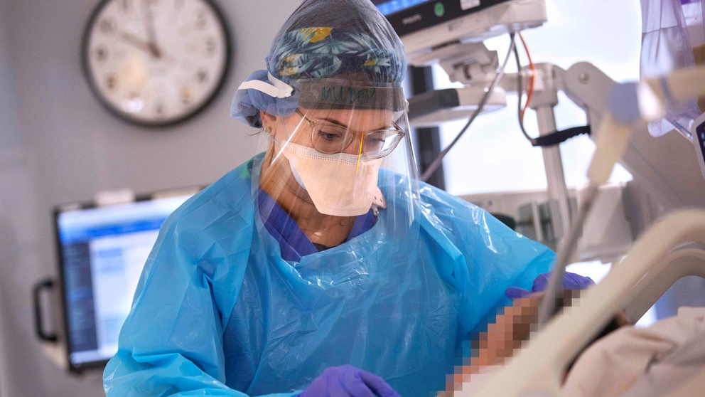
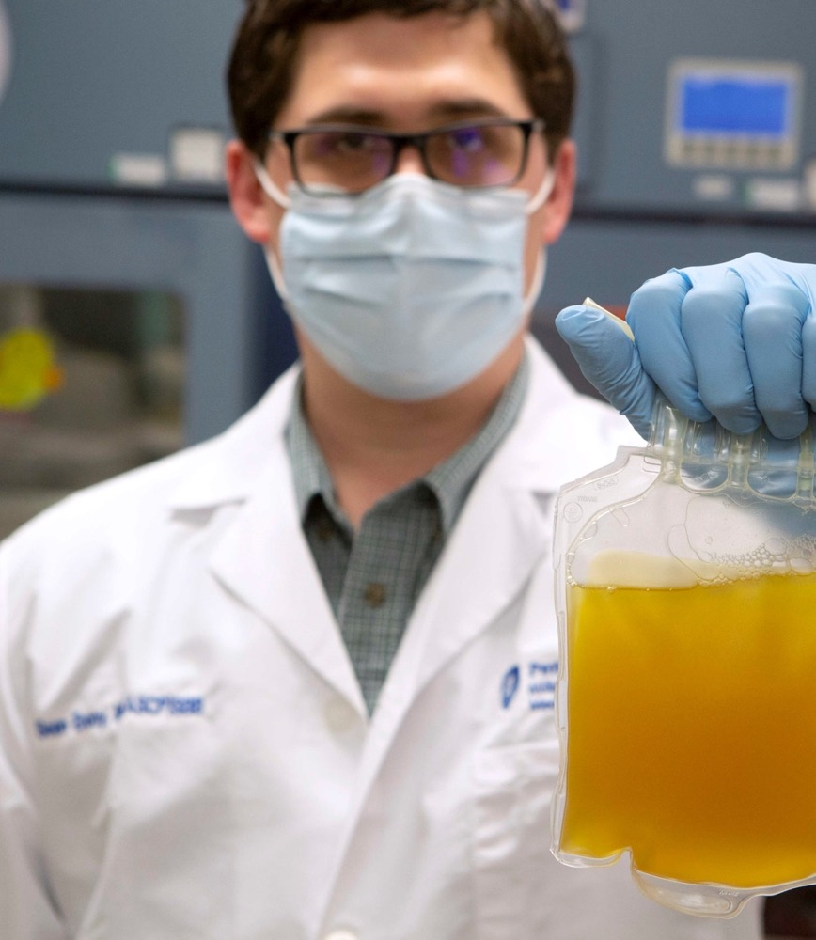
On the Front Lines
Penn State Health hospitals now using plasma from recovered patients as possible treatment for COVID-19
Hershey Medical Center joins clinical trial evaluating antiviral drug remdesivir
44

Slide 45
Interdisciplinarity: Our Strength
Colleges of Arts & Architecture and Engineering teamed up to design a glove-box nursing booth.
Huck’s Center for Infectious Disease Dynamics (CIDD) launched a video outreach series to answer the public’s basic questions about the pandemic.
www.AskCIDD.psu.edu
45

Slide 46
We are here to support your Research!
Research.psu.edu
@PSUResearch

