Slide 1
Welcome to Penn State and University Overview
Dr. Nicholas P. Jones
2020 New Faculty Orientation
Thursday, August 20, 2020
Office of the Executive Vice president and provost
Notes:
JONES – Slide 1 of 20:
Welcome to Penn State and University Overview

Slide 2



The Provost’s Role
Chief Academic Officer and Chief Budget Officer
Direct reports across variety of areas/units
Engagement with University Faculty Senate, President’s Council, and Academic Leadership Council
OFFICE OF THE EXECUTIVE VICE PRESIDENT AND PROVOST
Notes:
JONES – Slide 2:
The Provost’s Role

Slide 3
Penn State By the Numbers
24 campuses throughout the Commonwealth, plus the World Campus
Nearly 97,000 students and 30,000 full-time employees, including faculty, and more than 700,000 living alumni
More than 160 baccalaureate and 190 graduate degree programs
Penn State Health Milton S. Hershey Medical Center: 1 million+ patients
Annual research funding in 2019-20: $968 million
Impact: Recent study shows Penn State contributes about $11.6 billion to the Pennsylvania economy, supporting more than 105,000 jobs
OFFICE OF THE EXECUTIVE VICE PRESIDENT AND PROVOST
Notes:
JONES – Slide 3:
Penn State By the Numbers

Slide 4


Multi-Campus Structure:
We Are Not a “System”
Abington Greater Allegheny
OFFICE OF THE EXECUTIVE VICE PRESIDENT AND PROVOST
Notes:
JONES – Slide 4:
Multi-Campus Structure: We Are Not a “System”

Slide 5

The Benefits of Penn State’s Unique Structure
One University, geographically distributed
OFFICE OF THE EXECUTIVE VICE PRESIDENT AND PROVOST
Notes:
JONES – Slide 5:
The Benefits of Penn State’s Unique Structure

Slide 6
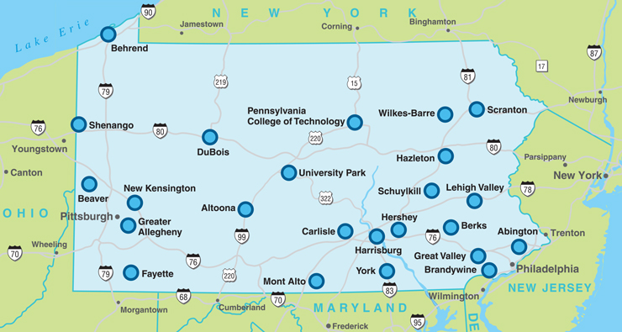
Penn State’s Campuses
OFFICE OF THE EXECUTIVE VICE PRESIDENT AND PROVOST
Notes:
JONES – Slide 6:
Penn State’s Campuses

Slide 7

Enabling Access to Education
About half of first-year students start at a Commonwealth Campus
About 30,000 students total; many adult learners and first-generation students
Most campuses offer first two years of baccalaureate instruction and some
four-year programs, with strategically selected curricula based on student
interest and career orientation
Several thousand students typically transition annually across campuses
OFFICE OF THE EXECUTIVE VICE PRESIDENT AND PROVOST
Notes:
JONES – Slide 7:
Enabling Access to Education

Slide 8
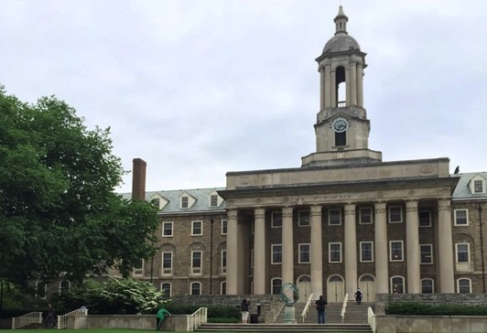
Penn State’s Strategic Plan:
“Our Commitment to Impact”
University-wide plan through 2025
Key Plan Foundation: Engaging
Our Students
Key Thematic Priority: Transforming Education
Faculty critical to these and others
Implementation efforts well underway
strategicplan.psu.edu
OFFICE OF THE EXECUTIVE VICE PRESIDENT AND PROVOST
Notes:
JONES – Slide 8:
Penn State’s Strategic Plan

Slide 9
Funding for Initiative Seed Grants
Grants Awarded:
43
Funds Awarded:
$9,194,150
OFFICE OF THE EXECUTIVE VICE PRESIDENT AND PROVOST
Notes:
JONES – Slide 9:
Funding for Initiative Seed Grants

Slide 10
Signature Initiatives
One Penn State 2025
  An ambitious rethinking of approaches to how we structure learning and operate to support student success
Consortium to Combat Substance Abuse
  Charged with developing and implementing programs, policies, and practices to address the opioid crisis by preventing and treating addiction and mitigating its impacts
Humanities Institute
  Positions Penn State as national leader in the humanities
Center for Immersive Technologies
  Focused on truly transformative technologies, such as virtual and augmented reality, 3D modeling
Consortium for Integrated Energy Systems
  A visionary proposal to build capacity in energy research and education
OFFICE OF THE EXECUTIVE VICE PRESIDENT AND PROVOST
Notes:
JONES – Slide 10:
Signature Initiatives

Slide 11
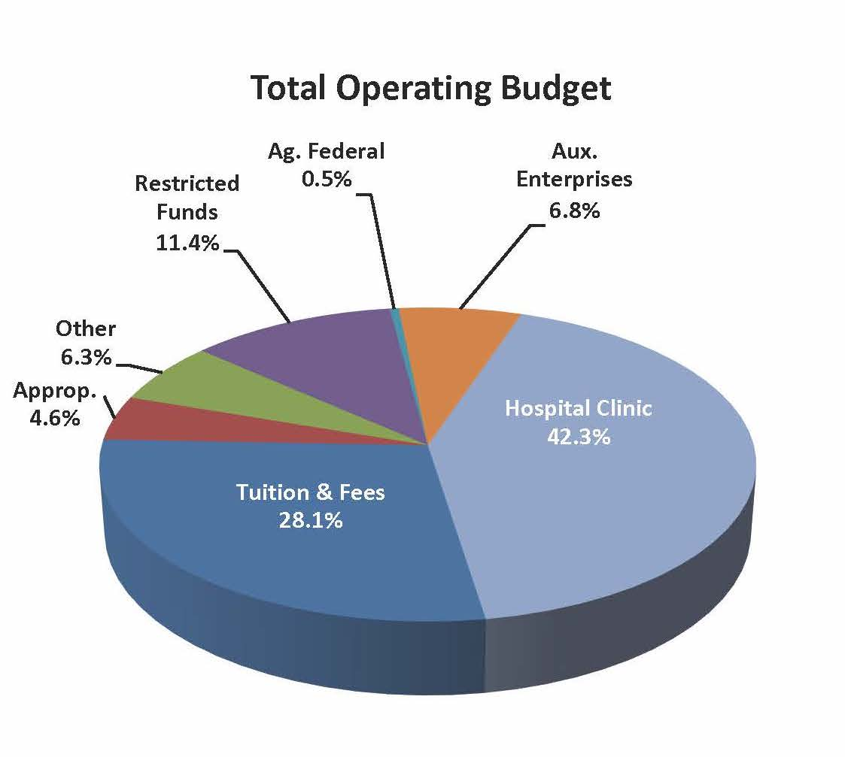
2020-2021
Budget Overview
Total Operating
Budget for 2020-2021:
$6.97 billion
budget.psu.edu
OFFICE OF THE EXECUTIVE VICE PRESIDENT AND PROVOST
Notes:
JONES – Slide 11:
2020-2021 Budget Overview

Slide 12
Budgeted Funds to Support Students
Total 2020-21 Operating Budget $6.97B
Less Self-Supporting Operations:
Auxiliary Enterprises $466M
Restricted and Ag/Federal $820M
Hospital/Clinic $2.95B
Penn College $112M
College of Medicine $209M
Ag Research and Extension $59M
Funding to Support Students $2.36B
(represents most of E&G operating budget)
OFFICE OF THE EXECUTIVE VICE PRESIDENT AND PROVOST
Notes:
JONES – Slide 12:
Budgeted Funds to Support Students

Slide 13
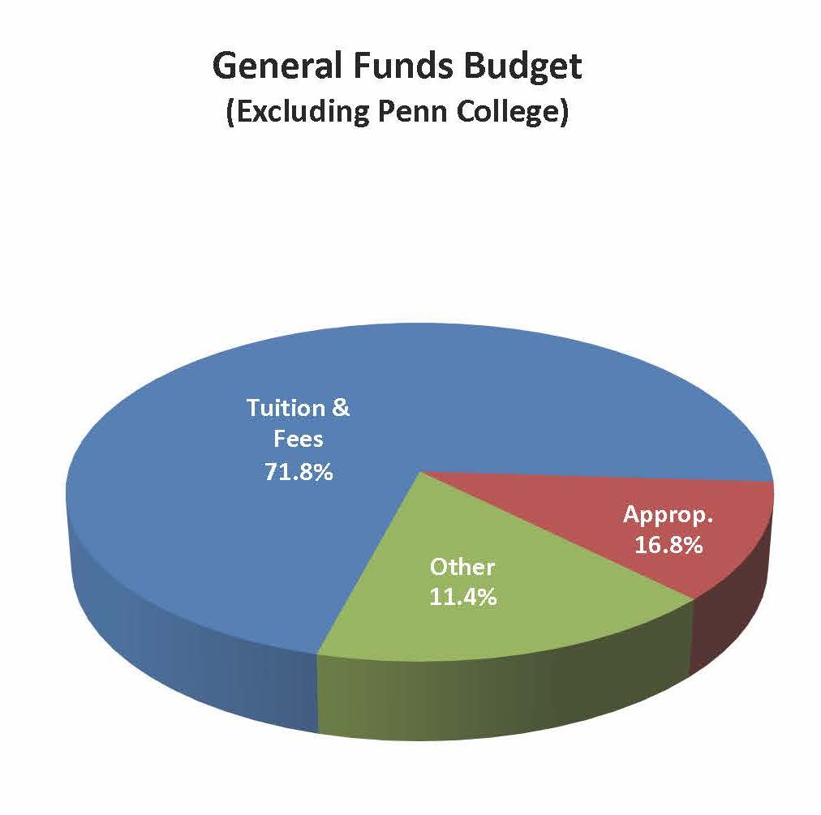
2020-2021
Education
& General
(E&G) Funds
Operating Budget
General Funds:
$2.36 billion
OFFICE OF THE EXECUTIVE VICE PRESIDENT AND PROVOST
Notes:
JONES – Slide 13:
2020-2021 Education & General (E&G) Funds Operating Budget

Slide 14
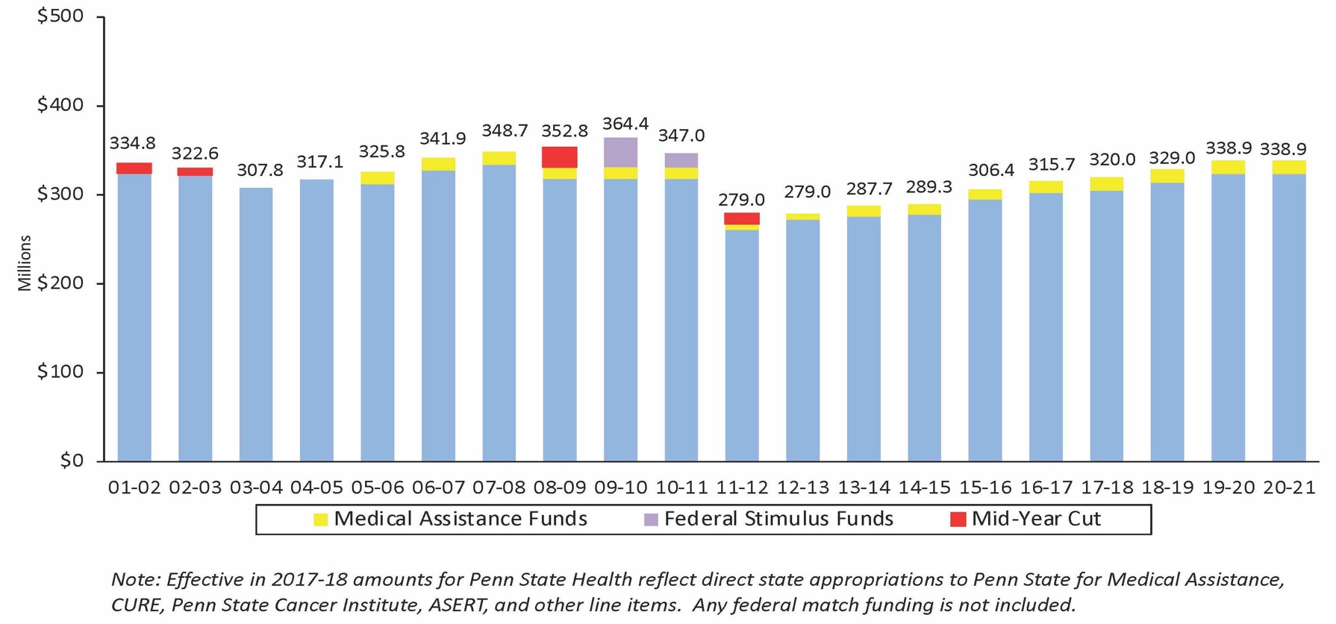
Annual State Appropriation History
Dollars in Millions
OFFICE OF THE EXECUTIVE VICE PRESIDENT AND PROVOST
Notes:
JONES – Slide 14:
Annual State Appropriation History

Slide 15
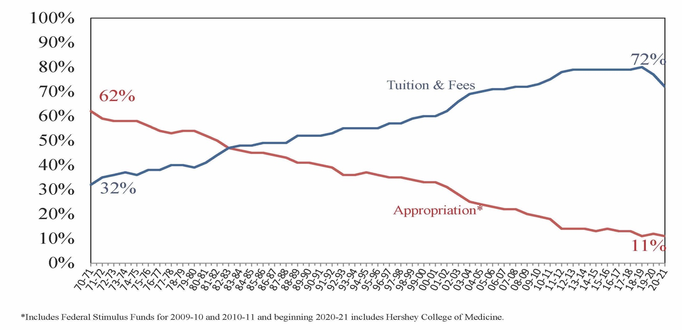
State Appropriation vs. Tuition and Fees as a Percent of General Funds Budget
OFFICE OF THE EXECUTIVE VICE PRESIDENT AND PROVOST
Notes:
JONES – Slide 15:
Appropriation vs. Tuition and Fees as a Percent of General Funds Budget

Slide 16
How Our Revenue Is Spent
OFFICE OF THE EXECUTIVE VICE PRESIDENT AND PROVOST
Notes:
JONES – Slide 16:
How Our Revenue Is Spent

Slide 17

Research at Penn State
More than $968 million in research expenditures in FY19
Highest rating from Carnegie Foundation
Faculty on cutting edge
OFFICE OF THE EXECUTIVE VICE PRESIDENT AND PROVOST
Notes:
JONES – Slide 17:
Research at Penn State

Slide 18

Teaching at Penn State
University actively promotes and supports excellence in teaching
Value teaching and research more than ever before
Combination essential to fulfilling Penn State’s mission
Role is especially vital this year
PROJECTED
OFFICE OF THE EXECUTIVE VICE PRESIDENT AND PROVOST
Notes:
JONES – Slide 18:
Teaching at Penn State

Slide 19
Key Recommendations
First, learn about all things Penn State.
Tap into the many support systems and structures we offer to drive your success – especially important during unique time.
Be engaged in your department, campus, or college, and the University overall.
Be accessible to students and colleagues.
Find a trusted mentor or two and allow yourself to be mentored as well.
OFFICE OF THE EXECUTIVE VICE PRESIDENT AND PROVOST
Notes:
JONES – Slide 19:
Key Recommendations

Slide 20


Thank You.
Questions or
Comments?
OFFICE OF THE EXECUTIVE VICE PRESIDENT AND PROVOST
Notes:
JONES – Slide 20:
Thank You. Questions or Comments?

