Slide 1
Welcome to Penn State’s
2020 New Administrators Seminar
Dr. Kathleen Bieschke
Vice Provost for Faculty Affairs
Tuesday, September 29, 2020
Office of the Vice provost for faculty affairs

Slide 2
Today’s Agenda
10-10:15 Welcome and Introductions
10:15-10:45 Academic Leadership
10:45-11:45 What I Wish I Would Have Known
11:45-noon Closing Remarks
OFFICE OF THE VICE PROVOST FOR FACULTY AFFAIRS

Slide 3

Introductions
OFFICE OF THE VICE PROVOST FOR FACULTY AFFAIRS

Slide 4
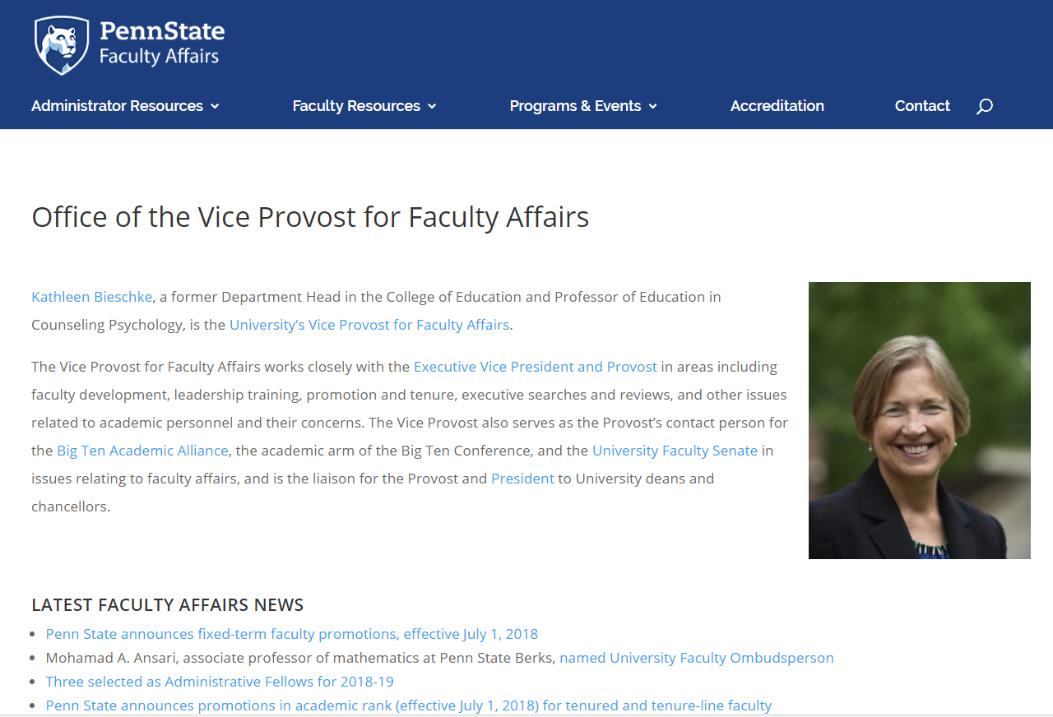

Full-Time Focus on Faculty Affairs
Office of the Vice Provost for Faculty Affairs
vpfa.psu.edu
OFFICE OF THE VICE PROVOST FOR FACULTY AFFAIRS

Slide 5
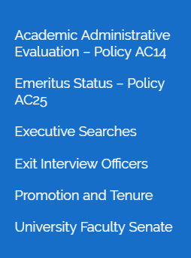
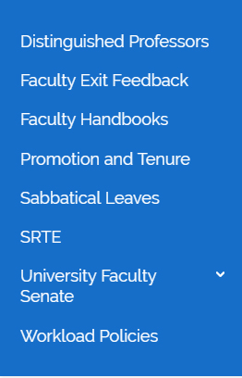
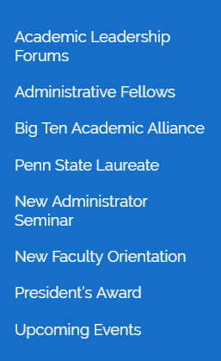
Web Resources
Office of the Vice Provost for Faculty Affairs
vpfa.psu.edu
policies.psu.edu
OFFICE OF THE VICE PROVOST FOR FACULTY AFFAIRS

Slide 6

Quick shout out!
Dr. Brent Ruben
Senior University Fellow
Rutgers Center for Organizational Leadership
Faculty Advisor to the Senior Vice President
Distinguished Professor of Communication

Slide 7
The Higher Ed Leadership Paradox
What are the qualities of a good faculty member?
  Personal effectiveness ≠ organizational leadership effectiveness
  Personal planning ≠ organizational planning
  Personal advancement ≠ organizational advancement
  Ruben (2017)

Slide 8


Perspective Makes All the Difference

Slide 9
A Useful Metaphor: The Transition from Private Pilot to Air Traffic Controller
Faculty members (pilots)
  Focus on our own needs and aspirations, goals, and our personal flight plans, trajectories, aspirations.
Academic leaders (air traffic controllers)
  Focus on the perspectives and needs of others, and the aspirations and trajectory of the unit as a whole.
Ruben (2017)

Slide 10
Changes Many Encounter as Part of the Transition from Faculty Member to Faculty Leader
Shifting priorities
The control you have over your schedule
The way you are viewed
The broader and precedent-setting impact of your decisions and actions
The nature of your interpersonal relationships
The way you understand your role (leader, colleague, follower)
The proportion of effort expended related to tasks vs people
Leader–faculty member balance
Ruben (2017)

Slide 11

Leadership Strategy: A Problem-solving Rubric for Situations of All Kinds (Ruben, 2017)
Analyze the Situation
Define the Audience(s)
Clarify Goal(s)
Select and Implement a Plan of Action
Debrief

Slide 12
1. Analyze the Situation: What’s at Stake?
For the institution or academic unit
For other individuals involved
For you as a leader
Brent Ruben (2017)

Slide 13
2. Define the Audience(s)
Who needs to hear from you and why?
  A specific individual/individuals
  Who else would you inform?
    Committee?
    Administrators?
    Senior colleague(s)
    Students?
    Alumni
    Members of advisory groups?
    A friend, spouse, or confidant?
  Brent Ruben (2017)

Slide 14

3. Clarify Goals (Ruben, 2017)
Provide input?
Solicit input?
Clarify facts?
Provide evidence?
Demonstrate interest/concern?
Persuade or influence?
Demonstrate your expertise?
Assure that your position, reaction, perspective is clear?
Be on the record?
Others?

Slide 15
4. Select and Implement a Plan of Action
What action do you take, what is your timing, and why?
Respond immediately, and if so what do you do?
Do nothing special
Think further about the situation
What is your message, and why?
Informative
Persuasive
What channel(s) do you use, and why?
One-on-one
Group
Mediated
Brent Ruben (2017)

Slide 16
5. Debrief
Did your strategy achieve the outcome you intended? Were there unintended outcomes?
How would those involved in the process describe how things went?
Is further follow-up needed? (Repeat previous four steps iteratively)
What might you do differently in the future to address this kind of problem if it were to occur again?
How could you prevent this kind of situation from developing? (e.g., set clearer expectations, stay closer to the process, request periodic progress reports, assign several people to collaborate on the task)
What personal and/or professional leadership lessons can you take away from the situation?
Brent Ruben (2017)

Slide 17
Leadership Strategy: A Problem-solving Rubric for Situations of All Kinds (Ruben, 2017)
Analyze the Situation
Define the Audience(s)
Clarify Goal(s)
Select and Implement a Plan of Action
Debrief

Slide 18
What I Wish I Would Have Known
Carolee Bull, Department Head, Plant Pathology and Environmental Microbiology, Professor of Plant Pathology and Systematic Bacteriology, and Director, Penn State Microbiome Center
Kathryn Drager, Associate Dean for Research and Graduate Education, Professor of Communication Sciences and Disorders
Tom La Porta, Director, School of Electrical Engineering and Computer Science Evan Pugh Professor
Elizabeth Wright, Associate Dean for Academic Affairs, Office of the Vice President for Commonwealth Campuses, and Director of Academic Affairs, Hazleton, Associate Professor of English

Slide 19
New Administrators Seminar Series
Session I – Academic Leadership and What I Wish I Would Have Known
September 29, 2020, 10:00 a.m. – 12:00 p.m.
Session II – Managing Faculty Concerns/Conduct
October 28, 2020, 10:00 – 11:00 a.m.
Session III – The Budget and SIMBA
November 19, 2020, 9:00 – 10:00 a.m.
Session IV – Conducting Performance Reviews
Spring Semester – TBD
Session V – Promotion and Tenure
Spring Semester – TBD

Slide 20

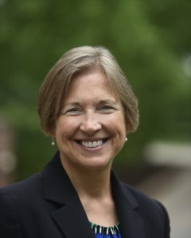
Thank You.
Questions or Comments?
vpfa.psu.edu
OFFICE OF THE VICE PROVOST FOR FACULTY AFFAIRS

