Slide 1

Key Trends Key Actions
REVISITED
A Discussion with the Academic Leadership Forum
November 17, 2020
Notes:
Good afternoon. Today I will report to the Senate about two related topics. First, I’ll discuss the status of the University’s operating budget for the current, 2015-2016 fiscal year. Then, I’ll explain our financial appropriation request to the Commonwealth of Pennsylvania and related budget planning for the 2016-2017 fiscal year.

Slide 2
Presentation Overview
How has COVID-19 affected Key Trends and Strategies in:
Enrollment
Financial
Faculty
Research
Future of Learning
Notes:
Despite uncertainty regarding the state appropriation, several priorities guided the development of our 2015-2016 budget. We wanted to keep tuition increases low or flat. We also wanted to stimulate the Pennsylvania economy and student career success, building on the momentum of Invent Penn State and Penn State’s $30 million start-up investment. We identified potential expense reductions and moderate spending priorities—especially important given the anticipated increases in the costs of employee benefits, including health insurance.
We wanted to fund operating cost increases and selective strategic initiatives—with a special focus on access and affordability, in accordance with a new strategic plan. We also wanted to maintain a competitive position to attract and retain the best talent, who provide the foundation for the high quality of our academic programs.

Slide 3

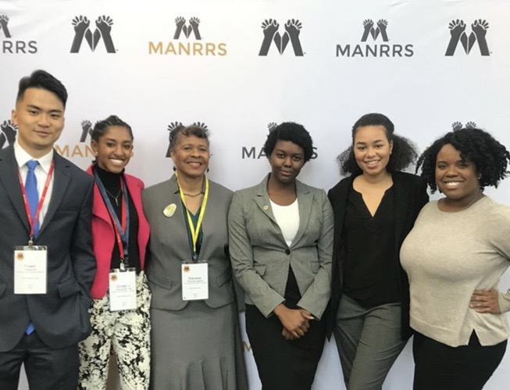

Key Trends — Enrollment

Slide 4
National Enrollment Trends — Pre-Pandemic
Demographic mismatch for students of the future:
  Northeast continued decline in birth rates and high school graduates.
  Greatest decline - well-prepared students with high income.
  Greatest growth – urban, lower income, first-in-family, minorities.
Notes:
Despite uncertainty regarding the state appropriation, several priorities guided the development of our 2015-2016 budget. We wanted to keep tuition increases low or flat. We also wanted to stimulate the Pennsylvania economy and student career success, building on the momentum of Invent Penn State and Penn State’s $30 million start-up investment. We identified potential expense reductions and moderate spending priorities—especially important given the anticipated increases in the costs of employee benefits, including health insurance.
We wanted to fund operating cost increases and selective strategic initiatives—with a special focus on access and affordability, in accordance with a new strategic plan. We also wanted to maintain a competitive position to attract and retain the best talent, who provide the foundation for the high quality of our academic programs.

Slide 5
Penn State Actions Taken—Pre-Pandemic
Achieve Penn State: Programs and philanthropic strategy for
scholarships that enable low income first-in-family students
to graduate and graduate on time (PASSS, STEP, RaiseMe,
Complete Penn State, Smart Track to Success).
Ensuring graduation of a population not expected to graduate
(US News – predicted vs. actual) But…low income students still graduate 22% below the university average.
$477 million raised for Open Doors Program priority to date.
Inaugural Discover Awards: Cost competitive – adjacent seven states;
775 new student admits for Fall 2020.
Notes:
Despite uncertainty regarding the state appropriation, several priorities guided the development of our 2015-2016 budget. We wanted to keep tuition increases low or flat. We also wanted to stimulate the Pennsylvania economy and student career success, building on the momentum of Invent Penn State and Penn State’s $30 million start-up investment. We identified potential expense reductions and moderate spending priorities—especially important given the anticipated increases in the costs of employee benefits, including health insurance.
We wanted to fund operating cost increases and selective strategic initiatives—with a special focus on access and affordability, in accordance with a new strategic plan. We also wanted to maintain a competitive position to attract and retain the best talent, who provide the foundation for the high quality of our academic programs.

Slide 6
Current Penn State Actions
Data-driven media approach to recruitment.
“All In”: The importance of an inclusive campus.
Common Application: Increase in applications and diversity of applications.
Strategic focus on diversity, equity and inclusion.
Educational Equity Scholarships (total impact $25M).
Next level of commitment - taskforces nearing completion
(Report to Board’s Oversight Taskforce on November 18).
  Select Commission on Racism, Bias and Community Safety
  Student Code of Conduct
Notes:
Despite uncertainty regarding the state appropriation, several priorities guided the development of our 2015-2016 budget. We wanted to keep tuition increases low or flat. We also wanted to stimulate the Pennsylvania economy and student career success, building on the momentum of Invent Penn State and Penn State’s $30 million start-up investment. We identified potential expense reductions and moderate spending priorities—especially important given the anticipated increases in the costs of employee benefits, including health insurance.
We wanted to fund operating cost increases and selective strategic initiatives—with a special focus on access and affordability, in accordance with a new strategic plan. We also wanted to maintain a competitive position to attract and retain the best talent, who provide the foundation for the high quality of our academic programs.

Slide 7
Pandemic’s Toll on Higher Ed Enrollment
Largest enrollment declines in freshman, part-time (community colleges declined 8%) and international students (11.2%).
Enrollment among undergraduates is down 2.5% this year across all types of institutions, and graduate enrollment is up 3.9%.
Overall enrollment is down 1.8% compared with the same period last year.
Four-year publics have the most robust enrollments.
Source: National Student Clearinghouse Research Center
Notes:
Despite uncertainty regarding the state appropriation, several priorities guided the development of our 2015-2016 budget. We wanted to keep tuition increases low or flat. We also wanted to stimulate the Pennsylvania economy and student career success, building on the momentum of Invent Penn State and Penn State’s $30 million start-up investment. We identified potential expense reductions and moderate spending priorities—especially important given the anticipated increases in the costs of employee benefits, including health insurance.
We wanted to fund operating cost increases and selective strategic initiatives—with a special focus on access and affordability, in accordance with a new strategic plan. We also wanted to maintain a competitive position to attract and retain the best talent, who provide the foundation for the high quality of our academic programs.

Slide 8
Penn State’s Fall 2020 Enrollment Data
Overall enrollment, excluding Penn College, saw a 1.8% decline to 89,816 compared to fall 2019.
Undergraduate enrollment is 74,446, down 2.2%.
First-time baccalaureate students number 15,614, down 2.3%.
  8,465 at University Park
  6,799 at the Commonwealth Campuses,
  350 in the World Campus
Nearly even if “deferred” enrollment included
Graduate enrollment increased 0.6% to 14,039.
Source: Penn State Census
Notes:
Despite uncertainty regarding the state appropriation, several priorities guided the development of our 2015-2016 budget. We wanted to keep tuition increases low or flat. We also wanted to stimulate the Pennsylvania economy and student career success, building on the momentum of Invent Penn State and Penn State’s $30 million start-up investment. We identified potential expense reductions and moderate spending priorities—especially important given the anticipated increases in the costs of employee benefits, including health insurance.
We wanted to fund operating cost increases and selective strategic initiatives—with a special focus on access and affordability, in accordance with a new strategic plan. We also wanted to maintain a competitive position to attract and retain the best talent, who provide the foundation for the high quality of our academic programs.

Slide 9
Post-Pandemic Forecast
Most predictions suggest a short-term enrollment impact.
Whitman Insight Strategies – Penn State analysis:
  Opportunity to attract students who wish to remain close to home.
  Students “stuck” in the decision-making process despite improved personal outlooks.
  Desire personal connections to make decisions (e.g. tours).
  Parent concerns about COVID safety and career success.
  Penn State favorability markers are higher now than in June.
  Perceptions of openness and inclusion – Penn State rated highly compared to peers.
Notes:
Despite uncertainty regarding the state appropriation, several priorities guided the development of our 2015-2016 budget. We wanted to keep tuition increases low or flat. We also wanted to stimulate the Pennsylvania economy and student career success, building on the momentum of Invent Penn State and Penn State’s $30 million start-up investment. We identified potential expense reductions and moderate spending priorities—especially important given the anticipated increases in the costs of employee benefits, including health insurance.
We wanted to fund operating cost increases and selective strategic initiatives—with a special focus on access and affordability, in accordance with a new strategic plan. We also wanted to maintain a competitive position to attract and retain the best talent, who provide the foundation for the high quality of our academic programs.

Slide 10
Strategies Moving Forward
Penn State needs to:
  Focus on flexibility – “meet you where you are.”
  Focus on those thinking “locally” to drive Commonwealth Campus enrollment.
  Double-down on our “fit” – provide unprecedented access
  to students, faculty and space virtually.
  Proactive communication on what we are doing and how we are moving forward.
  Focus on career outcomes (e.g. recruiter surveys rank us 5th; tied with MIT).
Notes:
Despite uncertainty regarding the state appropriation, several priorities guided the development of our 2015-2016 budget. We wanted to keep tuition increases low or flat. We also wanted to stimulate the Pennsylvania economy and student career success, building on the momentum of Invent Penn State and Penn State’s $30 million start-up investment. We identified potential expense reductions and moderate spending priorities—especially important given the anticipated increases in the costs of employee benefits, including health insurance.
We wanted to fund operating cost increases and selective strategic initiatives—with a special focus on access and affordability, in accordance with a new strategic plan. We also wanted to maintain a competitive position to attract and retain the best talent, who provide the foundation for the high quality of our academic programs.

Slide 11

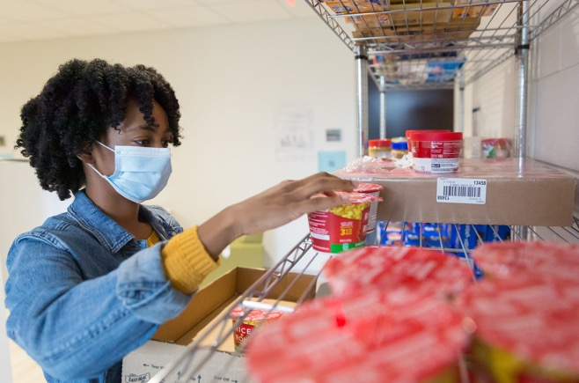
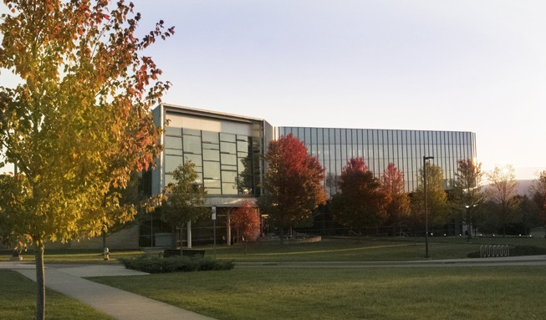
Key Trends — Financial

Slide 12
National Financial Trends — Pre-Pandemic
Financial ranking organizations place 1/3 of all colleges and universities as unsustainable (another quarter at risk).
Small schools most problematic: enrollment demographically controlled; 40% have fewer than 1,000 students; 80% have fewer than 5,000 students (800 schools have critical finances).
State flagships and well-heeled privates: the most robust.
State funding is predicted to continue to decline.
Forbes most recent report (Nov. 2019) has financial conditions deteriorating. D financial grade colleges have increased by 61% since 2013.
Notes:
Despite uncertainty regarding the state appropriation, several priorities guided the development of our 2015-2016 budget. We wanted to keep tuition increases low or flat. We also wanted to stimulate the Pennsylvania economy and student career success, building on the momentum of Invent Penn State and Penn State’s $30 million start-up investment. We identified potential expense reductions and moderate spending priorities—especially important given the anticipated increases in the costs of employee benefits, including health insurance.
We wanted to fund operating cost increases and selective strategic initiatives—with a special focus on access and affordability, in accordance with a new strategic plan. We also wanted to maintain a competitive position to attract and retain the best talent, who provide the foundation for the high quality of our academic programs.

Slide 13
Pandemic’s Toll on Higher Ed Finances
Forbes estimates pandemic impact on higher ed exceeded
$120 billion by the start of the semester – not built into any university plan.
Cost-cutting measures have become common.
Dependency on enrollment growth appears even more problematic.
Overwhelmingly, colleges and universities went “remote.”
Pandemic revealed a lack of innovation in higher ed.
Students believe online education delivers less quality and value.
Loss of liquidity.
Notes:
Despite uncertainty regarding the state appropriation, several priorities guided the development of our 2015-2016 budget. We wanted to keep tuition increases low or flat. We also wanted to stimulate the Pennsylvania economy and student career success, building on the momentum of Invent Penn State and Penn State’s $30 million start-up investment. We identified potential expense reductions and moderate spending priorities—especially important given the anticipated increases in the costs of employee benefits, including health insurance.
We wanted to fund operating cost increases and selective strategic initiatives—with a special focus on access and affordability, in accordance with a new strategic plan. We also wanted to maintain a competitive position to attract and retain the best talent, who provide the foundation for the high quality of our academic programs.

Slide 14
Penn State’s Pre-Pandemic Actions to Ensure Financial Stability
Focus on recruitment.
Tuition taskforce.
SIMBA replaced Penn State’s legacy systems.
Focus on retention to graduation–becoming key financial factor– a student retained is a student we don’t have to recruit.
Substantial efforts to create efficiencies and savings for innovation and affordability. Huron savings approach–Penn State’s leadership commitment to the Board.
Notes:
Despite uncertainty regarding the state appropriation, several priorities guided the development of our 2015-2016 budget. We wanted to keep tuition increases low or flat. We also wanted to stimulate the Pennsylvania economy and student career success, building on the momentum of Invent Penn State and Penn State’s $30 million start-up investment. We identified potential expense reductions and moderate spending priorities—especially important given the anticipated increases in the costs of employee benefits, including health insurance.
We wanted to fund operating cost increases and selective strategic initiatives—with a special focus on access and affordability, in accordance with a new strategic plan. We also wanted to maintain a competitive position to attract and retain the best talent, who provide the foundation for the high quality of our academic programs.

Slide 15
Penn State’s Strategies Since Pandemic
Plan for a budget that cannot be balanced by reliance on traditional out-of-state students who are increasingly financially challenged. Will pendulum swing even more to international,
but are they less likely to come?
Started early on extensive cost-cutting measures – hiring chills, salary freezes, unit budget cuts, etc.
Innovation dollars sacrificed for financial stability.
Accelerated investment in the vibrancy of online/remote education, building upon Penn State foundations and expertise.
Strong efforts to protect our enrollment.
Notes:
Despite uncertainty regarding the state appropriation, several priorities guided the development of our 2015-2016 budget. We wanted to keep tuition increases low or flat. We also wanted to stimulate the Pennsylvania economy and student career success, building on the momentum of Invent Penn State and Penn State’s $30 million start-up investment. We identified potential expense reductions and moderate spending priorities—especially important given the anticipated increases in the costs of employee benefits, including health insurance.
We wanted to fund operating cost increases and selective strategic initiatives—with a special focus on access and affordability, in accordance with a new strategic plan. We also wanted to maintain a competitive position to attract and retain the best talent, who provide the foundation for the high quality of our academic programs.

Slide 16



Key Trends — Faculty

Slide 17
National Faculty Trends—Pre-Pandemic
Faculty are aging: at least 25% of tenured and tenure-track professors are approaching 70. Renewal of the faculty is more challenging than ever.
Institutional response: hire part-time and non-tenure track
(In 1969, 80% tenured; now, less than 1/3). But does high use of adjuncts result in decreased student success?
Emergence of mission faculty; mission support–preceptors as well as TA’s; coupled with instructional designers (if you can afford it).
Does shared governance become a burden?
Notes:
Despite uncertainty regarding the state appropriation, several priorities guided the development of our 2015-2016 budget. We wanted to keep tuition increases low or flat. We also wanted to stimulate the Pennsylvania economy and student career success, building on the momentum of Invent Penn State and Penn State’s $30 million start-up investment. We identified potential expense reductions and moderate spending priorities—especially important given the anticipated increases in the costs of employee benefits, including health insurance.
We wanted to fund operating cost increases and selective strategic initiatives—with a special focus on access and affordability, in accordance with a new strategic plan. We also wanted to maintain a competitive position to attract and retain the best talent, who provide the foundation for the high quality of our academic programs.

Slide 18
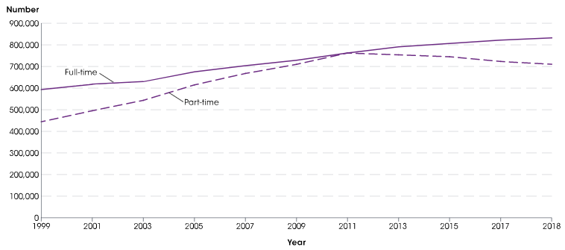
Number of faculty in degree-granting postsecondary institutions, by employment status: Selected years, fall 1999 through fall 2018
In fall 2018, of the 1.5 million faculty in degree-granting postsecondary institutions, 54% were full-time and 46% were part-time.
SOURCE: U.S. Department of Education, National Center for Education Statistics, Integrated Postsecondary Education Data System (IPEDS)

Slide 19
Penn State Actions—Continuing
47% tenured or tenure-track; adjuncts only 6% of credit hours.
Voluntary Retirement Program was an opportunity to add young faculty (202 faculty) with $14M in savings from faculty and staff positions.
End of college/campus recycling associated with significant shift
to non-tenure track (restarted because of pandemic).
Philanthropy providing endowments to support new faculty hires: Digital Innovation, Transformative Experiences, Impact the World themes.
Strategic funding of technical and support staff.
Notes:
Despite uncertainty regarding the state appropriation, several priorities guided the development of our 2015-2016 budget. We wanted to keep tuition increases low or flat. We also wanted to stimulate the Pennsylvania economy and student career success, building on the momentum of Invent Penn State and Penn State’s $30 million start-up investment. We identified potential expense reductions and moderate spending priorities—especially important given the anticipated increases in the costs of employee benefits, including health insurance.
We wanted to fund operating cost increases and selective strategic initiatives—with a special focus on access and affordability, in accordance with a new strategic plan. We also wanted to maintain a competitive position to attract and retain the best talent, who provide the foundation for the high quality of our academic programs.

Slide 20
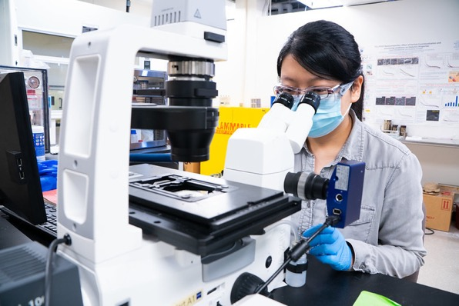
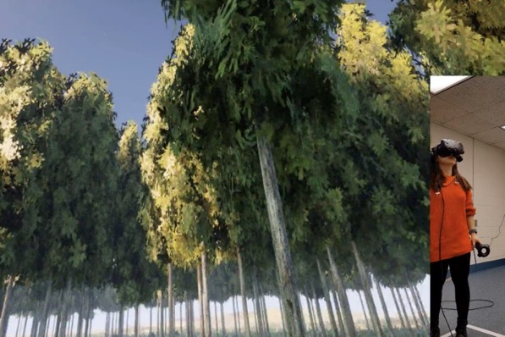
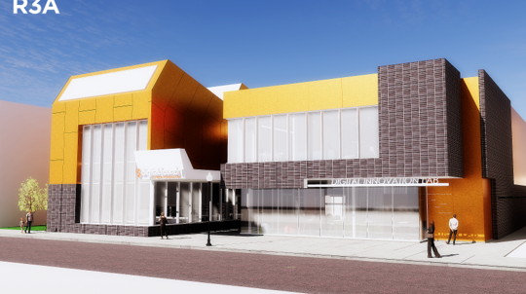
Key Trends — Research

Slide 21
National Research Funding Trends
Considerable downward pressure on federal support.
Post-recession: Flat to declining federal support except in areas perceived as having more direct impact (e.g. NIH, computer science).
1960: Feds 73% of university support – now 60%; corporate sponsorship 3% to 6%; universities 10% to 20%.
Research universities flat or slight increase; smaller educational institutions flat or decrease.
Notes:
Despite uncertainty regarding the state appropriation, several priorities guided the development of our 2015-2016 budget. We wanted to keep tuition increases low or flat. We also wanted to stimulate the Pennsylvania economy and student career success, building on the momentum of Invent Penn State and Penn State’s $30 million start-up investment. We identified potential expense reductions and moderate spending priorities—especially important given the anticipated increases in the costs of employee benefits, including health insurance.
We wanted to fund operating cost increases and selective strategic initiatives—with a special focus on access and affordability, in accordance with a new strategic plan. We also wanted to maintain a competitive position to attract and retain the best talent, who provide the foundation for the high quality of our academic programs.

Slide 22
Pandemic’s Impact on Research
AAU reports that the research university response to the pandemic has built a stronger degree of trust that is bi-partisan.
Pandemic has demonstrated the importance of interdisciplinary research.
Opportunity to leverage that trust by continuing to focus on enduring problems.
Notes:
Despite uncertainty regarding the state appropriation, several priorities guided the development of our 2015-2016 budget. We wanted to keep tuition increases low or flat. We also wanted to stimulate the Pennsylvania economy and student career success, building on the momentum of Invent Penn State and Penn State’s $30 million start-up investment. We identified potential expense reductions and moderate spending priorities—especially important given the anticipated increases in the costs of employee benefits, including health insurance.
We wanted to fund operating cost increases and selective strategic initiatives—with a special focus on access and affordability, in accordance with a new strategic plan. We also wanted to maintain a competitive position to attract and retain the best talent, who provide the foundation for the high quality of our academic programs.

Slide 23
Penn State Actions Taken—Continuing
Focus on global issues– energy, water and food security; human health; economic development (Impact the World themes).
Focus on national needs (AI, additive manufacturing, 5G, opioid epidemic, child maltreatment).
Importance of interdisciplinary investments.
Continued growth in research expenditures (up over 4% and exceeding $1.0 billion for the first time in our history).
Diverse research portfolio receives funding from all 15 Federal agencies.
Notes:
Despite uncertainty regarding the state appropriation, several priorities guided the development of our 2015-2016 budget. We wanted to keep tuition increases low or flat. We also wanted to stimulate the Pennsylvania economy and student career success, building on the momentum of Invent Penn State and Penn State’s $30 million start-up investment. We identified potential expense reductions and moderate spending priorities—especially important given the anticipated increases in the costs of employee benefits, including health insurance.
We wanted to fund operating cost increases and selective strategic initiatives—with a special focus on access and affordability, in accordance with a new strategic plan. We also wanted to maintain a competitive position to attract and retain the best talent, who provide the foundation for the high quality of our academic programs.

Slide 24
Some Specific Penn State Actions Taken Since the Pandemic
Rapidly shifted labs and research to study COVID-19 to contribute to the national effort.
Contributed PPE to hospitals and medical personnel when there were national shortages.
Focusing on safety, while enabling research personnel and students to continue their research.
Notes:
Despite uncertainty regarding the state appropriation, several priorities guided the development of our 2015-2016 budget. We wanted to keep tuition increases low or flat. We also wanted to stimulate the Pennsylvania economy and student career success, building on the momentum of Invent Penn State and Penn State’s $30 million start-up investment. We identified potential expense reductions and moderate spending priorities—especially important given the anticipated increases in the costs of employee benefits, including health insurance.
We wanted to fund operating cost increases and selective strategic initiatives—with a special focus on access and affordability, in accordance with a new strategic plan. We also wanted to maintain a competitive position to attract and retain the best talent, who provide the foundation for the high quality of our academic programs.

Slide 25
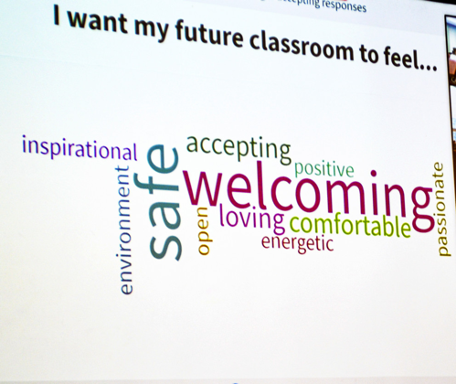

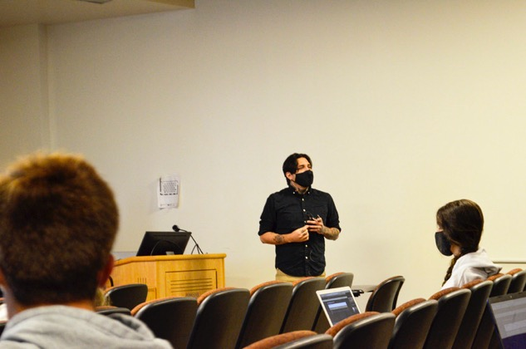
Key Trends — Future of Learning

Slide 26
Future of Learning—Pre-Pandemic
Upward mobility: High School 4%; AAU College 45%.
Rapid automation/“Jetson’s lifestyle”: College education even more important to achieve high salaries.
Cognitive, intrapersonal, and interpersonal skills key to career success (role of internships plus other engagement).
Learning through failure vs. learning by syllabus.
Competency-based, badge-based; stacked credentials.
Data analytics in the classroom.
Notes:
Despite uncertainty regarding the state appropriation, several priorities guided the development of our 2015-2016 budget. We wanted to keep tuition increases low or flat. We also wanted to stimulate the Pennsylvania economy and student career success, building on the momentum of Invent Penn State and Penn State’s $30 million start-up investment. We identified potential expense reductions and moderate spending priorities—especially important given the anticipated increases in the costs of employee benefits, including health insurance.
We wanted to fund operating cost increases and selective strategic initiatives—with a special focus on access and affordability, in accordance with a new strategic plan. We also wanted to maintain a competitive position to attract and retain the best talent, who provide the foundation for the high quality of our academic programs.

Slide 27
Four Key Trends
From the Berlin School of Creative Leadership
1) The unbundling of education--more competency-based approaches.
2) Personalization--through technology and other resources.
3) Continuous education--transcending time, place, and the traditional 'bundles' of requirements.
4) Creativity orientation--commitment to integrate arts and humanity-minded learning with more technical and critical thinking skills.

Slide 28
Penn State Actions—Pre-Pandemic
“Open concept” for courses across the university to allow for seamless progress toward degree.
Strategic Plan focus: priorities including Digital Innovation and Transformative Experiences (requires major investment).
Living laboratories.
Invent Penn State.
One Penn State 2025: Penn State as your university for life. Highly accessible portal. Breadth of opportunities. Responsive to needs.
Notes:
Despite uncertainty regarding the state appropriation, several priorities guided the development of our 2015-2016 budget. We wanted to keep tuition increases low or flat. We also wanted to stimulate the Pennsylvania economy and student career success, building on the momentum of Invent Penn State and Penn State’s $30 million start-up investment. We identified potential expense reductions and moderate spending priorities—especially important given the anticipated increases in the costs of employee benefits, including health insurance.
We wanted to fund operating cost increases and selective strategic initiatives—with a special focus on access and affordability, in accordance with a new strategic plan. We also wanted to maintain a competitive position to attract and retain the best talent, who provide the foundation for the high quality of our academic programs.

Slide 29
Pandemic’s Toll on Learning
Whitman Insight Strategies – Penn State analysis
  Students are concerned about the value and quality of online.
  Students want the college experience: Socialization, extracurriculars, sports, living away from parents.
  By a large margin, students want a combination of in-person and online instruction: The college experience with flexibility and choices.
Notes:
Despite uncertainty regarding the state appropriation, several priorities guided the development of our 2015-2016 budget. We wanted to keep tuition increases low or flat. We also wanted to stimulate the Pennsylvania economy and student career success, building on the momentum of Invent Penn State and Penn State’s $30 million start-up investment. We identified potential expense reductions and moderate spending priorities—especially important given the anticipated increases in the costs of employee benefits, including health insurance.
We wanted to fund operating cost increases and selective strategic initiatives—with a special focus on access and affordability, in accordance with a new strategic plan. We also wanted to maintain a competitive position to attract and retain the best talent, who provide the foundation for the high quality of our academic programs.

Slide 30
Penn State Strategies Moving Forward
Analysis of outcomes are driving decisions.
Focusing on “meeting students where they are” with in-person, hybrid, remote synchronous, and remote asynchronous classes.
Accelerating opportunities and resources to enable remote teaching at a high level.
Notes:
Despite uncertainty regarding the state appropriation, several priorities guided the development of our 2015-2016 budget. We wanted to keep tuition increases low or flat. We also wanted to stimulate the Pennsylvania economy and student career success, building on the momentum of Invent Penn State and Penn State’s $30 million start-up investment. We identified potential expense reductions and moderate spending priorities—especially important given the anticipated increases in the costs of employee benefits, including health insurance.
We wanted to fund operating cost increases and selective strategic initiatives—with a special focus on access and affordability, in accordance with a new strategic plan. We also wanted to maintain a competitive position to attract and retain the best talent, who provide the foundation for the high quality of our academic programs.

Slide 31
Key Conclusions—National
The pandemic has accelerated many of the trends in higher ed.
Financial strain is exacerbated by the pandemic coupled with demographic changes and decreasing support for public higher education.
Predictions indicate robust outcomes for public flagships (research points to need for flexibility, career success, support programs, fit, etc.—strategies already in place at Penn State that we can amplify).
Students want a college experience with flexibility.
Notes:
Despite uncertainty regarding the state appropriation, several priorities guided the development of our 2015-2016 budget. We wanted to keep tuition increases low or flat. We also wanted to stimulate the Pennsylvania economy and student career success, building on the momentum of Invent Penn State and Penn State’s $30 million start-up investment. We identified potential expense reductions and moderate spending priorities—especially important given the anticipated increases in the costs of employee benefits, including health insurance.
We wanted to fund operating cost increases and selective strategic initiatives—with a special focus on access and affordability, in accordance with a new strategic plan. We also wanted to maintain a competitive position to attract and retain the best talent, who provide the foundation for the high quality of our academic programs.

Slide 32
Key Conclusions—Penn State
One Penn State 2025 is more important than ever: Pandemic accelerated this path (meet students where they are; invest in educational experiences online; need for transformative experiences even if online).
Much of our strategic programming reflects national trends.
Key issue is innovation in the face of growing financial strain.
Notes:
Despite uncertainty regarding the state appropriation, several priorities guided the development of our 2015-2016 budget. We wanted to keep tuition increases low or flat. We also wanted to stimulate the Pennsylvania economy and student career success, building on the momentum of Invent Penn State and Penn State’s $30 million start-up investment. We identified potential expense reductions and moderate spending priorities—especially important given the anticipated increases in the costs of employee benefits, including health insurance.
We wanted to fund operating cost increases and selective strategic initiatives—with a special focus on access and affordability, in accordance with a new strategic plan. We also wanted to maintain a competitive position to attract and retain the best talent, who provide the foundation for the high quality of our academic programs.

