Slide 1
COVID-19 Operations and Plans:
Update and Comments from the Provost
Dr. Nicholas P. Jones
Academic Leadership Forum
Tuesday, November 17, 2020
Office of the Executive Vice president and provost
Notes:
Slide 1: COVID-19 Operations and Plans (Introduction)

Slide 2

Today’s Topics
Accomplishments
Current Data Snapshot
Active Efforts
Year-End and Spring 2021 Plans
Future Efforts
Reminders and Resources for
Faculty and Academic Administrators
Office of the Executive Vice president and provost
Notes:
Slide 2: Today’s Topics

Slide 3
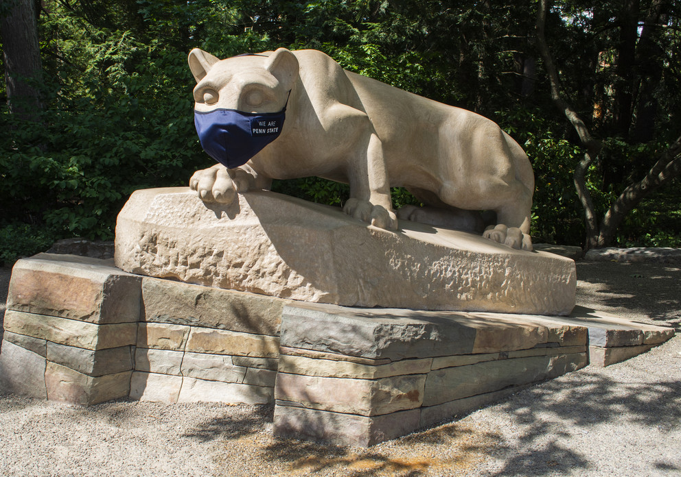
Accomplishments
Uninterrupted Fall 2020 on campus
Established COCC
Robust testing and contract tracing
COVID-19 Dashboard reporting
Mitigation of cases / spread
Quarantine and isolation processes
Clear, cohesive communications
Call Center launch and operations
Collaboration, flexibility across campuses, colleges, faculty, staff
Office of the Executive Vice president and provost
Notes:
Slide 3: Accomplishments – Want to spotlight achievements that everyone at PSU helped to make happen

Slide 4
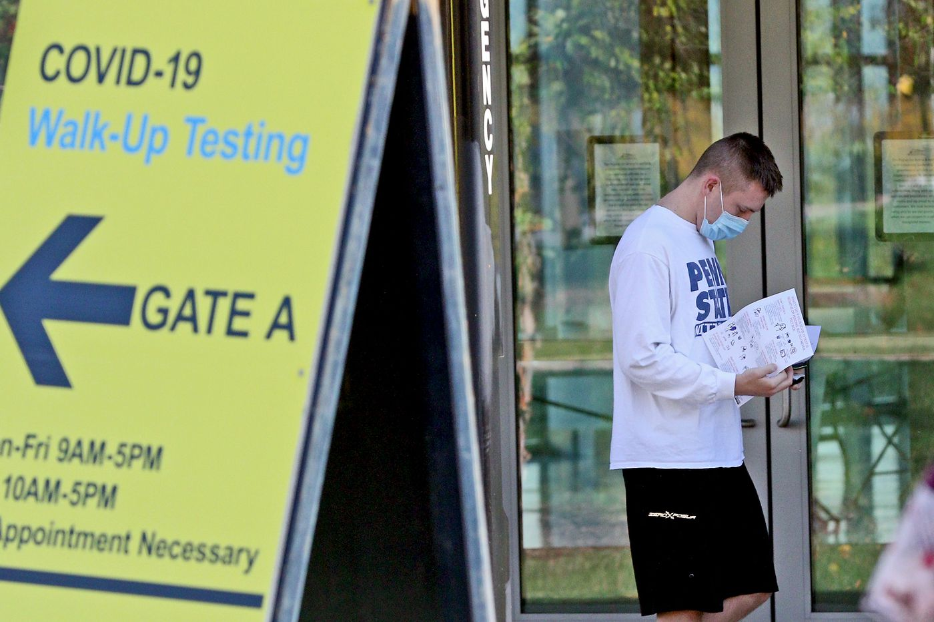
Current Data Snapshot
Testing University-wide: 100,000+ since August
4,328 positive cases at UP; 319 “active”
Campuses Outside UP: 433 positive cases total
Quarantine: 47 (about 30% of capacity)
Isolation: 62 (about 25% of capacity)
Employees: 24 positive cases University-wide
Contact Tracing: 11,000+ interactions identified
Call Center: 814-865-2121 – 713 calls in first
4 weeks, most from University Park students with testing-related queries
PHOTO CREDIT: THE PHILADELPHIA INQUIRER
Office of the Executive Vice president and provost
Notes:
Slide 4: Data Snapshot

Slide 5
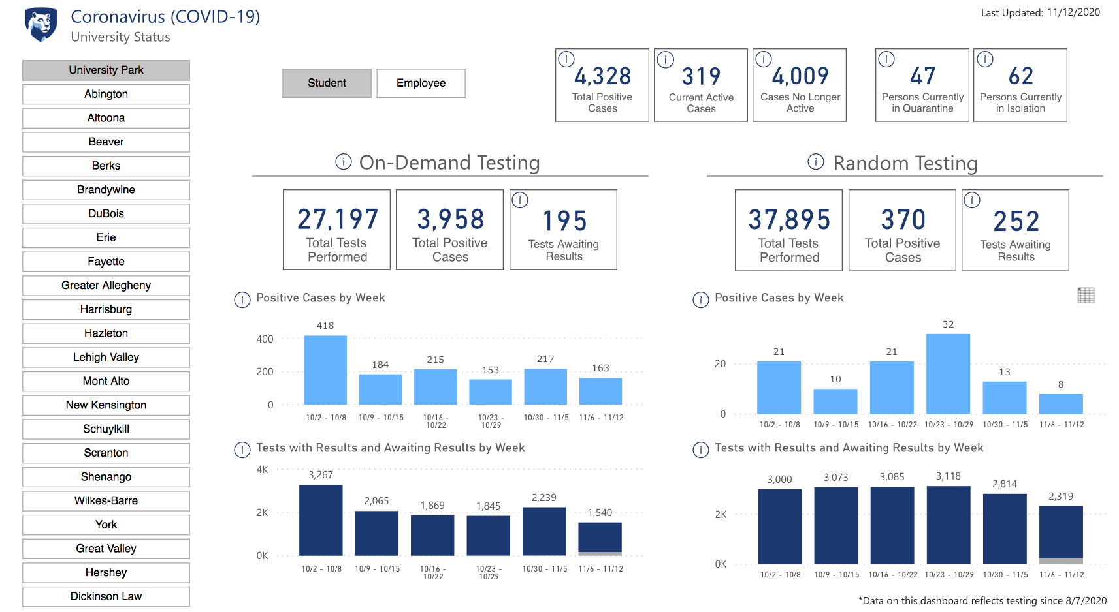
COVID-19 Dashboard https://virusinfo.psu.edu/covid-19-dashboard
Office of the Executive Vice president and provost
Notes:
Slide 5: COVID-19 Dashboard (published Friday, November 13 – most recent, with update coming later today – on Tuesday – day of ALF)

Slide 6


Active Efforts
“Return Home” Initiative – Fall 2020
  Robust communications plan
  Voluntary, free student testing before shift
  to remote learning for rest of semester
  13,375 Departure Test appointments scheduled University-wide as of Monday, Nov. 16
Maintain quarantine, isolation space
Opt-in testing for faculty, staff
Ongoing Call Center operations
Working with PA Department of Health
Planning for rest of 2020 and Spring 2021
Data-driven decision-making
Office of the Executive Vice president and provost
Notes:
Slide 6: Active Efforts

Slide 7

Year-End and Spring 2021 Plans
Comprehensive communications
Testing availability (opt-in)
Campus building/classroom access
Spring 2021 preparations
  Overarching Goals, Strategy
  Pre-Arrival (Classes begin Tuesday, Jan. 19)
  Arrival and Weeks 1-2
  Weeks 3 and beyond
  (no Spring Break but added 3 wellness days)
  Supply Chain
  CLIA Laboratory
  Be ready for potential need to pivot
Office of the Executive Vice president and provost
Notes:
Slide 7: Year-End and Spring 2021 Plans

Slide 8
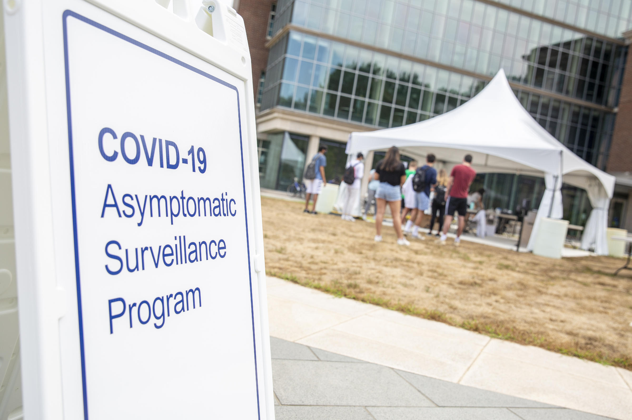
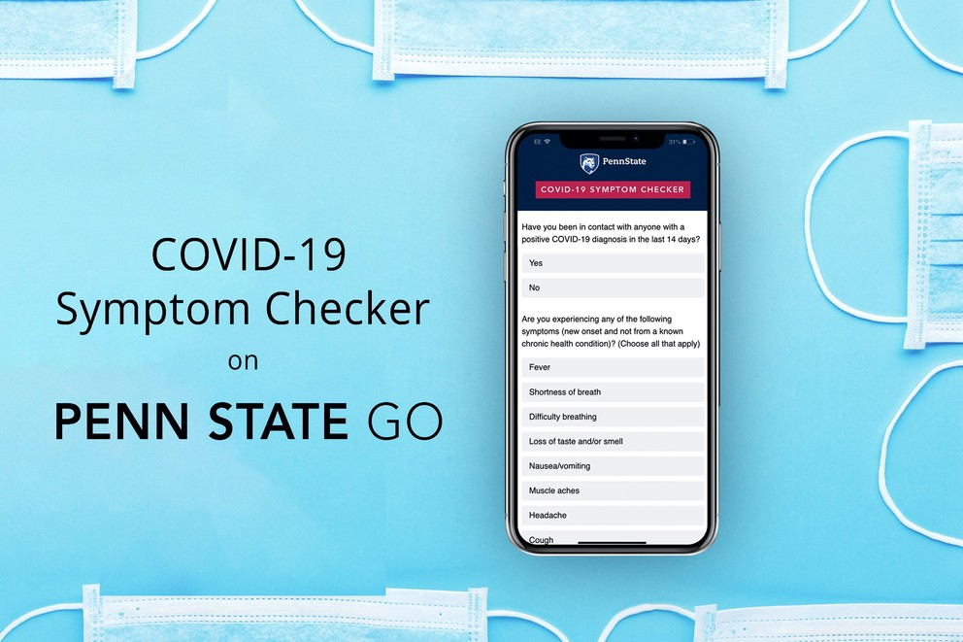
Future Efforts
Continued review of COVID-19 science
Enhancement of all processes
Technology improvements
Sustained vendor relationships
Rapid antigen testing
Penn State Testing Lab
Contact tracing, wastewater monitoring
Call Center evolution
Promote, leverage use of Penn State Go app, COVID-19 Symptom Checker
Office of the Executive Vice president and provost
Notes:
Slide 8: Future Efforts

Slide 9

Reminders and Resources
KeepTeaching.psu.edu – many resources
- Robust FAQs
- Guidelines
- Webinars
Alternative grading available for Fall 2020
Updated meetings and events guidance
Email newsletters sent twice weekly specifically for faculty – read and share
Virusinfo.psu.edu remains official site with news and many FAQs specific to faculty
Office of the Executive Vice president and provost
Notes:
Slide 9: Reminders and Resources for Faculty and Academic Administrators

Slide 10



Thank You.
Questions and Comments
Office of the Executive Vice president and provost
Notes:
Slide 10: Thank You / Open Q&A

