Slide 1
Promotion and tenure Workshop series
Welcome!
The session will begin shortly.
Transitioning from Associate to Full in a Tenured Faculty Position

Slide 2
Transitioning from Associate to Full in a Tenured Faculty Position
Promotion and Tenure Workshop Series
Ann Clements, Ph.D. Assistant Vice Provost of faculty Affairs – Faculty Development
Kathy Bieschke, Ph.D., Vice Provost of Faculty Affairs
Abby Diehl, Ph.D. Assistant Vice Provost of Faculty Affairs

Slide 3
Presentation Overview
Why seek promotion to Full Professor?
Criteria and expectations for seeking promotion.
The review process.

Slide 4
Why seek promotion to full professor?

Slide 5
* Source: Baker, et. al (2018). Success After Tenure: Lessons in Engaging Mid-Career Faculty. Collaborative on Academic Careers in Higher Education. Harvard Graduate School. https://coache.gse.harvard.edu/blog/success-after-tenure-lessons-engaging-mid-career-faculty

Slide 6
THE REWARDS FOR EARNING TENURE
New projects and topics
Stability of a secured position
Acknowledgement of expertise by peers
Increased professional stature
Greater ability to voice your opinions
Increased opportunities within the university and beyond
Salary increase
Notes:
Can still be fired for incompetene, immoral conduct, violation of school policies, negligence

Slide 7
THE ‘REWARDS’ FOR EARNING TENURE
Teaching protections, if any, are lifted
Course load may diversify
Service load increases
Asked to serve in leadership roles
Mentoring changes
Grants may become larger or more competitive
Family life may change
New chair/dean moves the goalposts to full
Unclear path to promotion
All the above x2 for women, faculty of color*
* Source: Baker, et. al (2018). Success After Tenure: Lessons in Engaging Mid-Career Faculty. Collaborative on Academic Careers in Higher Education. Harvard Graduate School. https://coache.gse.harvard.edu/blog/success-after-tenure-lessons-engaging-mid-career-faculty

Slide 8
What is promotion?
Promotion seeks to recognize and reward excellence.
In general, excellence is defined in terms of contributions to one's profession through teaching, research or creative accomplishment, and service.
Excellence is evaluated in a variety of ways.
Notes:
Raise-on Deh-tra – the most important reason for its existence

Slide 9
Timing
Determined for you
Flexible
Focus of work
Starting your agenda
Impact of contributions
Risk
Playing to one's strength
Risk-taking, expanding or more challanging topics
Reputation
Local, reginal, national (international)
National, international
Service
Less
More or different
Authorship/project leadership
Emphasis on solo or first
Cross-disciplinary, longer-term
Differences between promotion levels.
Promotion to Full
Notes:
In promotion to Associate...
Timeline is determined for you
Focus on getting a research or creative accomplishment agenda started
Doing what can be done in a specific “window of time”
Playing to one’s strengths to be successful
Often “protected” from some forms of service
Present evidence of state, regional, and national engagement, with potential for national reputation
In promotion to Full…
The timeline is flexible
A change in the quality or quantity of work
Not “have they met the bar?” but “what is the impact of their contributions?”
More about the big picture
More risk taking – longer-term projects, increased cross-disciplinary work as well as independent work, collaboration, more challenging topics
Potential for impact along with known impact
Body of work may be extraordinarily different than it was when you went up for tenure, more freedom
You will have more service experiences
Present evidence of national and international reputation

Slide 10
Why consider promotion to Full Professor?
Status and prestige in your field.
May opens new opportunities within your field and within the university.
Potential increase in influence within your unit and beyond.
May contributes positively to the recruitment of quality students.
May strengthen your ability to secure grants and funding.
Not just individual success, but institution rankings and community perceptions.
Increase in salary.
Increased freedom to work on new projects, topics, or areas of interest.

Slide 11
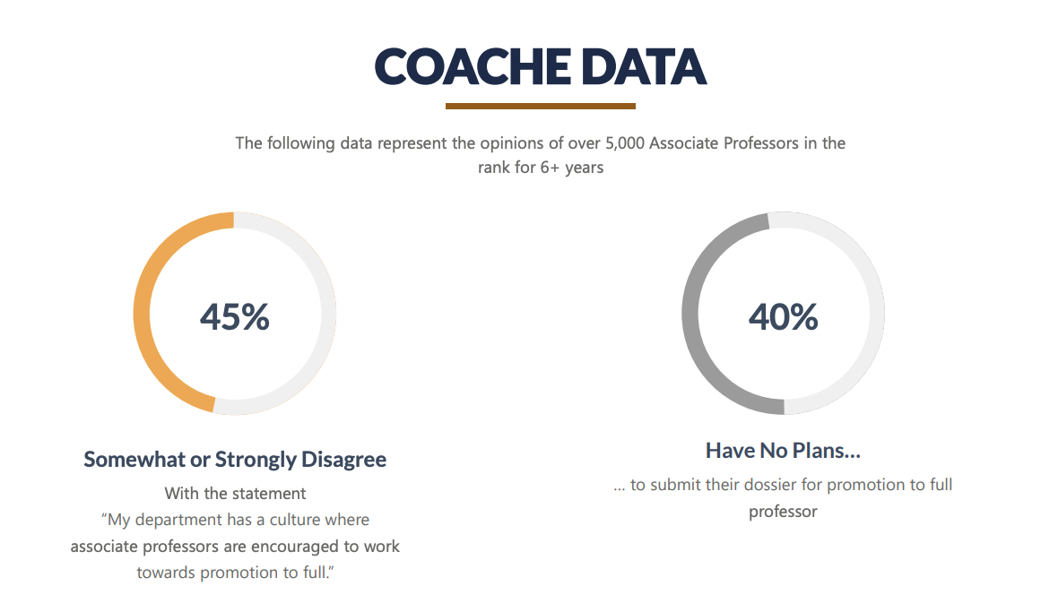
* Source: Baker, et. al (2018). Success After Tenure: Lessons in Engaging Mid-Career Faculty. Collaborative on Academic Careers in Higher Education. Harvard Graduate School. https://coache.gse.harvard.edu/blog/success-after-tenure-lessons-engaging-mid-career-faculty

Slide 12
Common Barriers to Seeking Promotion
Insufficient research and/or creative accomplishment or productivity
A fear of failure
Workload paralysis
Inertia
Exhaustion after tenure
Overwhelmed by the context or environment at home or work
Notes:
Are you committed to being a full professor
Research : Lack of research is far more frequently a barrier to becoming a full professor than is poor teaching. Inadequate teachers tend to be weeded out in the tenure process, and higher research expectations are often the key distinction between associate and full professor ranks. In these cases, the mentor should try to determine constructive ways of shifting the faculty member's research focus, pairing the individual with one or more colleagues in a research team, assigning additional graduate research assistants, allocating an increased travel budget to conferences, securing editorial assistance for articles, or taking others steps to remove what is causing the lack of research.
Fear of failure: A fear of failure. When faculty seem paralyzed by the thought of failure, the chair's mentoring task becomes quite different. In these cases, it is usually best to engage in a bit of metaphorical "hand holding," assuring the faculty member that no one will think less of him or her if the application is not successful, being turned down one year has absolutely no impact on one's chances the following year, and the department will continue to recommend the faculty member for as long as necessary for the application to be successful. It is then often useful to shift the conversation from "What if I fail?" to "What if i succeed?" This emphasizes the personal and professional benefits that will result from the promotion while minimizing the risks.
Workload: Sometimes people just become immobilized by the sheer amount of work involved in applying for a promotion. Institutions don't help themselves by requiring multiple binders packed with documentation that often require faculty members to divert their attention from more important duties to assembling a cumbersome application. Providing administrative assistance in gathering and formatting materials may make the faculty member more willing to begin the process. Except in situations where the material involved must remain confidential, it is helpful to assign a graduate assistant with an interest in a higher education career to this task: putting the application together thus becomes both a service to the faculty member and a learning experience for the student.
Inertia: There are also faculty members whose sole obstacle to promotion is that they never quite got around to it. With no mandatory timetable for when one must apply to become a full professor, some associate professors become comfortable where they are and see little reason to change. In these instances, the mentor's task often becomes one of "gentle nagging" and repeated encouragement. These are usually the easiest faculty members to mentor because their answer to the question "Why haven't you applied for promotion?" is often "no one ever asked me to."

Slide 13
Myths about promotion to Full….
X
You decide when time is right for your promotion review.
After gaining tenure and being promoted to associate professor, a certain number of years of service are required before you can be nominated for a promotion review.
If you are unsuccessful at being promoted to Full you must wait for a certain amount of time before being nominated for review again.
There is a university-wide formula for what excellence in teaching, research, and service are.
X
X
X

Slide 14
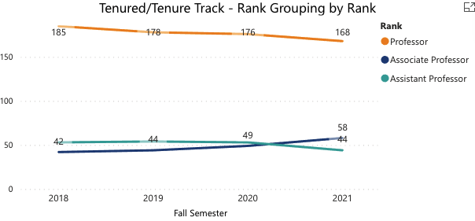
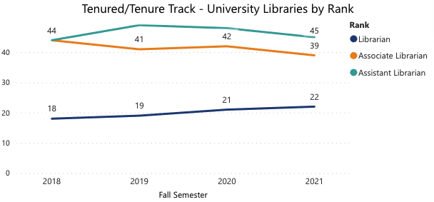
Penn State Rank Data (Number of faculty by rank in fall semesters, 2018-2021)
College of Medicine by Rank

Slide 15
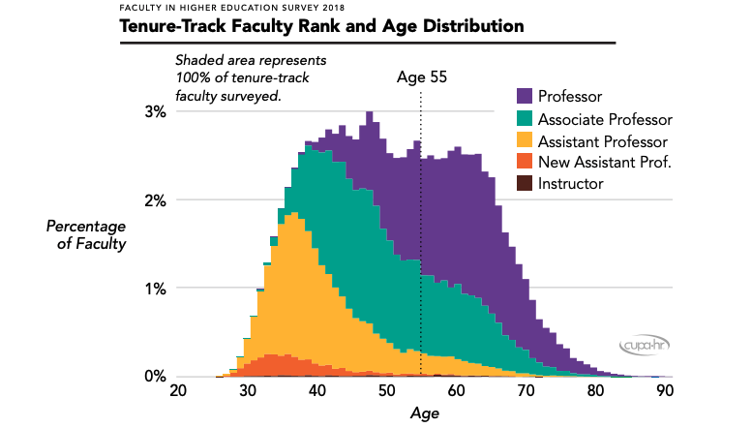
When should I consider going up?
Bichsel, J.; Li, J.; Pritchard, A.; & McChesney, J. (2018). Faculty in Higher Education Report: Key Findings, Trends, and Comprehensive Tables for Tenure-Track, Non-Tenure Teaching, and Non-Tenure Research Faculty; Academic Department Heads; and Adjunct Faculty at Four-Year Institutions for the 2017-18 Academic Year (Research Report). CUPA-HR.
Notes:
240,000 from 320 US institutions: https://www.cupahr.org/wp-content/uploads/surveys/Results/2018-Faculty-Report-Overview.pdf
When you have made significant progress towards the expectations of full professor

Slide 16
What if there aren’t enough full professors…?
Concerns about the health of a program
Potential lack of faculty leadership
Critical representation
Certain committees (such as university-wide promotion committees) require that their members be full professors
Too few can amount to an overburdening of those able to serve
This Photo by Unknown author is licensed under CC BY-ND.
Notes:
tangible problems that can result for a department with an insufficient number of full professors.

Slide 17
Criteria and Expectations for Seeking Promotion

Slide 18
Definition of Rank at Penn State (AC 21)
Assistant Professor
Associate Professor
Professor
The assistant professor should possess a terminal degree or its equivalent in organized research or professional practice; must have demonstrated ability as a teacher or research worker; and must have shown definite evidence of growth in scholarly, artistic, or professional achievement.
The associate professor should possess the same qualifications as the assistant professor but must also provide evidence of an established reputation in scholarly, artistic, or professional achievement.
The professor should possess the same qualifications as the associate professor but must also provide evidence of a substantial record of advanced research and/or creative work, and of leadership in their field of specialization. This rank should be reserved for persons of proven stature in teaching and/or research.
Notes:
Like promotion, academic tenure is not given it is earned. Promotion seeks to recognize and reward excellence.
Generally, excellence is defined in terms of contributions to one's profession through teaching, research or creative accomplishment, and service.
Do Zoom Survey – attendees what clock year are they in?

Slide 19
Specific criteria and expectations for successful promotion reside within the units.
Speak with academic unit leaders.
Speak with recently promoted faculty members.
“Shop around” your materials and ask for advice.
Take the feedback you receive in annual reviews seriously.
Ensure your academic unit leader knows you are interested in promotion.
Notes:
We have asked units to share their nomination process with this office and to increase transparency in their units.

Slide 20
Goal: Full Professor
What do you spend the majority of your day doing?
Which of those activities are getting you to the goal of being a Full Professor?

Slide 21
Map out your time.
Choose commitments carefully.
Notes:
Kathy story regarding the number of minutes an activity takes and how that affects the overall time schedule

Slide 22
The Review Process

Slide 23
AC23 Promotion and Tenure Procedures and Regulations (HR23)
Academic quality will be the basis for academic personnel decisions.
General and broad guidelines permit:
Judgments by faculty and academic administrators in their interpretation.
Each academic unit may develop its own specific expectations and standards as the operational basis for tenure and promotion recommendations.
Academic Excellence:
teaching and scholarly activity, both understood in their broadest sense.
What is tenure at Penn State? (AC 23)

Slide 24
Where to find information on promotion …
Website of the Vice Provost of Faculty Affairs
https://www.vpfa.psu.edu/promotion-and-tenure/
Policies AC 21 and AC 23
Administrative Guidelines (includes timeline)
P&T FAQs
College or Campus Specific Guidelines
Guidelines
P&T Annual Timeline (unit specific)
Unit Websites
Department Head, Division Head,
School Director, or DAA
P&T Committee Member
Mentor
Need help navigating through all of this – ASK!

Slide 25
Nomination Process for Promotion
Nominated by an appropriate academic administrator
OR
Nominated by the campus review committee (if appropriate) or by the department review committee after consultation with the appropriate academic administrator.
* For faculty whose tenure is outside of the college of residence, local committees or administrators should not begin the promotion process without consultation with the department head.
* Unless the department head, the department committee, or the dean support a recommendation to begin a promotion review, the process should not be initiated. ​
* It is also be assumed that for faculty at non-University Park colleges, department heads would consult with campus or college administrators in the college of residence before initiating the promotion process.

Slide 26
Times of Reviews (typical)
Every 5 years after tenure
Promotion to full on recommendation
Tenure
Years Reviewed and Materials
Dossier (T, R/CA, S & Narrative Statement)
CV - List of External Reviewers
Required materials are the same for promotion to full.
(Content is different.)
Unit Specific
Dossier (T, R/CA, S & Narrative Statement)
CV – List of External Reviewers
Notes:
Typically – some people have either accelerated time lines or have requested stays of their clock and we will cover potential reasons for those stays on the next slide.

Slide 27
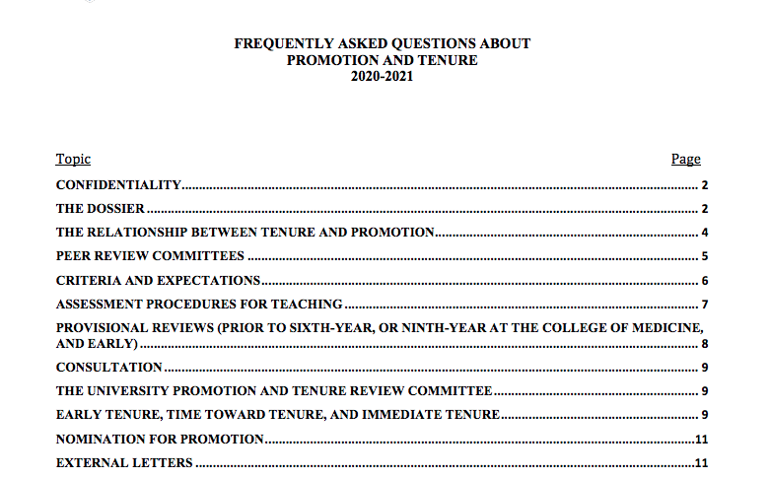
P&T FAQs
Great supplement to the policy.

Slide 28
Example 1
Most Colleges are now using Activity Insight (Faculty Success by Watermark, formerly Digital Measures) to generate dossiers. How does the use of Activity Insight impact the dossier and review process?
Activity Insight is a tool for generating the dossier. The output is consistent with the expectations outlined in the dividers as well as with the Administrative Guidelines.

Slide 29
Example 2
Who is responsible for the preparation of the dossier?
That responsibility is assigned to the department head (or director of academic affairs or division head), and the faculty member must cooperate by assembling whatever materials are in their possession by the timeline given by the department head. If the unit is using Activity Insight to generate the dossier, faculty members are responsible for ensuring their information is entered into Activity Insight in accordance with the timeline specified. (Page 7, III.B.4.; page 12, III.E.1)

Slide 30
Activity Insight at Penn State
Did you know...
Activity Insight (AI) has a support page for all your needs? https://activityinsight.psu.edu
You can reach support Monday-Friday 8:00am-5:00pm by email: AI-Support@psu.edu
"AI" is customized for each College; however, it falls under one main PSU umbrella.
The University Dossier report in "AI" is customized by the Faculty Affairs office and will put your data in the format recommended by the guidelines.
Faculty going up for Full professorship can seek help with entering back data.

Slide 31
Activity Insight at Penn State
What does the FAMS Team do for you?
Import credited course data from LionPath into the List of Credit Courses Taught. Data is automatically entered the 4th week of classes and updated at the end of the semester.
Import SRTE data from the Schreyer Institute for Teaching Excellence. Data is entered after Final Grade reporting.
Import Contracts, Grants, Fellowships, Sponsored Research from SIMS. This data is imported bi-weekly on Monday.
Offer classes on Activity Insight, typically the 2nd week of each semester. Contact your college AI representative for a college level training session.
Work with other Institutions and Universities that use the "AI" system to make suggested improvements to the Watermark team.

Slide 32
COVID-19 Teaching Impact
No SRTEs, peer teaching evaluations, or alternative documentation of teaching activities from spring 2020 can be used to penalize candidates.
One alternative assessments for each academic year.
Notes:
THIS NEEDS SOME CLARIFICATION! Is this correct?

Slide 33
Narrative Statement
No longer than 2,000 words
Provide the faculty member with the opportunity to place their work and activities in the context of their overall goals (e.g., what’s important to the discipline, how will your goals benefit students).
An opportunity to draw attention to your most prominent accomplishments.
COVID explanation: This word limit has been increased from the typical 1600 words to allow for an explanation of ways in which your teaching, research/creative accomplishment/service may have been impacted by COVID.
The production of the narrative has a different timeline than the production of the full Dossier. It will be due prior to the submission of other materials in order to be sent to external reviewers.
Notes:
ADD AN EXTENTION FOR COVID!!!

Slide 34
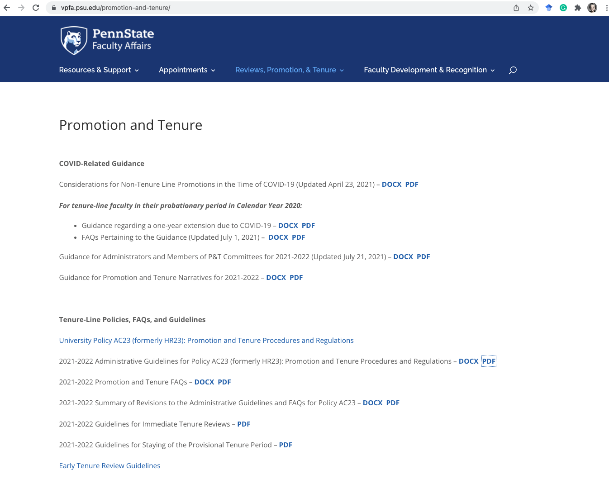
COVID-19 Narrative Statement
Teaching and Advising
Transitioning courses to remote or hybrid learning
Creating instructional innovations
Change in teaching and advising load
Encountering challenges with technology
And more….
Research and Creative Accomplishments
Change in access to studios, performance spaces, laboratories, or other spaces
Funded research opportunities/complexities
Encountering travel and field restrictions
And more….
Service
Transitioning service activities to online formats
Changes in access to community service sites
Disruptions to professional organizations
And more….
Librarianship
Changes to in-person services
Changes to the use of physical spaces
Managing access to and provisions of materials
And more…
Patient care
Additional responsibilities directly related to the care of COVID-19 patients
Decreasing patient care workload related to the pandemic (e.g. the cancelation or delay in elective surgical procedures)
Increasing need for continuing education to maintain competency in the rapidly changing treatments for COVID-19
And more….
Notes:
https://www.vpfa.psu.edu/files/2021/05/GUIDANCE-ON-PROMOTION-AND-TENURE-NARRATIVES-UPDATED-FINAL-4.12.21.pdf

Slide 35
Dossier Tips…
Update regularly
Ask advice
Consult the dividers
Maintain and update your curriculum vita on a regular basis
Proofread carefully
Meet all deadlines
P&T committee’s role
Review and act on advice in previous reviews
Ask if sample dossier and narrative statements are available in your unit
SRTEs
Notes:
- Maintain and regularly update the materials that will become part of your annual review and promotion materials.
- Before compiling your dossier materials, read all Guidelines, consult with the director, and seek advice from experienced colleagues. Members of the previous year’s School Committee can provide advice on current procedures, formatting and language. Don't hesitate to ask.
Confirm that you are using the most current version of the dossier dividers. Check and re-check your materials VERY carefully. Make sure that all spellings are correct (city, names, etc.) and grammar, order, and format are consistent.
In many units, the P&T Committee will also review your dossier carefully and will likely make suggestions.
Submit a draft of your materials to the director on the stated deadline. This will allow ample opportunity for discussion and possible revision.
: Read and heed the guidance provided to you by the committees and administrators following EVERY review in the process. Areas of concern identified in the second- and fourth-year reviews WILL become a focus for subsequent reviewers. Make sure that these concerns are addressed in the dossier.
Your CV is part of the material sent to external reviewers, but it is not used internally. There is no mandated format, but a standard CV would normally include your educational background, previous work history, awards that might not fall within the Penn State review period as well as a summary of creative work and research.
Encourage your students to complete online SRTE evaluations and paper forms (applied faculty), letting them know about the importance of this feedback. This is a critical aspect of your dossier, and there is evidence that students are more inclined to take the time to complete SRTEs if the instructor appears to value student feedback. Also, see Section D3 in the School’s P&T Guidelines about other information that will be sought.

Slide 36
Faculty Panel
Dr. Lorena Tribe
Professor of Chemistry
Penn State Berks
Dr. Lynn Martire
Professor, Human Development and Family Studies
University Park
Dr. Christopher Zorn
Liberal Arts Professor of Political Science and Sociology
Affiliate Professor in the College of Information Sciences and Technology
Affiliate Professor of Law
University Park

Slide 37
Thank you!
Questions?
Joins us for...
Tips for Writing a Narrative Statement
March 16, 2023 2:00-3:00 pm
Promotion and Tenure Workshop Series
Ann Clements, Ph.D. Assistant Vice Provost of faculty Affairs – Faculty Development
Kathy Bieschke, Ph.D., Vice Provost of Faculty Affairs
Abby Diehl, Ph.D. Assistant Vice Provost of Faculty Affairs

Slide 38
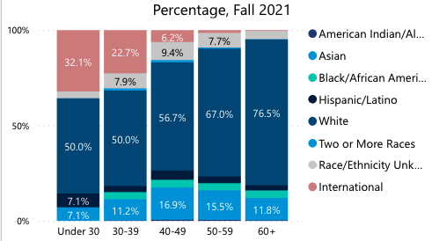
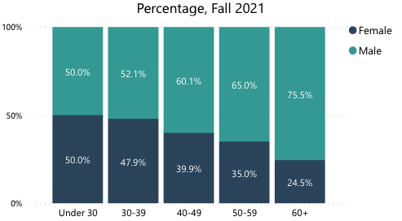
Fall 2021 Age by Race/Ethnicity & Age by Gender

